Slide 1
2024-25 NFHS Basketball Rules PowerPoint
Rules Changes
Editorial Changes
Points of Emphasis

Slide 2


Slide 3
NFHS

Slide 4
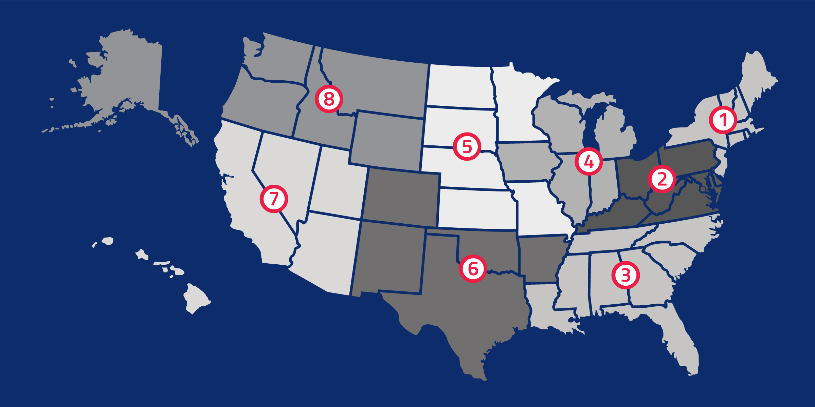
National Federation of
State High School Associations
NFHS (located in Indianapolis, IN – Est. 1920):
  National leader and advocate for
  high school athletics and
  performing arts programs.
  Serves 51 state associations, 19,500
  high schools and 12 million student
  participants.
  Writes playing rules for 17 high school
  sports for boys and girls.
  Offers online education courses for high school coaches,
  officials, parents, students and others.
  Ensures that students have opportunity to enjoy healthy participation, achievement and good sportsmanship in education-based athletics.

Slide 5








NFHS Rules Review Committee
The NFHS Rules Review Committee is chaired by the chief operating officer and composed of all rules editors. After each committee concludes its deliberations and has adopted its recommended changes for the subsequent year, such revisions will be evaluated by the Rules Review Committee.
Davis Whitfield
Chief Operating Officer
Lindsey Atkinson
Basketball, Girls Lacrosse and Volleyball
Bob Colgate
Football and Sports
Medicine
Sandy Searcy
Softball, Swimming & Diving and Water Polo
Elliot Hopkins
Baseball and Wrestling
Julie Cochran
Cross Country, Gymnastics, Field Hockey, Soccer and
Track & Field
James Weaver
Boys Lacrosse
and Spirit
Dan Schuster
Ice Hockey

Slide 6

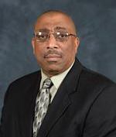

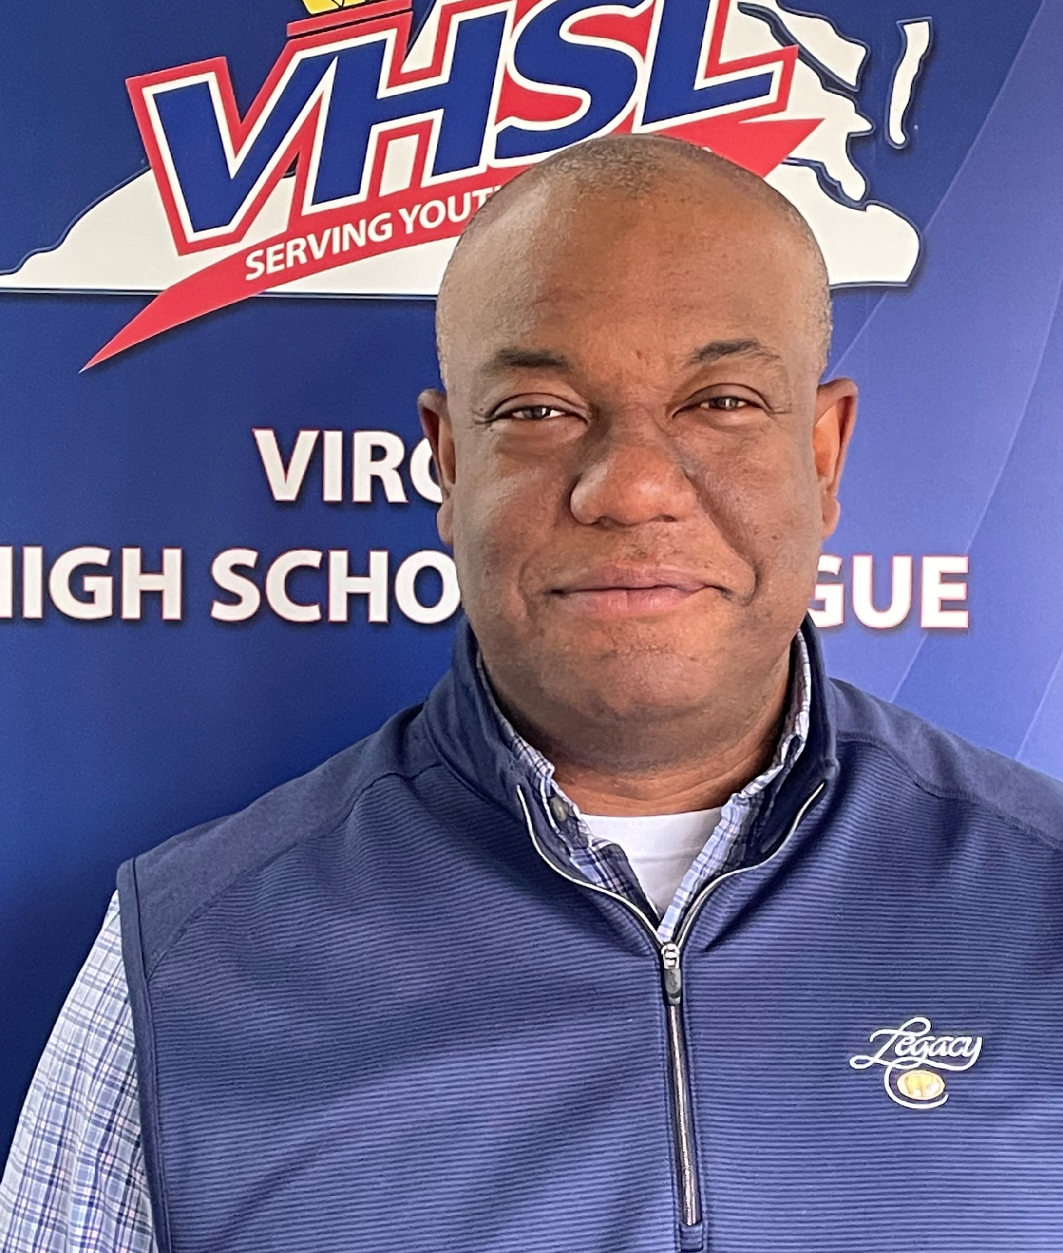

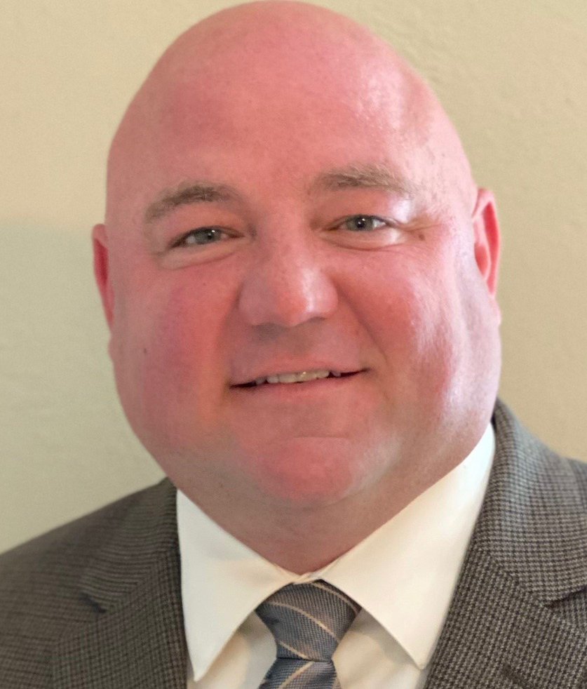




NFHS bASKETBALL RULES COMMITTEE
Billy Strickland
Anchorage, AK
Chair - 2025
Mary Klinger
Somerset, NJ
Coaches - 2026
Arthur Hardin
Winston-Salem, NC
Officials - 2025
Dan Shepardson
Hinesburg, VT
Section 1 - 2024
Ty Gafford
Charlottesville, VA
Section 2 - 2025
Stacey Franklin
Orangeburg, SC
Section 3 - 2024
Brian Lewis
Indianapolis, IN
Section 4 - 2026
Ben Boothe, Ed. D.
Lenexa, KS
Section 5 - 2025
Joseph Garmon
Austin, TX
Section 5 - 2027
Amy Cassell
Oklahoma City, OK
Section 6 - 2027
Lisa Bishop
Las Vegas, NV
Section 7 - 2026
Monica Maxwell
Wilsonville, OR
Section 8 - 2027
Notes:
The 2024 Basketball Rules Committee is comprised of a chair, representatives from the NFHS Coaches Association and the NFHS Officials Association, and representatives from each of the eight NFHS sections.

Slide 7


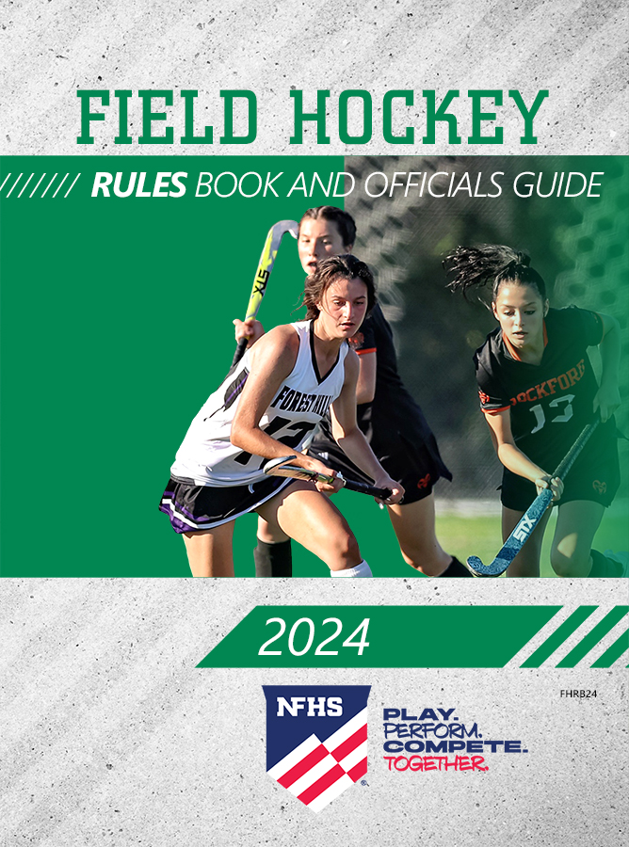
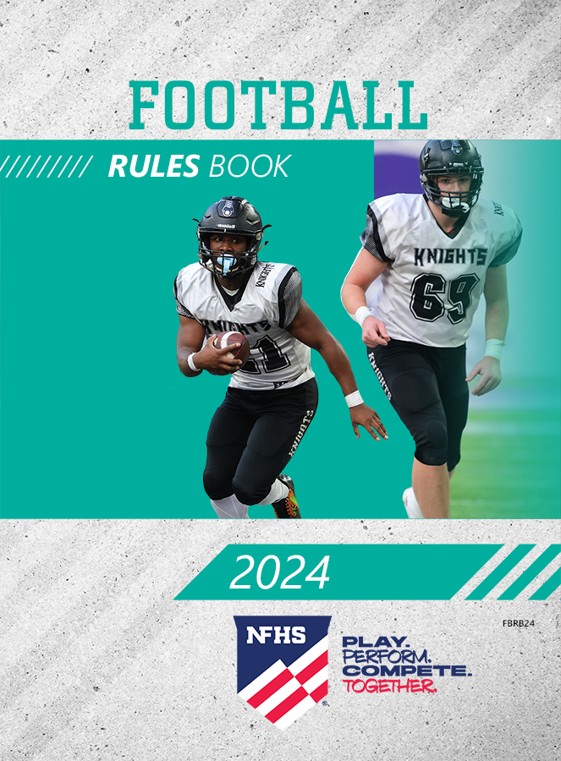
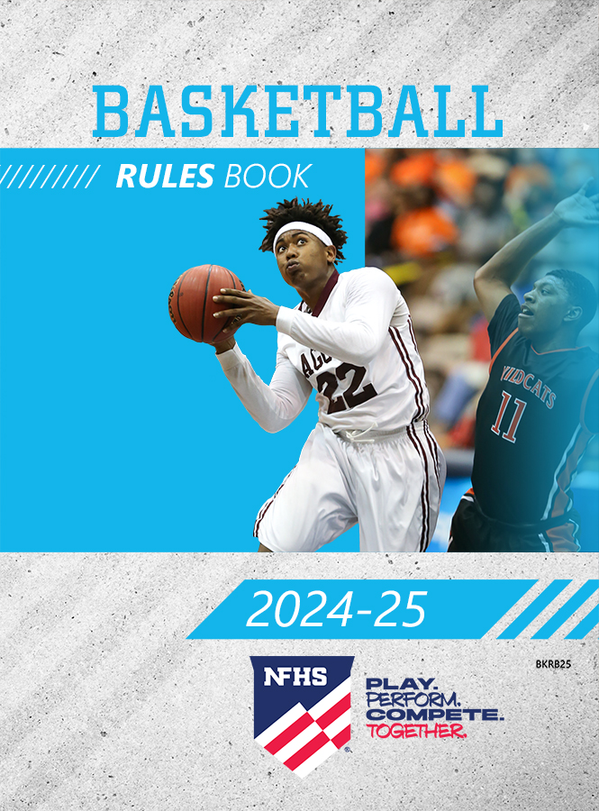
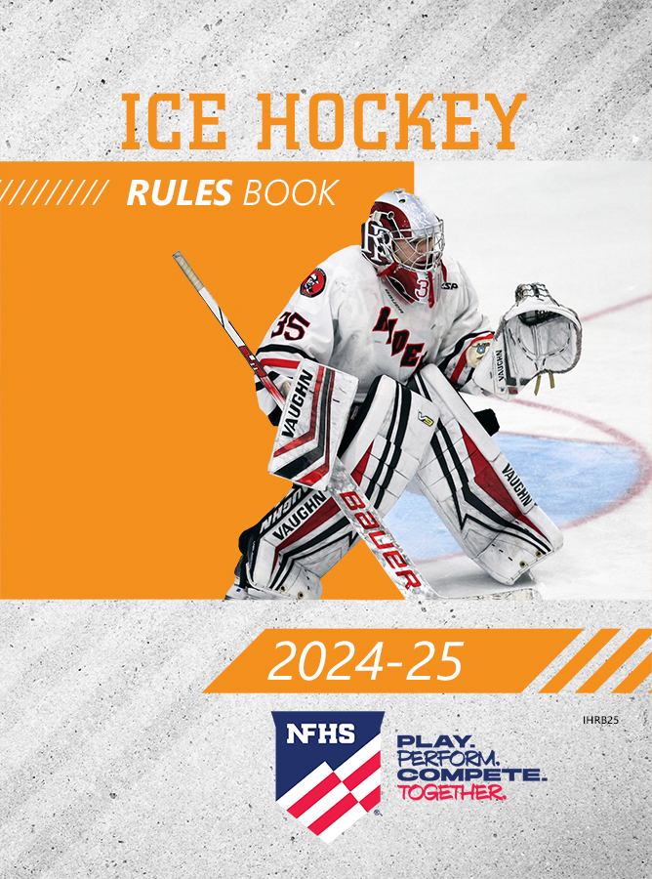
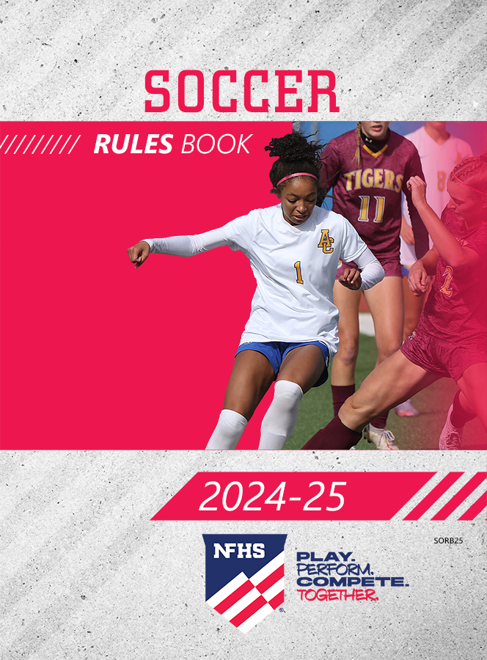
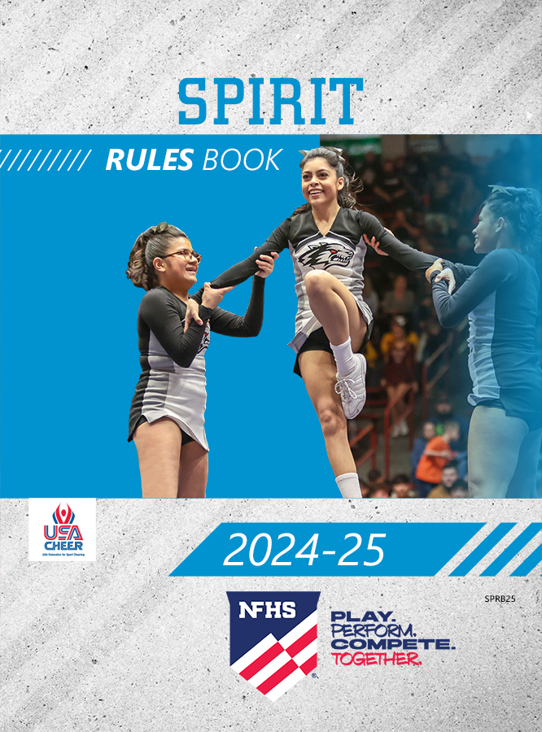
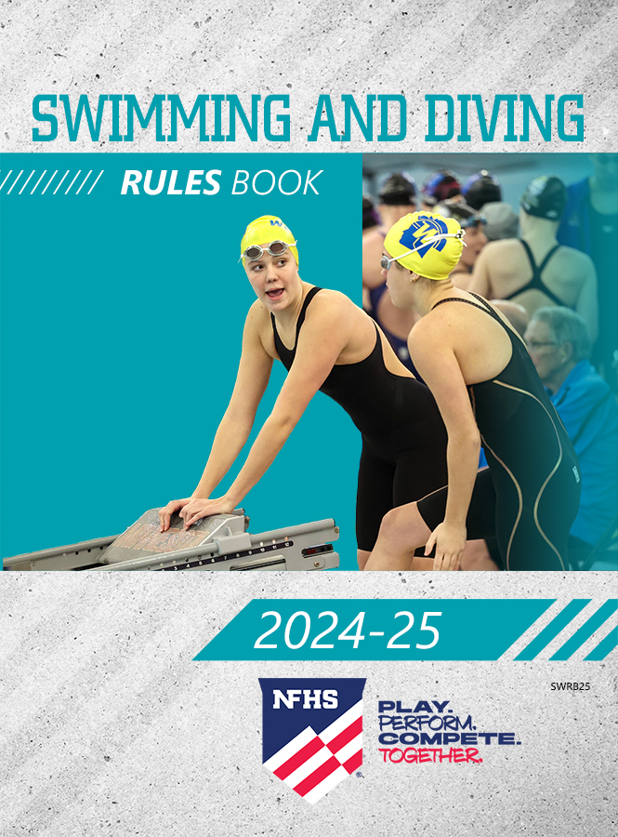

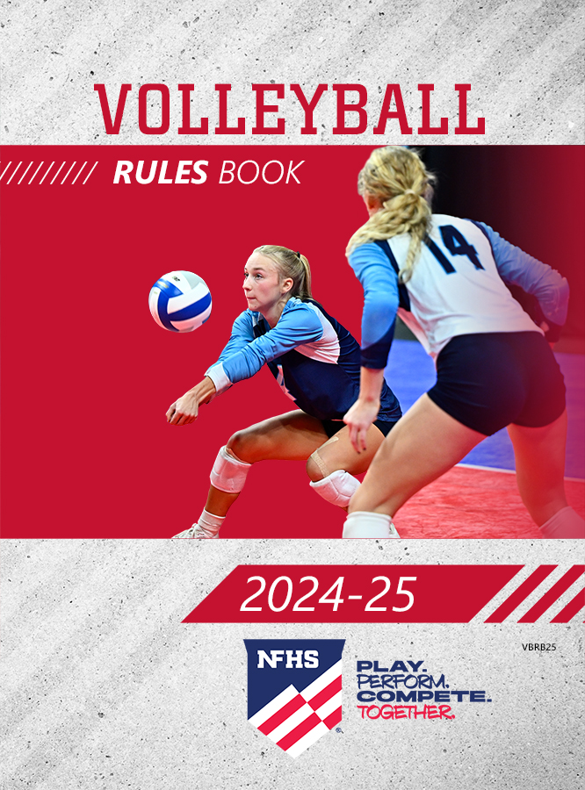
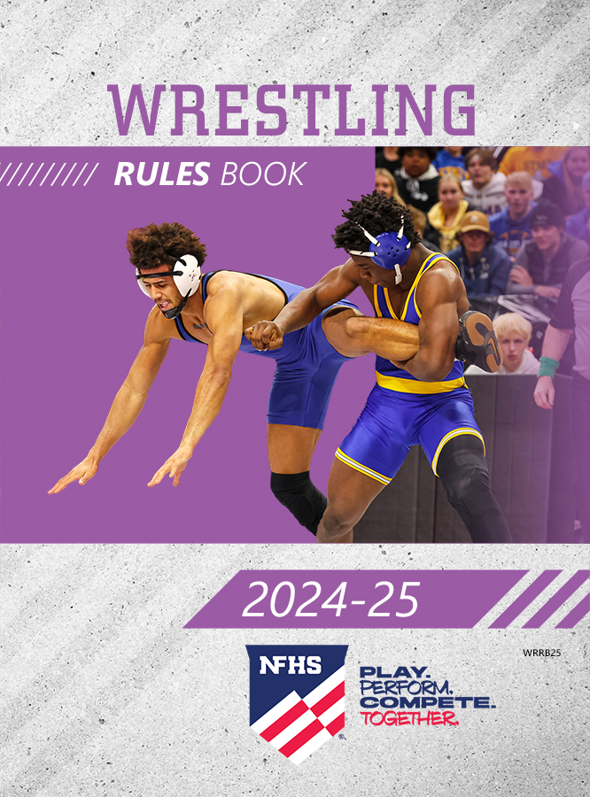
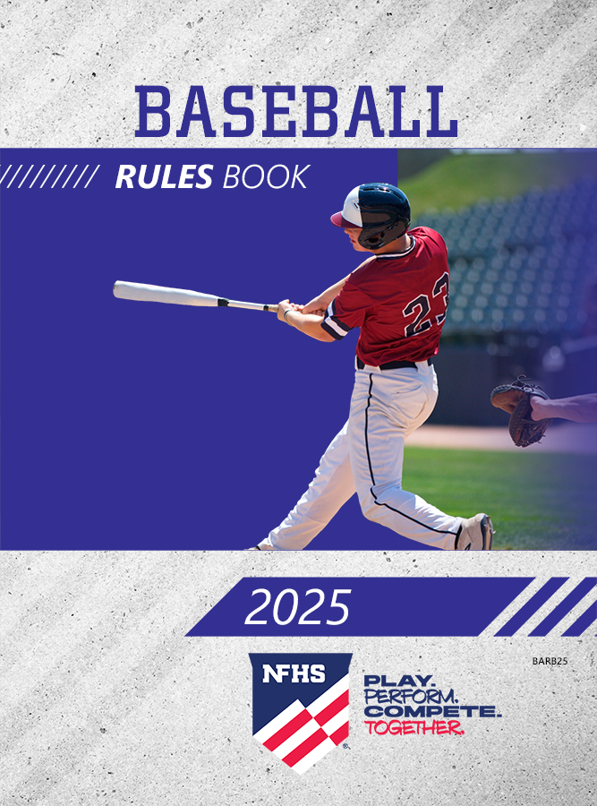
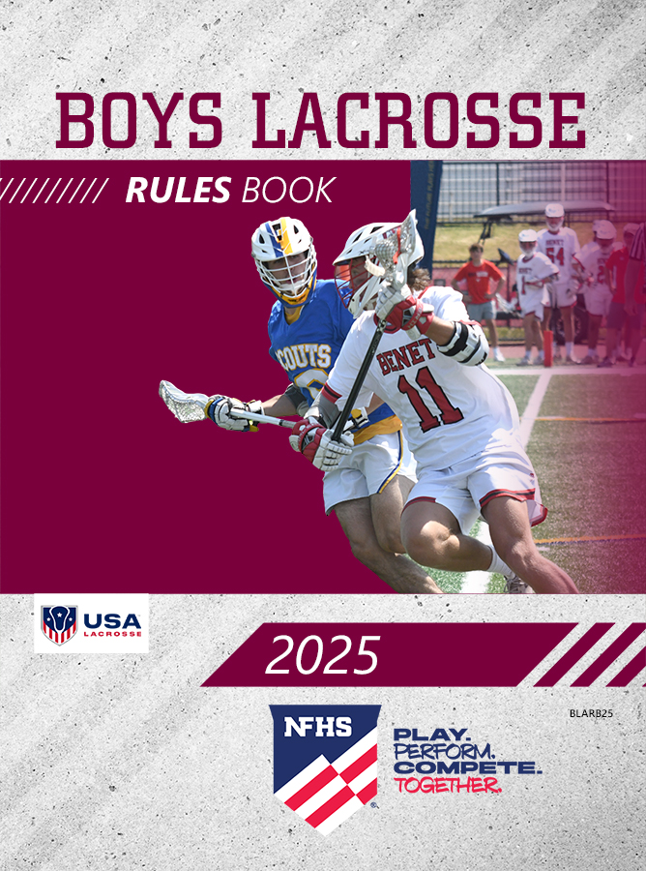
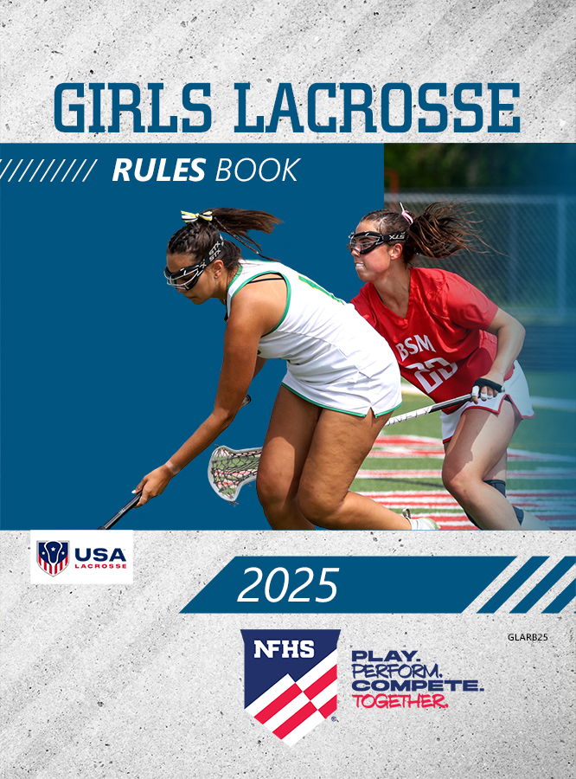
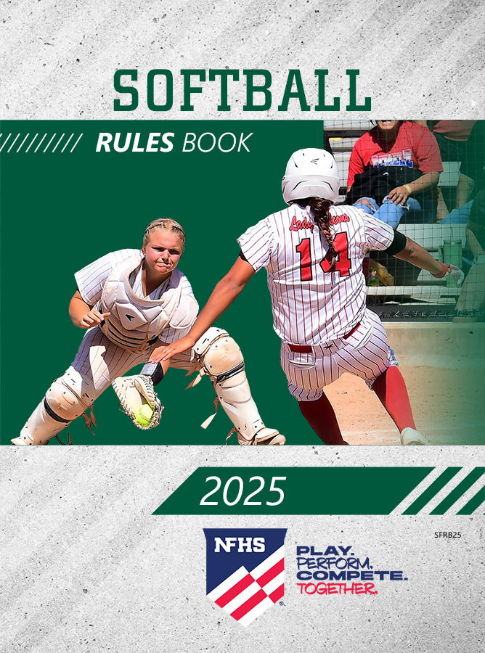

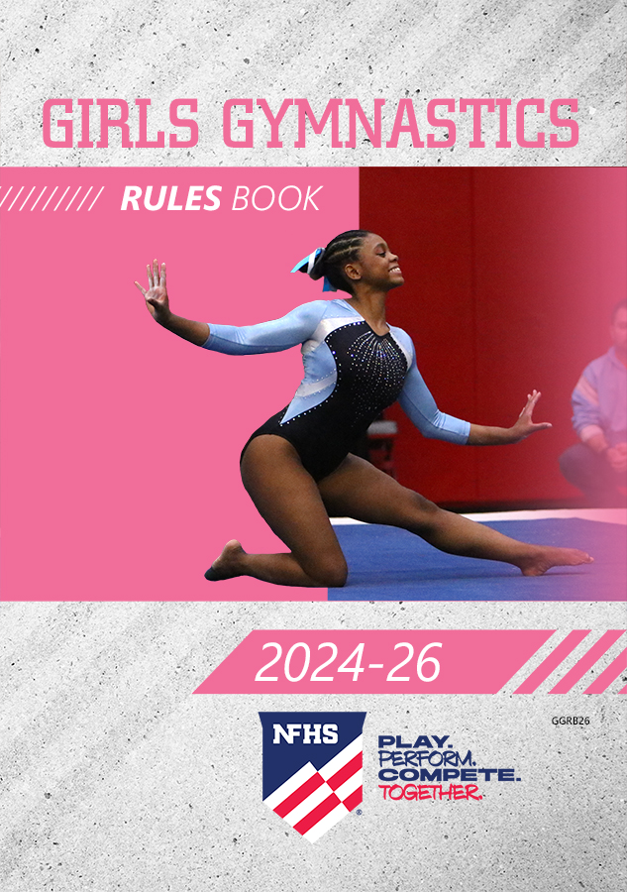
NFHS Publications
The NFHS writes playing rules for 17 sports
for boys and girls at the high school level.
  Publishes 4 million pieces of materials annually.

Slide 8
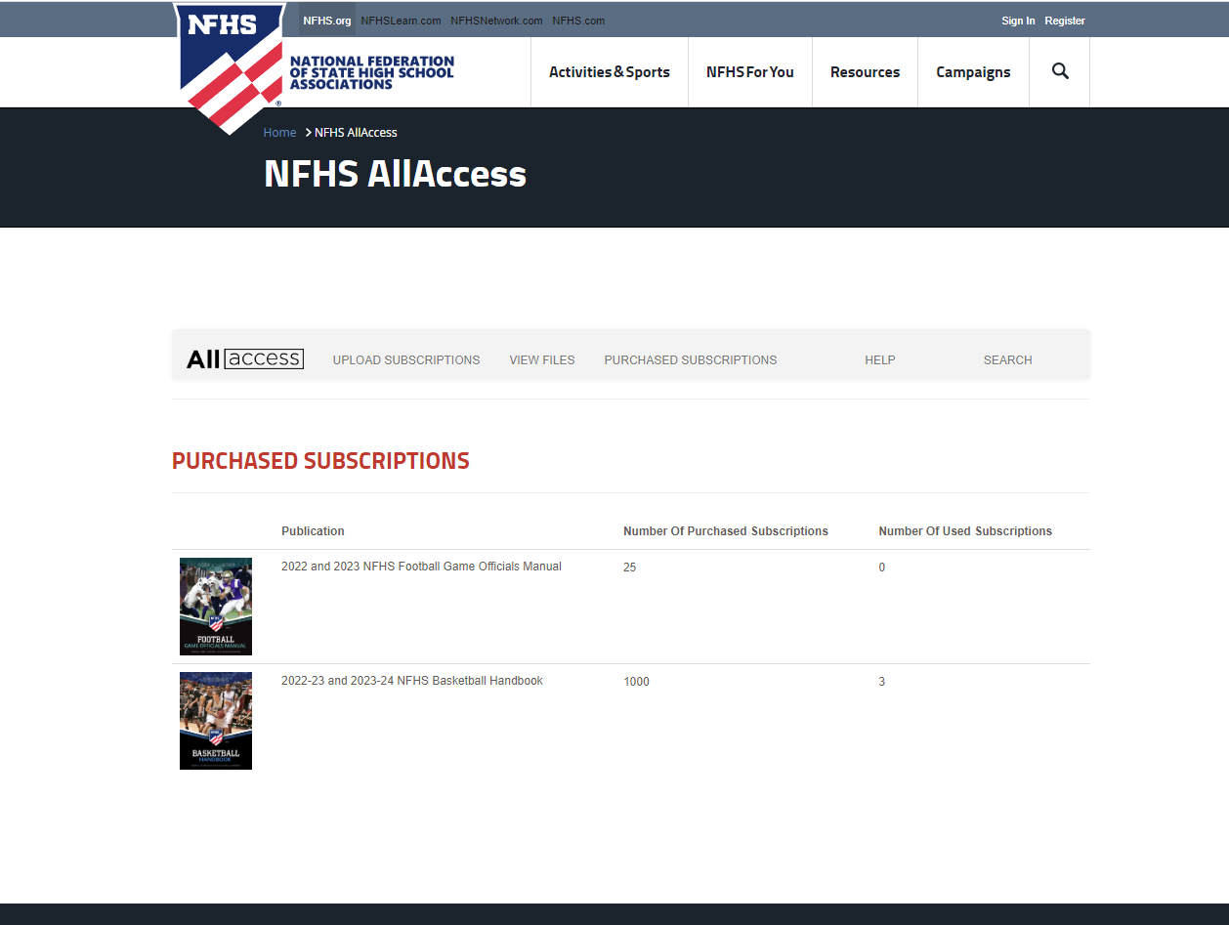
NFHS AllAccess – Website
AllAccess is the NFHS Digital Publications Platform that includes:
  Rules Publications
  High School Today Magazine
  Policy Debate Quarterlies
  Other NFHS Digital Publications
Website organized for associations and individuals to assign books and manage purchases
Visit https://allaccess.nfhs.org

Slide 9
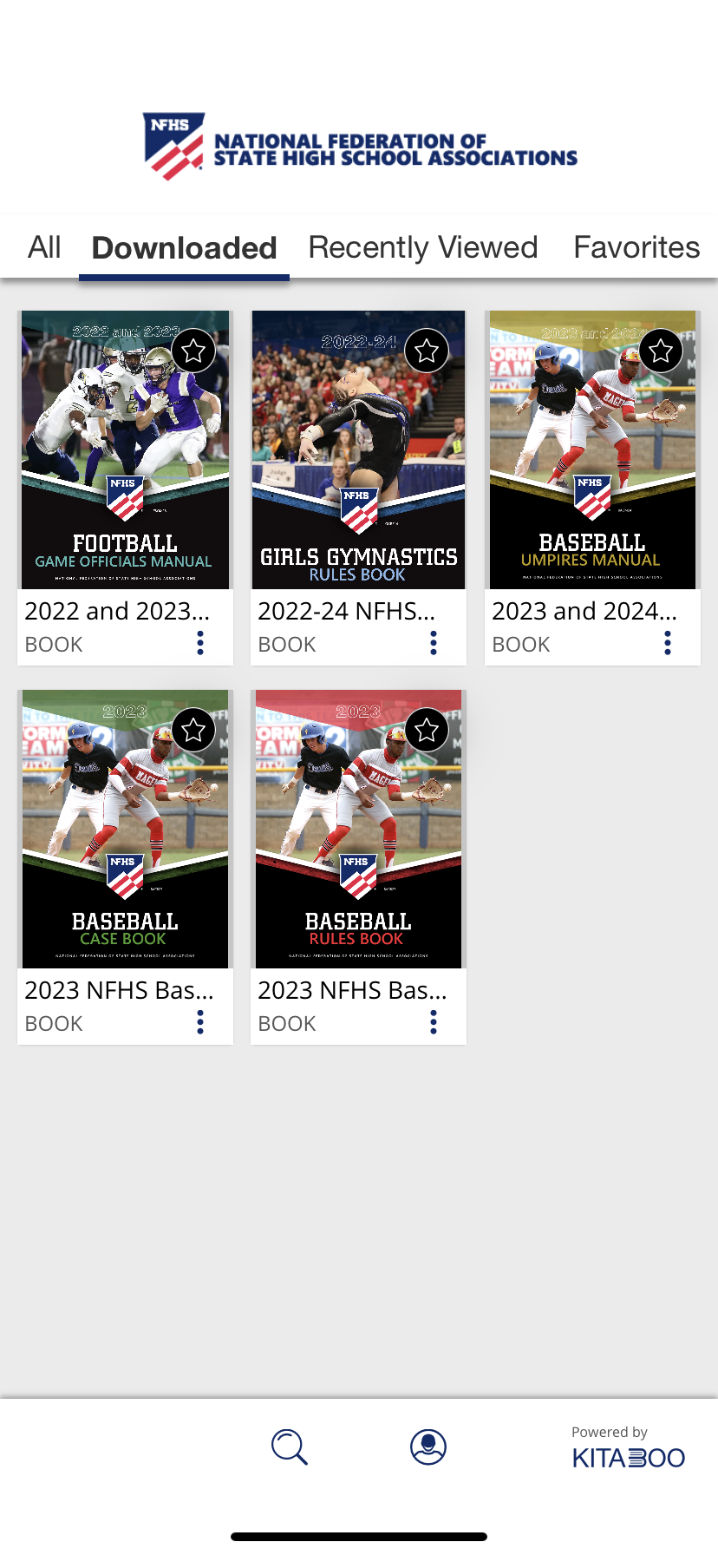
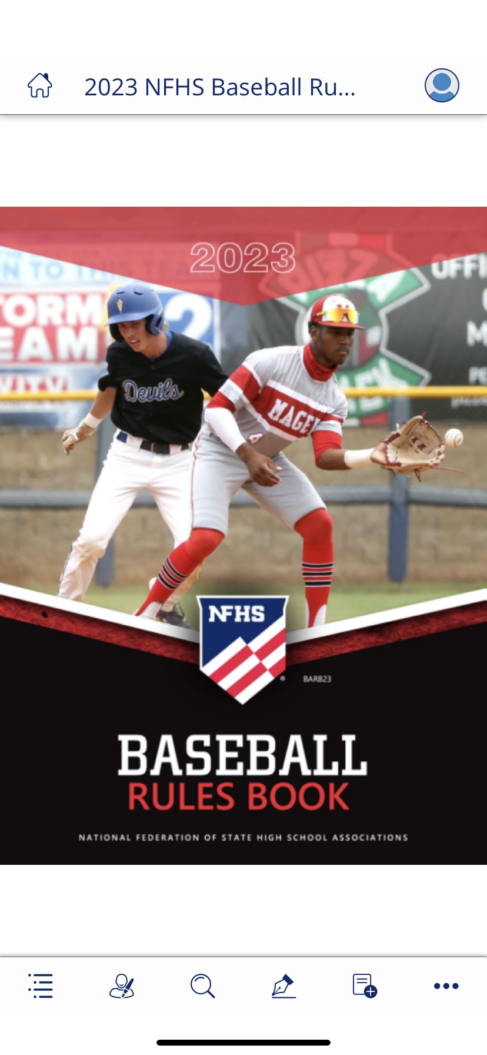

NFHS AllAccess – Mobile App
Access Via Website or Mobile App:
View available publications for sale
View publications assigned to you
Download books for offline viewing
Read publications as an e-book
Available on App Store and Google Play

Slide 10
2024-25 nfhs Basketball
Rules Changes

Slide 11
Electronic Devices
1-19
The use of electronic devices during a game is limited to the purposes of recording and tracking stats, reviewing or diagramming plays, or other similar contest-related functions.
Items that do not meet these requirements are not allowed during play.
  PlayPic A – Legal – Coach is using a tablet to diagram a play.
  PlayPic B – Illegal – Player wearing headphones during competition.
Notes:
The use of electronic devices during a game is limited to the purposes of recording and tracking stats, reviewing or diagramming plays, or other similar contest-related functions.
Items that do not meet these requirements are not allowed during play.
PlayPic A – Legal – Coach is using a tablet to diagram a play.
PlayPic B – Illegal – Player wearing headphones during competition.
Rationale: Clarifies the type of electronic devices that are allowed during the game, prohibiting the use of voice and video recording devices worn during a contest.

Slide 12
Scorer’s duties
2-11-11
Non-official scorers are required to compare records with the official scorer when multiple scorers are present.
If there is a discrepancy, the official scorer must notify the referee immediately.
Notes:
Non-official scorers are required to compare records with the official scorer when multiple scorers are present.
If there is a discrepancy, the official scorer must notify the referee immediately.
Rationale: Allows the official scorer to remain focused on game activity and places the responsibility of comparing scoring and other bookkeeping information on the auxiliary scorer(s).

Slide 13
substitution
2-12-6 (NEW), 3-3-7, 3-3-7 NOTE 1
A team is allowed 20 seconds to address any minor blood on the body or uniform of a player without that player having to leave the game.
The official will allow the player(s) to reach their bench area before signaling to start the timer. A warning signal will be given at 15 seconds.
If the blood cannot be appropriately covered/cleaned within 20 seconds, the head coach may use a time-out to address the issue or substitute for the player.
Notes:
A team is allowed 20 seconds to address any minor blood on the body or uniform of a player without that player having to leave the game.
The official will allow the player(s) to reach their bench area before signaling to start the timer. A warning signal will be given at 15 seconds.
If the blood cannot be appropriately covered/cleaned within 20 seconds, the head coach may use a time-out to address the issue or substitute for the player.
Rationale: Provides a short interval of time to handle a blood related issue without delaying the game, while still addressing the health-related concerns associated with blood on a player.

Slide 14
Substitution
3-3-6
A player who has been injured must be removed from the game if the coach is beckoned by an official, whether the coach enters the playing court or not, or if bench personnel (i.e. a coach or athletic trainer) enters the court without being beckoned.
  PlayPic A – Coach is beckoned – Player must be removed.
  PlayPic B – Coach enters the court without being beckoned – Player must be removed.
The coach may still use a time-out to continue assessment of the injury and allow the injured player to remain in the game.
Notes:
A player who has been injured must be removed from the game if the coach is beckoned by an official, whether the coach enters the playing court or not, or if bench personnel (i.e. a coach or athletic trainer) enters the court without being beckoned.
PlayPic A – Coach is beckoned – Player must be removed.
PlayPic B – Coach enters the court without being beckoned – Player must be removed.
The coach may still use a time-out to continue assessment of the injury and allow the injured player to remain in the game.
Rationale: Creates consistency for officials that an injured player is subject to removal from the game when an injury occurs, and the coach/team personnel are beckoned or if they enter the court without an official beckoning.

Slide 15
Uniforms
3-4-4a (New)
A school logo/mascot image may now be placed on the front of the jersey, centered directly above the uniform number, in place of an identifying name.
Notes:
A school logo/mascot image may now be placed on the front of the jersey, centered directly above the uniform number, in place of an identifying name.
Rationale: Removes the restriction of allowing only lettering on the front of the jersey.

Slide 16
Basket interference
4-6-1 Exception (NEW)
A player is allowed to touch only the net while the ball is on or within the basket provided that, in the official’s judgment, the net contact does not affect the ball, allowing play to continue.
If a player(s) contact with the net impacts the path of the ball, basket interference shall be called.
Notes:
A player is allowed to touch only the net while the ball is on or within the basket provided that, in the official’s judgment, the net contact does not affect the ball, allowing play to continue.
If a player(s) contact with the net impacts the path of the ball, basket interference shall be called.
Rationale: Allows play to continue unless the contact of the net affects the try for goal.

Slide 17
Closely guarded
4-10 EXCEPTION (NEW), 9-10-1a note (new), STATE ASSOCIATION ADOPTIONS
In states where the 35-second shot clock is being utilized, state associations may adopt a modification to the closely guarded rule that allows players to dribble the ball for more than five seconds while closely guarded.
As such, a closely guarded violation would only occur if a player holds the ball while closely guarded for five or more seconds.
Notes:
In states where the 35-second shot clock is being utilized, state associations may adopt a modification to the closely guarded rule that allows players to dribble the ball for more than five seconds while closely guarded.
As such, a closely guarded violation would only occur if a player holds the ball while closely guarded for five or more seconds.
Rationale: Permits states utilizing the 35-second shot clock to allow players to dribble without enforcing the closely guarded rule since they have a 35-second time limit to attempt a try for goal, maintaining an appropriate pace of play.

Slide 18
Warning for delay
4-47-5 (NEW), 10-2-1g (NEW), 10-4-5b
A new fifth delay warning has been added to address when a player fails to immediately pass the ball to the nearer official when a whistle sounds.
  A warning for delay is issued on the first occurrence, and;
  A team technical foul is issued for any subsequent violation of Rule 4-47 Warning for Delay.
Notes:
A new fifth delay warning has been added to address when a player fails to immediately pass the ball to the nearer official when a whistle sounds.
A warning for delay is issued on the first occurrence, and;
A team technical foul is issued for any subsequent violation of Rule 4-47 Warning for Delay.
Rationale: Allows officials to issue a warning before assessing a technical and the technical will now be assessed to the team and not the player, lessening the severity of the penalty while addressing the behavior.

Slide 19
Warning for faking being fouled
4-49 (NEW), 6-4-4g, 10-2-1h (NEW), 10-4-6f
A new definition for faking being fouled (flopping) has been created that includes a warning for a first team offense and a team technical foul for all subsequent infractions.
The warning for the first offense is recorded in the scorebook (PlayPic 2) and reported to the head coach (PlayPic 1) following the ruling so as not to disrupt play and take away the advantage that may exist for the team that is not being warned.
The ruling official will use the new signal No. 15 to indicate a flopping ruling when it occurs (PlayPic).
Notes:
A new definition for faking being fouled (flopping) has been created that includes a warning for a first team offense and a team technical foul for all subsequent infractions.
The warning for the first offense is recorded in the scorebook (PlayPic 2) and reported to the head coach (PlayPic 1) following the ruling so as not to disrupt play and take away the advantage that may exist for the team that is not being warned.
The ruling official will use the new signal No. 15 to indicate a flopping ruling when it occurs (PlayPic).
Rationale: Allows officials to issue a warning before assessing a technical and the technical will now be assessed to the team and not the player, lessening the severity of the penalty while addressing the behavior.

Slide 20
Out-of-bounds — Player, ball
7-1-1
A player is out of bounds if contact by a teammate or other bench personnel outside the boundary line of the playing court provides an advantage that allows the player to remain in bounds.
Notes:
A player is out of bounds if contact by a teammate or other bench personnel outside the boundary line of the playing court provides an advantage that allows the player to remain in bounds.
Rationale: Establishes that a player cannot be assisted from outside the boundary line by teammates or bench personnel to remain in-bounds.

Slide 21
Administrative/bench/team technicals
10-1-1 penalty, 10-1-2 penalty, 10-2-7 penalty (NEW), 10-5-1 Penalty (NEW)
Administrative, team and bench technical fouls that occur during pregame offset if they occur in equal numbers between the two teams.
  No free throws are awarded.
  The game begins with a jump ball.
Also, the head coaches do not lose the privileges of the coaching box.
Notes:
Administrative, team and bench technical fouls that occur during pregame offset if they occur in equal numbers between the two teams.
No free throws are awarded.
The game begins with a jump ball.
Also, the head coaches do not lose the privileges of the coaching box.
Rationale: Clarifies that an equal number of technical fouls committed by both teams during pregame offset and establishes how the game will start after offsetting technical fouls.

Slide 22
Team technical
10-2-7 penalty (NEW), 10-5-1i
The penalty for dunking or attempting to dunk or stuff a dead ball during pregame or intermission is now a team technical foul.
The offending player will no longer have a personal foul charged against them that counts toward disqualification.
The offending team’s head coach will not lose the privilege of using the coaching box.
Notes:
The penalty for dunking or attempting to dunk or stuff a dead ball during pregame or intermission is now a team technical foul.
The offending player will no longer have a personal foul charged against them that counts toward disqualification.
The offending team’s head coach will not lose the privilege of using the coaching box.
Rationale: Continues to penalize the offending team with a team technical foul (two free throws plus the ball for a division-line throw-in awarded to the offended team and a foul added to the offending team count), but no longer requires the coach to lose the coaching box to start the game and no personal foul is awarded.

Slide 23
Rule Change Reminder

Slide 24
Uniforms
3-4-3
A rule passed prior to the 2019-20 season takes effect this year as the option to have jersey numbers that are the same color as the predominant color of the jersey has now been eliminated.
The two legal options are a solid contrasting number with no more than two solid-colored, ¼-inch borders around the entire number, or a solid contrasting number with a “shadow” trim of a contrasting color not to exceed ½-inch in width that may be used with one ¼-inch border.
Notes:
A rule passed prior to the 2019-20 season takes effect this year as the option to have jersey numbers that are the same color as the predominant color of the jersey has now been eliminated.
The two legal options are a solid contrasting number with no more than two solid-colored, ¼-inch borders around the entire number, or a solid contrasting number with a “shadow” trim of a contrasting color not to exceed ½-inch in width that may be used with one ¼-inch border.

Slide 25
2024-25 nfhs Basketball
Editorial Changes

Slide 26
Officials’ jurisdiction
2-2-4 note
This note clarifies that scoring, timing and bookkeeping errors are not reviewable after the officials’ jurisdiction has ended, while state associations may intercede on a case-by-case basis for unusual incidents outside these areas.
Notes:
This note clarifies that scoring, timing and bookkeeping errors are not reviewable after the officials’ jurisdiction has ended, while state associations may intercede on a case-by-case basis for unusual incidents outside these areas.

Slide 27
uniforms
3-4-2a
One visible manufacturer’s logo/trademark/reference may be placed anywhere on the team jersey provided it does not interfere with the visibility of the uniform and meets all size specifications.
Notes:
One visible manufacturer’s logo/trademark/reference may be placed anywhere on the team jersey provided it does not interfere with the visibility of the uniform and meets all size specifications.

Slide 28
Team control
4-12-2 note (NEW), 9-7-1 Note (new), 9-9-3 NOTE (new)
Clarification that team control during a throw-in only applies to fouls committed by the offense, therefore, three-second and backcourt violations are not in effect.
Also, team control, as the result of a throw-in, remains in that team’s control until player control is established by either team on the court.
Notes:
Clarification that team control during a throw-in only applies to fouls committed by the offense, therefore, three-second and backcourt violations are not in effect.
Also, team control, as the result of a throw-in, remains in that team’s control until player control is established by either team on the court.

Slide 29
Throw-in provisions
9-2-10 note 2 (NEW)
Officials should ignore an intentional throw-in plane violation or a player interfering with the ball following a goal when the clock is running and there are five seconds or less on the game clock.
Notes:
Officials should ignore an intentional throw-in plane violation or a player interfering with the ball following a goal when the clock is running and there are five seconds or less on the game clock.

Slide 30
Throw-in provisions
9-2 penalties 1
Clarifies that after a warning is issued during an alternating-possession throw-in, the throw-in remains an alternating-possession throw-in.
Notes:
Clarifies that after a warning is issued during an alternating-possession throw-in, the throw-in remains an alternating-possession throw-in.

Slide 31
Official NFHS Basketball Signals
New signal No. 15 for flopping/faking being fouled.
Signal No. 21 renamed “Delayed Violation: Withheld Whistle” and shall be used to signal when a player steps out of bounds on their own volition in addition to a free throw lane violation by the defense.
Signal No. 25 renamed “Backcourt and First to Touch from Out of Bounds Violation’ and shall be used to signal the violation once the player is first to touch the ball after returning to the playing court in addition to a backcourt violation.
Notes:
New signal No. 15 for flopping/faking being fouled.
Signal No. 21 renamed “Delayed Violation: Withheld Whistle” and shall be used to signal when a player steps out of bounds on their own volition in addition to a free throw lane violation by the defense.
Signal No. 25 renamed “Backcourt and First to Touch from Out of Bounds Violation” and shall be used to signal the violation once the player is first to touch the ball after returning to the playing court in addition to a backcourt violation.

Slide 32
2024-25 nfhs Basketball
Points of Emphasis

Slide 33
Warning for delay
Officials should use a warning for delay to ensure the game maintains an appropriate pace of play, including throughout the administration of penalties, throw-ins, free throws, etc.
Rule 4-47 defines a warning for delay as an administrative procedure by an official that is recorded in the scorebook by the scorer and reported to the head coach.
The five warnings for delay are:
Throw-in plane violations;
Huddle by either team or contact with the free thrower that delays the administration of the free throw;
Interfering with the ball following a goal;
Failure to have the court ready following a time-out; and
New to 2024-25, failure to immediately pass the ball to the nearer official.
Notes:
Officials should use a warning for delay to ensure the game maintains an appropriate pace of play, including throughout the administration of penalties, throw-ins, free throws, etc.
Rule 4-47 defines a warning for delay as an administrative procedure by an official that is recorded in the scorebook by the scorer and reported to the head coach.
The five warnings for delay are:
Throw-in plane violations;
Huddle by either team or contact with the free thrower that delays the administration of the free throw;
Interfering with the ball following a goal;
Failure to have the court ready following a time-out; and
New to 2024-25, failure to immediately pass the ball to the nearer official.

Slide 34
Warning for delay
Any two delay warnings will result in a team technical foul. The warnings do not have to be issued for the same reason or to the same person to escalate to a team technical foul.
Officials must utilize the warning for delay as soon as the behavior occurs.
Notes:
Any two delay warnings will result in a team technical foul. The warnings do not have to be issued for the same reason or to the same person to escalate to a team technical foul.
Officials must utilize the warning for delay as soon as the behavior occurs.

Slide 35
Faking being fouled
Faking being fouled continues to be a point of concern for the NFHS Basketball Rules Committee, 20 years after it was first added to the NFHS Basketball Rules Book.
A warning for acts such as overtly embellishing the impact of incidental contact, using a “head bob” to simulate illegal contact, or using any other tactics to create an opinion of being fouled and therefore gaining an advantage has been added to the Rules Book.
Notes:
Faking being fouled continues to be a point of concern for the NFHS Basketball Rules Committee, 20 years after it was first added to the NFHS Basketball Rules Book.
A warning for acts such as overtly embellishing the impact of incidental contact, using a “head bob” to simulate illegal contact, or using any other tactics to create an opinion of being fouled and therefore gaining an advantage has been added to the Rules Book.

Slide 36
Faking being fouled
Officials will utilize the new signal No. 15 at the time the flop occurs.
The warning lessens the severity of the penalty while continuing to address the behavior. It also allows officials with an opportunity to warn a player before issuing a technical foul, allowing players to adjust their behaviors before receiving a harsher penalty.
Notes:
Officials will utilize the new signal No. 15 at the time the flop occurs.
The warning lessens the severity of the penalty while continuing to address the behavior and provides officials with an opportunity to warn a player before issuing a technical foul, allowing players to adjust their behaviors before receiving a harsher penalty.

Slide 37
Proper procedures for handling blood
Previously, when an injury occurred that involved blood on a player and/or uniform, play was stopped, and the player was directed to leave the game until the bleeding was stopped, the wound was covered, the uniform and/or body was appropriately cleaned, and/or the uniform is changed before returning.
Notes:
Previously, when an injury occurred that involved blood on a player and/or uniform, play was stopped, and the player was directed to leave the game until the bleeding was stopped, the wound was covered, the uniform and/or body was appropriately cleaned, and/or the uniform is changed before returning.

Slide 38
Proper procedures for handling blood
A new rule provides a team with 20 seconds to address blood situations without being charged a time-out.
Officials should allow the player(s) to report to the sideline near the team bench before signaling the timer to begin the 20-second timer.
Notes:
A new rule provides a team with 20 seconds to address blood situations without being charged a time-out.
Officials should allow the player(s) to report to the sideline near the team bench before signaling the timer to begin the 20-second timer.

Slide 39
Proper procedures for handling blood
If the issue is resolved within the 20 seconds, the player will be permitted to remain in the game.
If the issue is not resolved within the 20 seconds, a coach may request a time-out to allow the player to remain in the game.
Notes:
If the issue is resolved within the 20 seconds, the player will be permitted to remain in the game.
If the issue is not resolved within the 20 seconds, a coach may request a time-out to allow the player to remain in the game.

Slide 40
NFHS OFFICIALS Education

Slide 41

All things officiating in one place!
The all-in-one, cloud-based NFHS Center for Officials Services (COS) connects everyone associated with officiating. The COS handles registration, assignments, testing, payments, and a host of other features and integrations that consolidate all officiating needs into a single, modern solution. Free to all NFHS state associations, local associations, and assigner groups.
20+
Member States
300,000+
Officials
7,000+
Schools

Slide 42
COS Continued Improvements
Over 200 Updates and New Features in the Past 12 Months!
  COMING SOON
    Exam Center Improvements
    Streamlined Registrations and Onboarding
    Expanded Reporting Capabilities for States
    Event/Clinic Registration and Attendance Tracking
  Reciprocity
    In-State/Out-of-State
  Watch for Many More Updates from NFHS!

Slide 43
NFHS Learning Center

Slide 44

Notes:
The NFHS Learning Center is the home to more than 90 online professional development courses for everyone within the interscholastic community - coaches, students, officials, parents, administrators, and individuals within performing arts programs. More than 60 courses are available for free.
The NFHS is an Accredited Institution and has delivered more than 15 million courses on its NFHS Learning Center platform since its inception in 2007. In receiving national accreditation by Cognia, the NFHS has upheld itself to rigorous standards that focus on productive learning environments, equitable resource allocation that meet the needs of learners, and effective leadership.
The NFHS Learning Center features its flagship coaching course, “Fundamentals of Coaching,” as well as several health and safety courses that have been completed by millions of individuals, such as “Concussion in Sports,” “Heat Illness Prevention,” “Sudden Cardiac Arrest” and “Protecting Students from Abuse.” The NFHS Learning Center offers several national credentials that can be earned by individuals who complete specific NFHS courses. Through the School Honor Roll Program, schools can earn a physical banner to hang in their school.
To learn more and start your professional development journey, please visit the NFHS Learning Center at NFHSLearn.com.

Slide 45

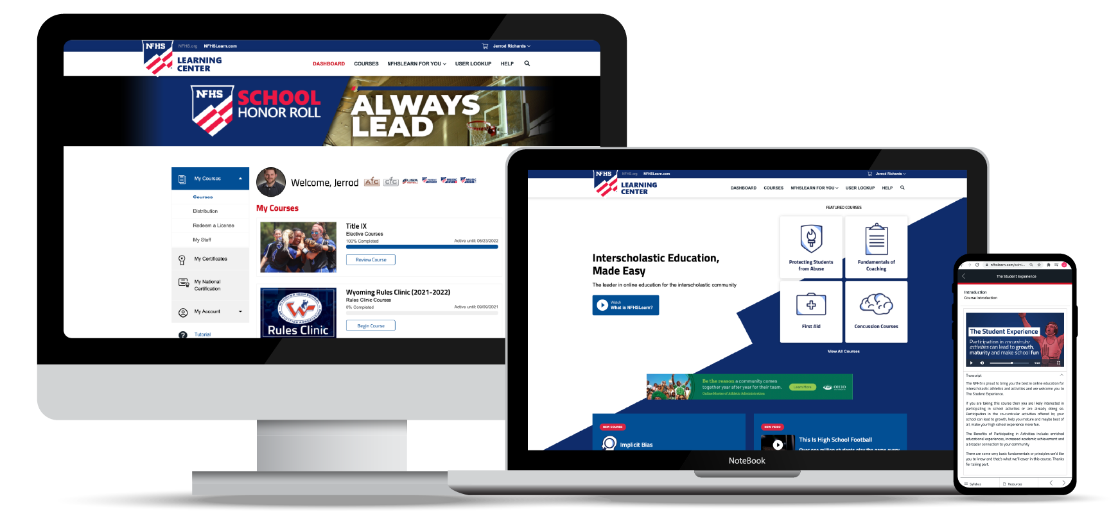
Over 21 million courses delivered!
Concussion in Sports – 7.2M+
Heat Illness Prevention – 2.2M+
Sudden Cardiac Arrest – 2.4M+
Concussion for Students – 1.2M+
The Collapsed Student (2020) – 67,550+
CPR & AED Training (2023) – 9,300+
Sportsmanship – 1M+
Fundamentals of Coaching – 928,000+
First Aid, Health and Safety – 418,000+
Bullying, Hazing and Inappropriate Behaviors – 425,000+
Student Mental Health and Suicide Prevention – 250,000+
Protecting Students from Abuse – 250,000+
Implicit Bias (2021) – 96,000+

Slide 46
NFHS Network

Slide 47
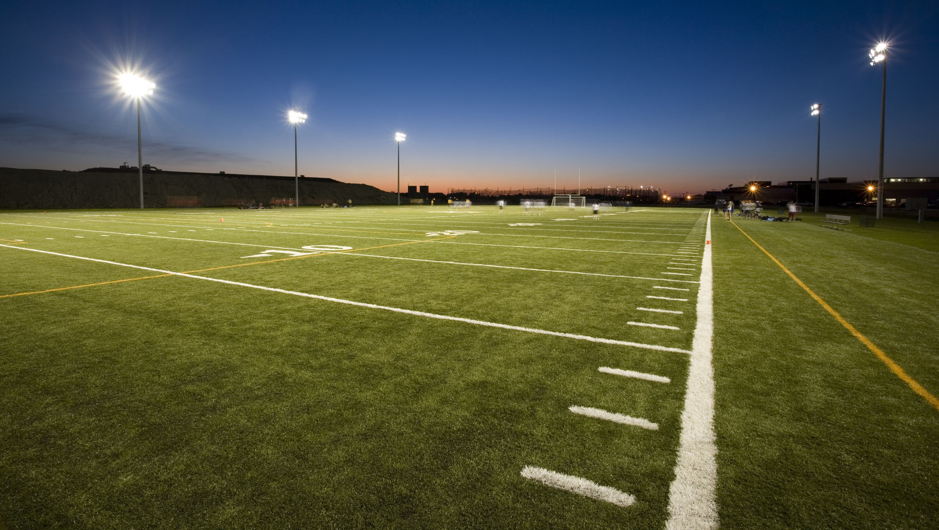

NFHS Network
By 2025, every high school sporting event in America will be streamed live.
The NFHS Network will be
THE DESTINATION for fans
to view these broadcasts.
27 Different Sports and Activities
www.NFHSnetwork.com
Notes:
The NFHS Network is the leader in streaming Live and On Demand high school sports.
Partnered with the National Federation of State High School Associations, 45 high school state athletic/activities associations, and PlayOn! Sports, the NFHS Network is a joint venture created to provide fans with the ability to stream high school sports on any device, from wherever they are.
All NFHS Network events are available to watch online at www.NFHSnetwork.com and through the NFHS Network Live App for iOS and Android. Follow us on Facebook, Twitter, Instagram, and YouTube.
Watching high school sports and events has never been easier.
The NFHS Network’s goal to broadcast live all 2 million high school sporting events by 2025.
The NFHS Network covers 27 different regular season and postseason sports, as well as other high school activities, celebrating the accomplishments of students-athletes, student broadcasters, and high schools across the country.

Slide 48
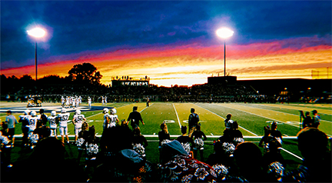

Over 1 million events this year…
Notes:
The NFHS Network will broadcast over 150,000 live events this year. If your school is not a member of the NFHS Network School Broadcast Program, please contact us at Mark.Koski@NFHSnetwork.com

Slide 49
Nfhs Authentication Mark Update

Slide 50



NFHS Authenticating Mark update
Specifications
Do not use the NFHS Authenticating Mark without prior written approval from the NFHS
This mark is for use of licensees only.
Minimum size
  Inflatable Balls - 2 ½" (Basketball, Football, Soccer, Volleyball, and Water Polo)
  Non-Inflatable Balls - 1 ¼" (Baseball, Field Hockey, Ice Hockey Puck, Lacrosse, and Softball)
  On a ball or puck, the NFHS logo may be smaller than manufacturer’s logo, but should be placed in proximity to the manufacturer’s name for easy identification. Allow enough space around the logo so it can be easily recognized as distinct and separate.
  Reproduce the logo only from the vector artwork provided here or on Direct Licensing Hub. Do not copy, scan art electronically or use as a template to redraw the symbol.
Note: If sizing or specifications do not work well in your particular design situation, contactK12 Licensing.
Current Logos
New Logo

Slide 51
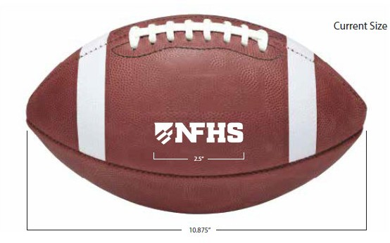
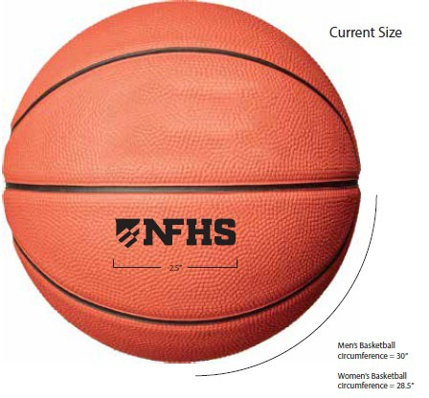
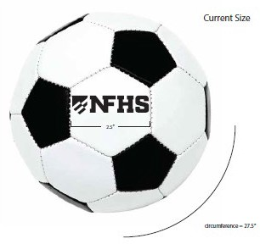
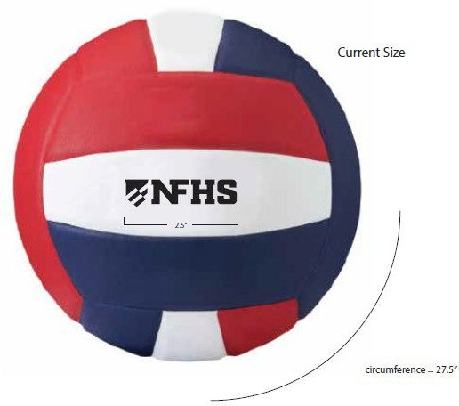
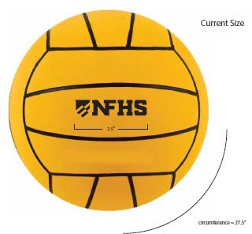
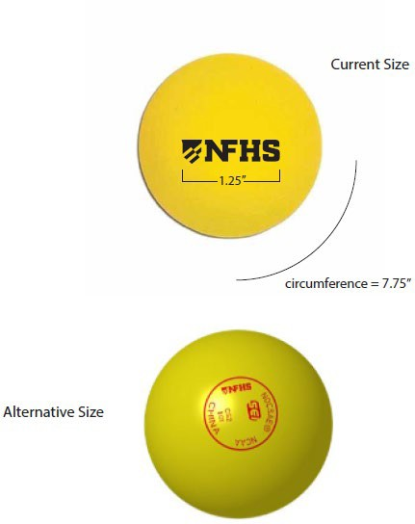
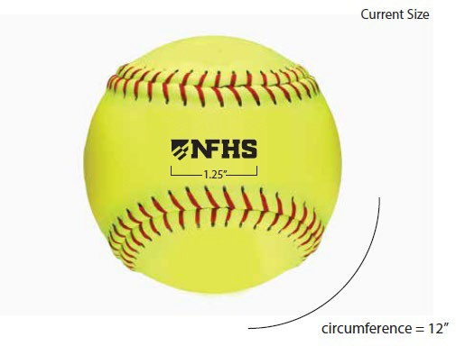
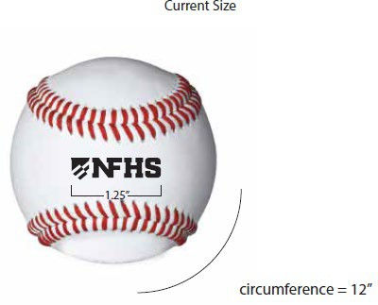
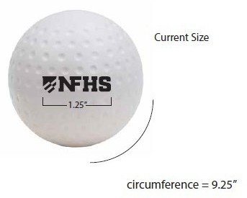
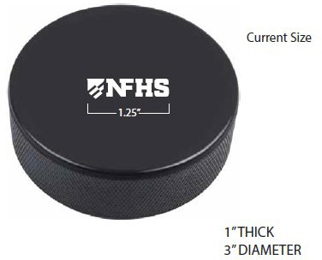
NFHS Authenticating Mark update
A current list of NFHS authenticated products can be found at www.nfhs.org, Resources, Authenticating Mark.

Slide 52
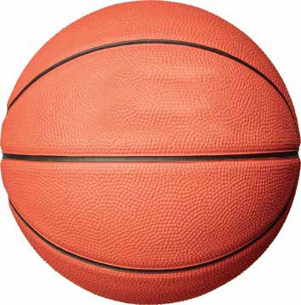


Basketball
Old Size
Current Size
OR
1.25”
2.5”
Men’s Basketball circumference = 30”
Men’s Basketball circumference = 30”
Women’s Basketball circumference = 28.5”
Women’s Basketball circumference = 28.5”

Slide 53
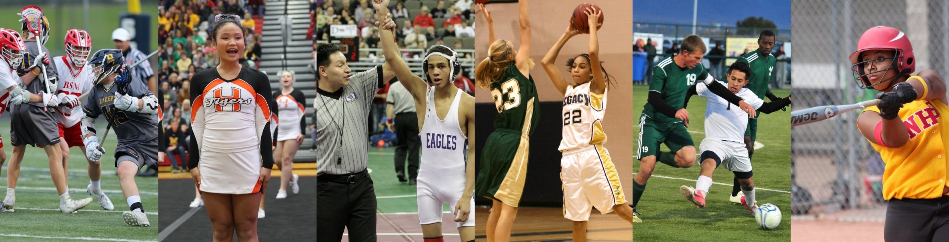
Thank You
National Federation of State High School Associations
PO Box 690 | Indianapolis, IN 46206
Phone: 317-972-6900
www.nfhs.org | www.nfhslearn.com | www.nfhsnetwork.com

