Slide 1
2022-23 NFHS Basketball Rules PowerPoint
Rules Changes
Editorial Changes
Points of Emphasis

Slide 2
Sponsor Slide
remove this text and place artwork centered here
Notes:
BISON – THE EXCLUSIVE PARTNER FOR THE SPORT OF BASKETBALL

Slide 3
National federation of state high school associations (NFHS)

Slide 4
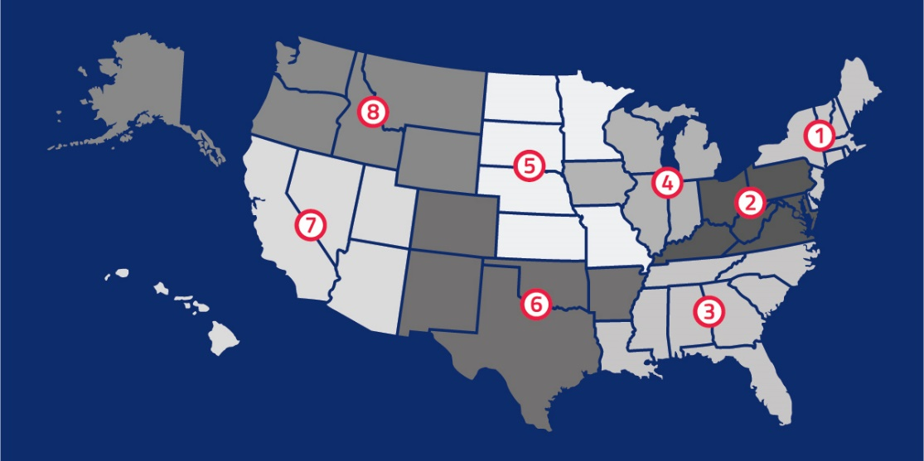
National Federation of State High School Associations
NFHS (located in Indianapolis, IN – Est. 1920):
National leader and advocate for high school athletics and performing arts programs.
Serves 51 state associations, 19,500 high schools and 12 million student participants.
Writes playing rules for 17 high school sports for boys and girls.
Offers online education courses for high school coaches, officials, parents, students and others.
Ensures that students have opportunity to enjoy healthy participation, achievement and good sportsmanship in education-based athletics.
Notes:
NFHS (located in Indianapolis, IN – Est. 1920):
National leader and advocate for high school athletics and performing arts programs.
Serves 51 state associations, 19,500 high schools and 12 million student participants.
Writes playing rules for 17 high school sports for boys and girls.
Offers online education courses for high school coaches, officials, parents, students and others.
Ensures that students have opportunity to enjoy healthy participation, achievement and good sportsmanship in education-based athletics.

Slide 5
NFHS Rules Review Committee
The NFHS Rules Review Committee is chaired by the chief operating officer and composed of all rules editors. After each committee concludes its deliberations and has adopted its recommended changes for the subsequent year, such revisions will be evaluated by the Rules Review Committee.
Davis Whitfield
Chief Operating Officer
Lindsey Atkinson
Basketball, Girls Lacrosse and Volleyball
Bob Colgate
Football and Sports
Medicine
Sandy Searcy
Softball, Swimming & Diving and Water Polo
Elliot Hopkins
Baseball and Wrestling
Julie Cochran
Cross Country, Gymnastics, Field Hockey, Soccer and
Track & Field
James Weaver
Boys Lacrosse
and Spirit
Dan Schuster
Ice Hockey
Notes:
The NFHS Rules Review Committee is chaired by the chief operating officer and composed of all rules editors. After each committee concludes its deliberations and has adopted its recommended changes for the subsequent year, such revisions will be evaluated by the Rules Review Committee.

Slide 6
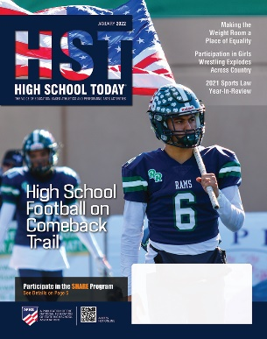
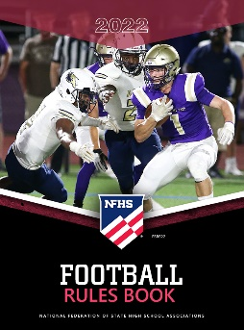
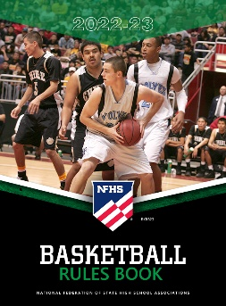
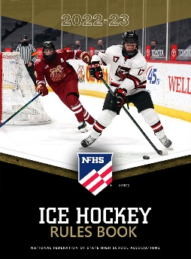
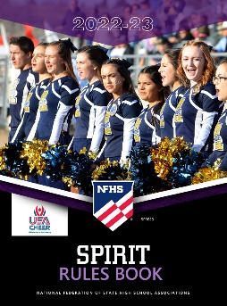
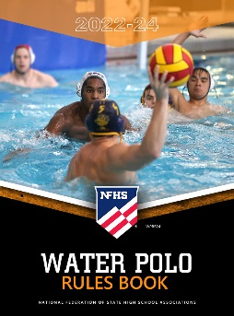
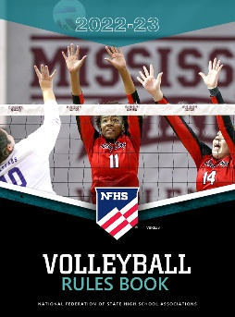
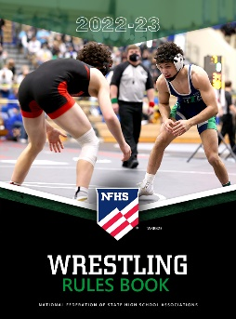
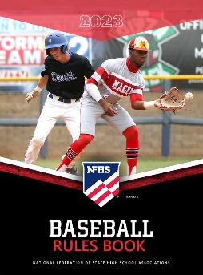
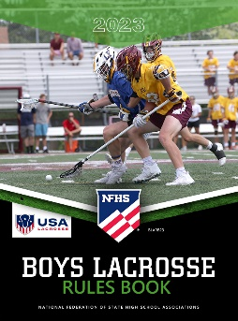
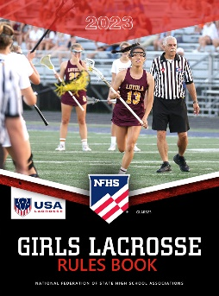
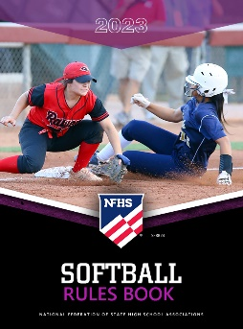
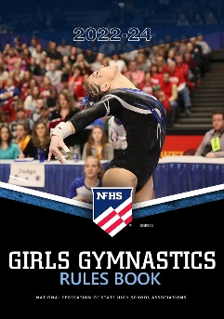
National Federation of State High School Associations
The NFHS writes playing rules for 17 sports for boys and girls at the high school level.
Publishes 4 million pieces of materials annually.
Notes:
The NFHS writes playing rules for 17 sports for boys and girls at the high school level.
Publishes 4 million pieces of materials annually.

Slide 7
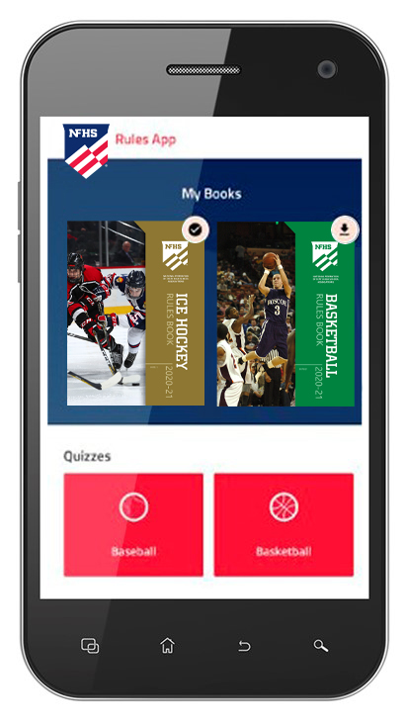
NEW NFHS Rules App
Rules App features:
Searchable
Highlight notes
Bookmarks
Quizzes for all sports
Easy navigation
Immediate availability
Free to paid members of the NFHS Coaches and Officials Associations
www.nfhs.org/erules for more information
Notes:
Rules App features:
Searchable
Highlight notes
Bookmarks
Quizzes for all sports
Easy navigation
Immediate availability
Free to paid members of the NFHS Coaches and Officials Associations
www.nfhs.org/erules for more information

Slide 8
2022-23 NFHS Basketball
Rules Changes
Notes:
2022-23 NFHS Basketball Rules Changes

Slide 9
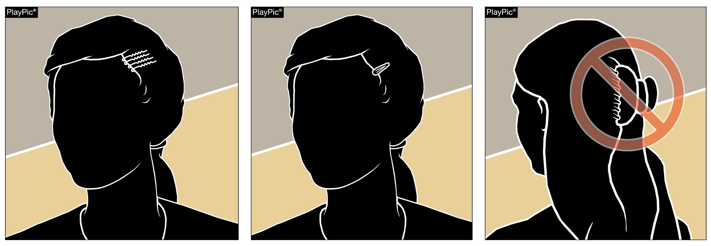
Team Member’s Equipment, Apparel 3-5-4d
Hair control devices that are securely fastened close to the head and do not increase risk to the athlete, teammates and opponents are permitted.
Hair clips that are hard, protrude from the head and/or are easily dislodged do not comply and are not legal.
Notes:
Hair control devices that are securely fastened close to the head and do not increase risk to the athlete, teammates and opponents are permitted.
Hair clips that are hard, protrude from the head and/or are easily dislodged do not comply and are not legal.
Rationale: Eliminates the restrictions of hair control devices while maintaining that the risk of injury to the athlete, teammates and opponents should not be compromised.

Slide 10
Team Member’s Equipment, Apparel 3-5-4d
Hair adornments, such as beads, that are securely fastened close to the head and do not increase risk to the player, teammates or opponents are permitted (PlayPics B and D).
PlayPics A and C illustrate hair beads that are not securely fastened close to the head and do increase risk of injury; therefore, these examples are non-compliant.
Notes:
Hair adornments, such as beads, that are securely fastened close to the head and do not increase risk to the player, teammates or opponents are permitted (PlayPics B and D).
PlayPics A and C illustrate hair beads that are not securely fastened close to the head and do increase risk of injury; therefore, these examples are non-compliant.
Rationale: Creates inclusivity of hair styles while maintaining that the risk of injury to the athlete, teammates and opponents should not be compromised.

Slide 11
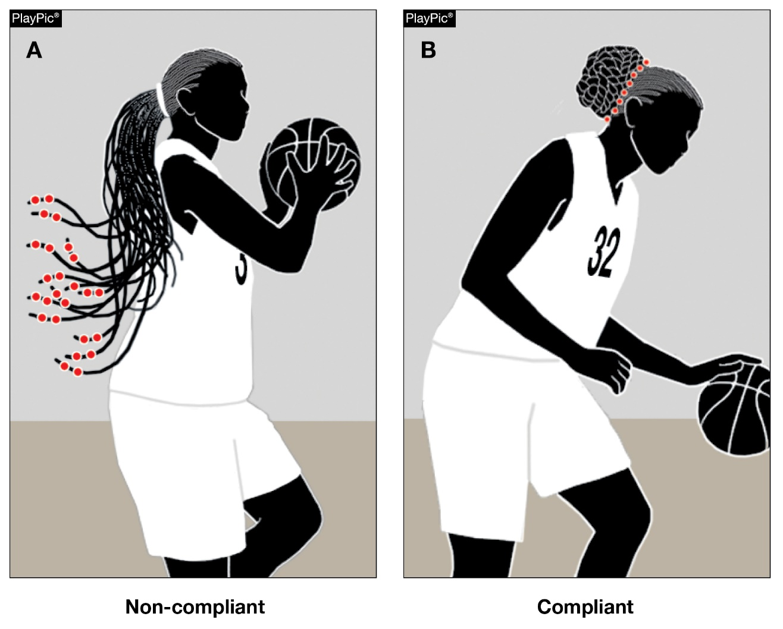
Team Member’s Equipment, Apparel 3-5-4d
Hair adornments that are not securely fastened, do increase the risk to the player, teammates or opponents and/or are not secured close to the head should be addressed by the official with the coach.
The player(s) shall have the opportunity to comply or remove the adornment(s).
Notes:
Hair adornments that are not securely fastened, do increase the risk to the player, teammates or opponents and/or are not secured close to the head should be addressed by the official with the coach.
The player(s) shall have the opportunity to comply or remove the adornment(s).
Rationale: Creates inclusivity of hair styles while maintaining that the risk of injury to the athlete, teammates and opponents should not be compromised.

Slide 12
Team Member’s Equipment, Apparel 3-5-4d
PlayPic A – Rules 3-5-4a & b still require headbands (any item that goes around the entire head) to adhere to the color requirements; be free of extensions, non-abrasive and unadorned, and no more than 3 inches wide.
PlayPics B and C – provide additional examples of compliant hair adornments.
Notes:
PlayPic A – Rules 3-5-4a & b still require headbands (any item that goes around the entire head) to adhere to the color requirements; be free of extensions, non-abrasive and unadorned, and no more than 3 inches wide.
PlayPics B and C – provide additional examples of compliant hair adornments.
Rationale: Creates inclusivity of hair styles while maintaining that all other rules related to headbands still apply and maintains that the risk of injury to the athlete, teammates and opponents should not be compromised.

Slide 13
Team Member’s Equipment, Apparel 3-5-4d
Hair charms are considered jewelry and per rule 3-5-7 would not be permitted.
Notes:
Hair charms are considered jewelry and per rule 3-5-7 would not be permitted.
Rationale: Maintains consistency that charms worn in the hair are considered jewelry and are not allowed.

Slide 14
2022-23 NFHS Basketball
Major Editorial Changes
Notes:
2022-23 NFHS Basketball Major Editorial Changes

Slide 15
Shot clock – state association adoption
Rule 2-14 outlines the rules, effective with the 2022-23 season, for state associations that adopt the shot clock. Those rules include:
The team in control shall attempt a try for field goal within 35 seconds after gaining team control.
The clock shall be visible.
The tap/try for field goal shall leave the shooter’s hand before the expiration of time.
The shot clock guidelines are recommendations by the NFHS Basketball Rules Committee. Modifications to these recommendations will not qualify as rules modifications.
Notes:
Rule 2-14 outlines the rules, effective with the 2022-23 season, for state associations that adopt the shot clock. Those rules include:
The team in control shall attempt a try for field goal within 35 seconds after gaining team control.
The clock shall be visible.
The tap/try for field goal shall leave the shooter’s hand before the expiration of time.
The shot clock guidelines are recommendations by the NFHS Basketball Rules Committee. Modifications to these recommendations will not qualify as rules modifications.

Slide 16
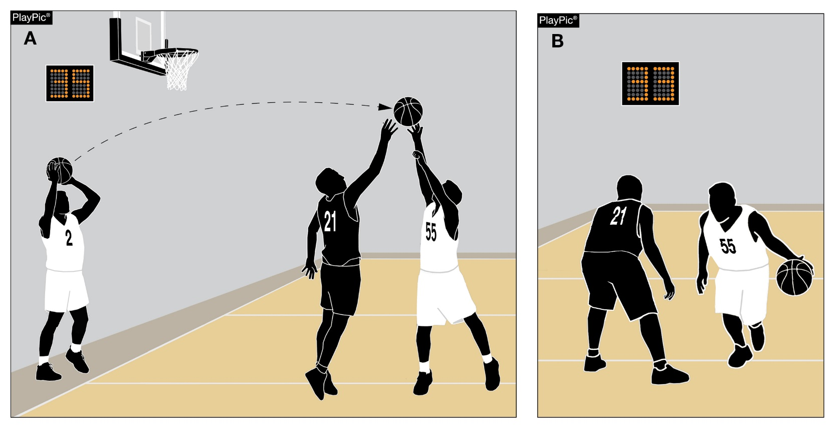
Shot clock – state association adoption
OFFICIALS’ GENERAL DUTIES
If using the shot clock to administer the 10-second backcourt count, the 10-second count begins when the ball touches or is legally touched by a player in the backcourt.
Rationale: Creates consistency for the shot clock operator and game officials.
If the ball is not cleanly caught by a player on the court, the team in control will get the remaining first 10-seconds of the shot clock to exit the backcourt.
Notes:
OFFICIALS’ GENERAL DUTIES
If using the shot clock to administer the 10-second backcourt count, the 10-second count shall begin when the ball touches or is legally touched by a player in the backcourt.
Rationale: Creates consistency for the shot clock operator and game officials.
If the ball is not cleanly caught by a player on the court, the team in control will get the remaining first 10-seconds of the shot clock to exit the backcourt.

Slide 17
Shot clock – state association adoption
THE SHOT CLOCK OPERATOR SHALL:
Item 2: Eliminated the reference to turning off the shot clock when 5-5-3 NOTE (Mercy Rules) are implemented.
Rationale: This is a state association determination based on state association mercy rules.
Items 5a-c and 6b v & vi: Simplified language when the shot clock operator shall start the clock and when the shot clock operator shall stop and reset to the full amount.
Rationale: Clarifies shot clock operator duties while aligning language with other rules codes.
Notes:
THE SHOT CLOCK OPERATOR SHALL:
Item 2: Eliminated the reference to turning off the shot clock when 5-5-3 NOTE (Mercy Rules) are implemented.
Rationale: This is a state association determination based on state association mercy rules.
Items 5a-c and 6b v & vi: Simplified language when the shot clock operator shall start the clock and when the shot clock operator shall stop and reset to the full amount.
Rationale: Clarifies shot clock operator duties while aligning language with other rules codes.

Slide 18
Shot clock – state association adoption
THE SHOT CLOCK OPERATOR SHALL:
Item 8: Eliminated reference to resetting the shot clock not to the full shot clock amount (20 seconds).
Rationale: State associations may determine if resetting to not the full shot clock and to what amount based on experience level of shot clock operators. A 35-second shot clock could result in a 25-second reset if/when not resetting to the full shot clock, a different amount or only administer a full reset.
Notes:
THE SHOT CLOCK OPERATOR SHALL:
Item 8: Eliminated reference to resetting the shot clock not to the full shot clock amount (20 seconds).
Rationale: State associations may determine if resetting to not the full shot clock and to what amount based on experience level of shot clock operators. A 35-second shot clock could result in a 25-second reset if/when not resetting to the full shot clock, a different amount or only administer a full reset.

Slide 19
2022-23 NFHS Basketball
Editorial Changes
Notes:
2022-23 NFHS Basketball Editorial Changes

Slide 20
editorial changes
3-7: The referee shall not permit any team member to participate if, in the referee’s judgment, any item constitutes a safety concern, such as, but not limited to a player’s fingernails or hairstyle.
4-19-4: …If technical, it involves dead-ball contact or noncontact conduct at any time…
4-22: Reformatted as 4-22-1 and 4-22-2
Notes:
3-7: The referee shall not permit any team member to participate if, in the referee’s judgment, any item constitutes a safety concern, such as, but not limited to a player’s fingernails or hairstyle.
4-19-4: …If technical, it involves dead-ball contact or noncontact conduct at any time…
4-22: Reformatted as 4-22-1 and 4-22-2

Slide 21
Editorial Changes
4-28-2: The jump ball begins when the ball leaves the official’s hand(s) and ends when the touched ball contacts a nonjumper, an official or the floor, a basket or backboard.
6-4-3f NOTE: When the alternating-possession procedure has not been established, the jump ball shall be in the center retraining circle between the two players involved in the subsequent previous action.
Notes:
4-28-2: The jump ball begins when the ball leaves the official’s hand(s) and ends when the touched ball contacts a nonjumper, an official or the floor, a basket or backboard.
6-4-3f NOTE: When the alternating-possession procedure has not been established, the jump ball shall be in the center retraining circle between the two players involved in the subsequent previous action.

Slide 22
2022-23 NFHS Basketball
Rule Change Reminders
Notes:
2022-23 NFHS Basketball Rules Change Reminders

Slide 23
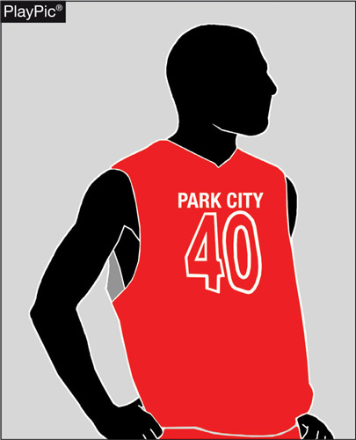
JERSEY NUMBERS 3-4-3e(2)
Beginning in the 2024-25 season, the body of the number must clearly contrast from the body of the uniform regardless of trim.
This option [3-4-3e(2)] will no longer be compliant.
Notes:
Beginning in the 2024-25 season, the body of the number must clearly contrast from the body of the uniform regardless of trim.
This option [3-4-3e(2)] will no longer be compliant.

Slide 24
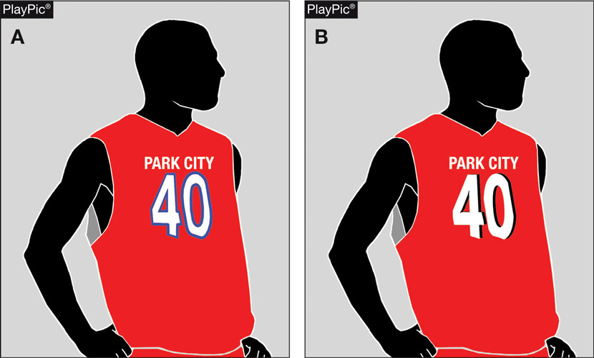
JERSEY NUMBERS 3-4-3e(1 & 3)
Two legal jersey numbering options will remain:
A solid contrasting number with no more than two solid color ¼-inch borders around the entire number (PlayPic A);
A solid contrasting color with a “shadow” trim of a contrasting color on part of the number not to exceed ½ inch in width and may be used with one ¼-inch border (PlayPic B).
Notes:
Two legal jersey numbering options will remain:
A solid contrasting number with no more than two solid color ¼-inch borders around the entire number (PlayPic A);
A solid contrasting color with a “shadow” trim of a contrasting color on part of the number not to exceed ½ inch in width and may be used with one ¼-inch border (PlayPic B).

Slide 25
2022-23 NFHS Basketball
Points of Emphasis
Notes:
2022-23 NFHS Basketball Points of Emphasis

Slide 26
Reducing Illegal Contact
To maintain the sound traditions of all sports, encourage sportsmanship, and minimize the inherent risk of injury, playing rules are developed to serve the varying skill levels of the involved participants.
When officials allow personal philosophies to enter into their enforcement of the rules, unintended advantages can be provided to players or teams, advantages that can determine the outcome of a contest.
It’s incumbent on contest officials to enforce the rules as written.
Participants should expect nothing less from contest officials on a nightly basis, and the enforcement of all playing rules should be made without regard for time and circumstance.
A foul or violation in the first quarter is expected to be a foul or violation in the last minute of a contest.
Notes:
To maintain the sound traditions of all sports, encourage sportsmanship, and minimize the inherent risk of injury, playing rules are developed to serve the varying skill levels of the involved participants.
When officials allow personal philosophies to enter into their enforcement of the rules, unintended advantages can be provided to players or teams, advantages that can determine the outcome of a contest.
It’s incumbent on contest officials to enforce the rules as written.
Participants should expect nothing less from contest officials on a nightly basis, and the enforcement of all playing rules should be made without regard for time and circumstance.
A foul or violation in the first quarter is expected to be a foul or violation in the last minute of a contest.

Slide 27
Reducing Illegal Contact
Hand Checks: Rule 10-7-12 is very clear for officials to apply. Over the recent years, freedom of movement for players has improved, and officials need to remember the simple concepts of Rule 10-7-12 that prohibit defensive players from:
Placing two hands on the player (PlayPic A),
Placing an extended arm bar on the player (PlayPic B),
Placing and keeping a hand on an opponent (PlayPic C), or
Contacting an opponent more than once with the same hand or alternating hands (PlayPic D).
Keeping these simple principles in mind are critical for officials and need to be ruled when they occur.
Notes:
Hand Checks: Rule 10-7-12 is very clear for officials to apply. Over the recent years, freedom of movement for players has improved, and officials need to remember the simple concepts of Rule 10-7-12 that prohibit defensive players from:
Placing two hands on the player (PlayPic A),
Placing an extended arm bar on the player (PlayPic B),
Placing and keeping a hand on an opponent (PlayPic C), or
Contacting an opponent more than once with the same hand or alternating hands (PlayPic D).
Keeping these simple principles in mind are critical for officials and need to be ruled when they occur.

Slide 28
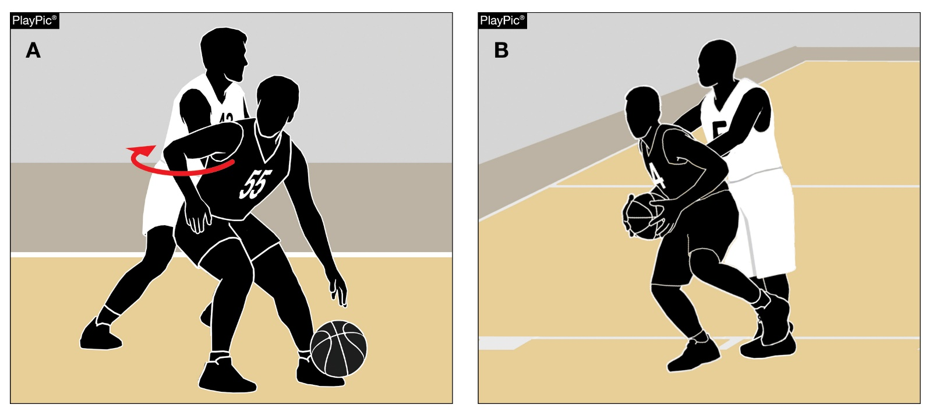
Reducing Illegal Contact
Post Play: The High School RIO National High School Sports-Related Injury Surveillance Study revealed more basketball injuries occur in the post than any other place on the floor. Officials need to monitor play in the post, whether the ball is involved or not.
Players who either illegally carve out space for themselves (PlayPic A) or defenders who repeatedly push, knee, or otherwise attempt to knock offensive players off balance (PlayPic B) need to be penalized for their actions.
Failure to address the first illegal contact leads to more physical play.
Regardless of the player’s location on the floor, when a player’s rhythm, speed, balance, or quickness is impeded, a foul has occurred.
Notes:
Post Play: The High School RIO National High School Sports-Related Injury Surveillance Study revealed more basketball injuries occur in the post than any other place on the floor. Officials need to monitor play in the post, whether the ball is involved or not.
Players who either illegally carve out space for themselves (PlayPic A) or defenders who repeatedly push, knee, or otherwise attempt to knock offensive players off balance (PlayPic B) need to be penalized for their actions.
Failure to address the first illegal contact leads to more physical play.
Regardless of the player’s location on the floor, when a player’s rhythm, speed, balance, or quickness is impeded, a foul has occurred.

Slide 29
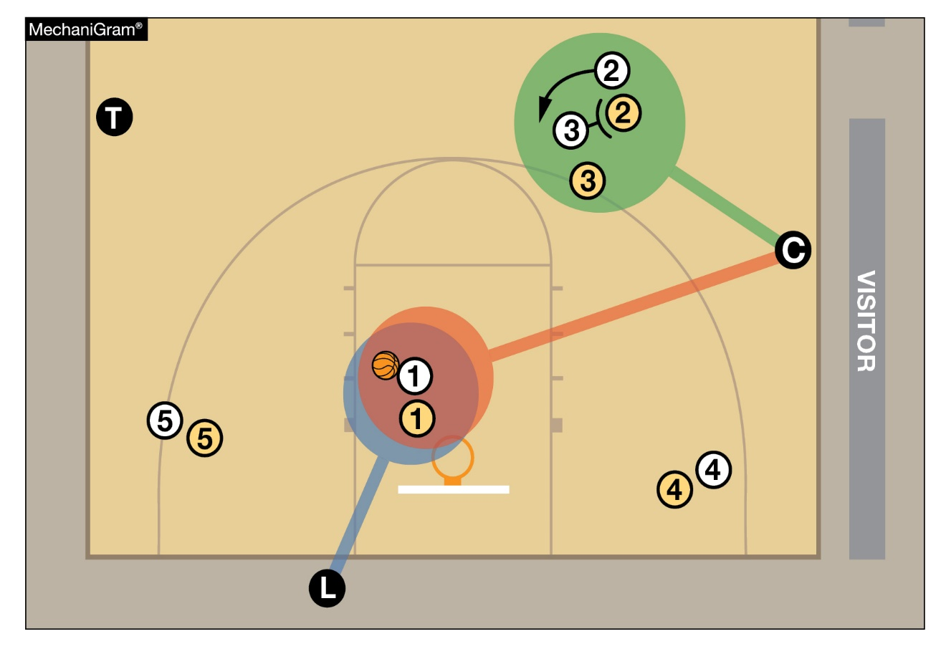
Reducing Illegal Contact
Off-ball play: Keeping eyes on off-ball plays is also necessary to help reduce the physicality in the game. Officials need to keep their focus on their primary coverage area, and no place is that more critical than off-ball plays.
Officials who tend to ‘ball watch’ will miss screening plays in front of them that involve illegal contact. Allowable action by screeners, cutters, and defenders are outlined in the rules, and officials who stay in their primary area will naturally better officiate these kinds of plays.
When either the offense or defense are allowed to play outside the screening and defending rules off-ball, more physical and illegal play tends to follow.
Notes:
Off-ball play: Keeping eyes on off-ball plays is also necessary to help reduce the physicality in the game. Officials need to keep their focus on their primary coverage area, and no place is that more critical than off-ball plays.
Officials who tend to ‘ball watch’ will miss screening plays in front of them that involve illegal contact. Allowable action by screeners, cutters, and defenders are outlined in the rules, and officials who stay in their primary area will naturally better officiate these kinds of plays.
When either the offense or defense are allowed to play outside the screening and defending rules off-ball, more physical and illegal play tends to follow.

Slide 30
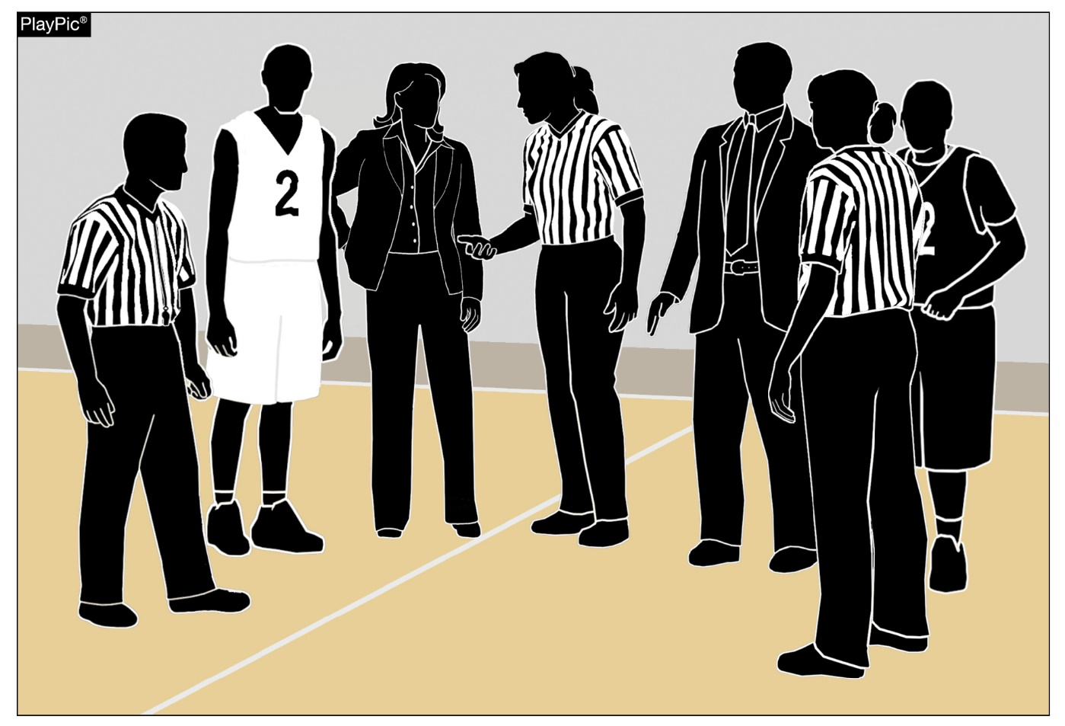
Pregame Meeting – Addressing Illegal Uniforms, Equipment and Apparel
Rule 2-4-5 requires that game officials verify with each head coach, prior to the start of a contest, that the teams’ uniforms and equipment are legal and will be worn properly, and that all participants will exhibit proper sporting behavior throughout the contest.
Before and after this pre-game verification, officials should monitor players and notify the head coach if they notice anything that needs to be addressed, including the color of uniforms, undershirts/undergarments, jewelry, casts, braces, or hair control devices.
Notes:
Rule 2-4-5 requires that game officials verify with each head coach, prior to the start of a contest, that the teams’ uniforms and equipment are legal and will be worn properly, and that all participants will exhibit proper sporting behavior throughout the contest.
Before and after this pre-game verification, officials should monitor players and notify the head coach if they notice anything that needs to be addressed, including the color of uniforms, undershirts/undergarments, jewelry, casts, braces, or hair control devices.

Slide 31
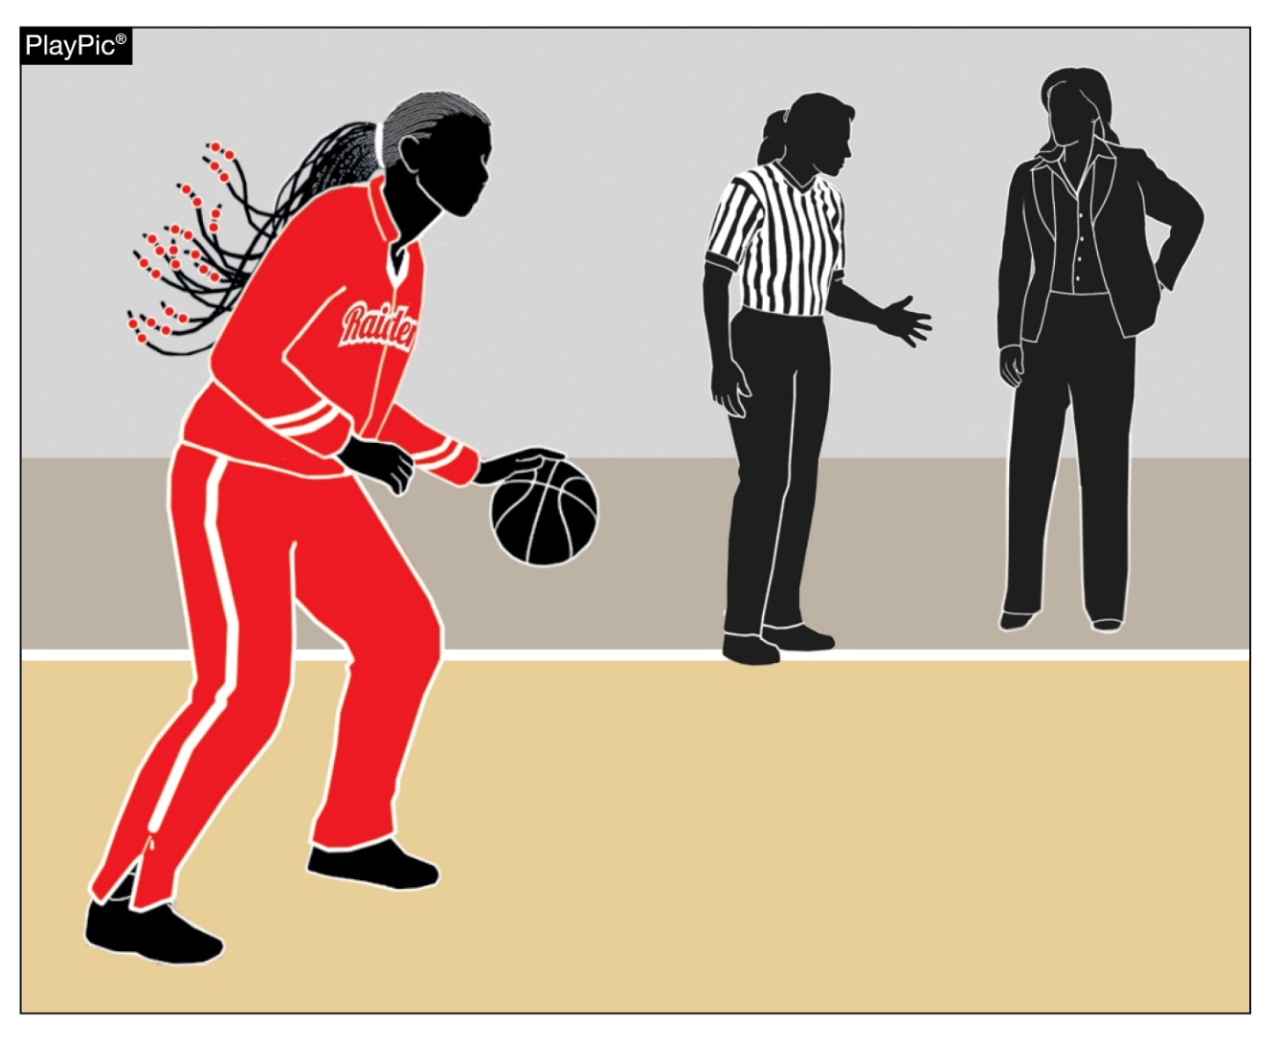
Pregame Meeting – Addressing Illegal Uniforms, Equipment and Apparel
If an official identifies any uniform or equipment issue that is of concern, the official should allow head coaches to address the problem and not take it upon themselves to deal directly with the player.
Even during the pre-game period, players must be legally attired, and paying attention to these details in pre-game will set the tone for the contest.
Notes:
If an official identifies any uniform or equipment issue that is of concern, the official should allow head coaches to address the problem and not take it upon themselves to deal directly with the player.
Even during the pre-game period, players must be legally attired, and paying attention to these details in pre-game will set the tone for the contest.

Slide 32
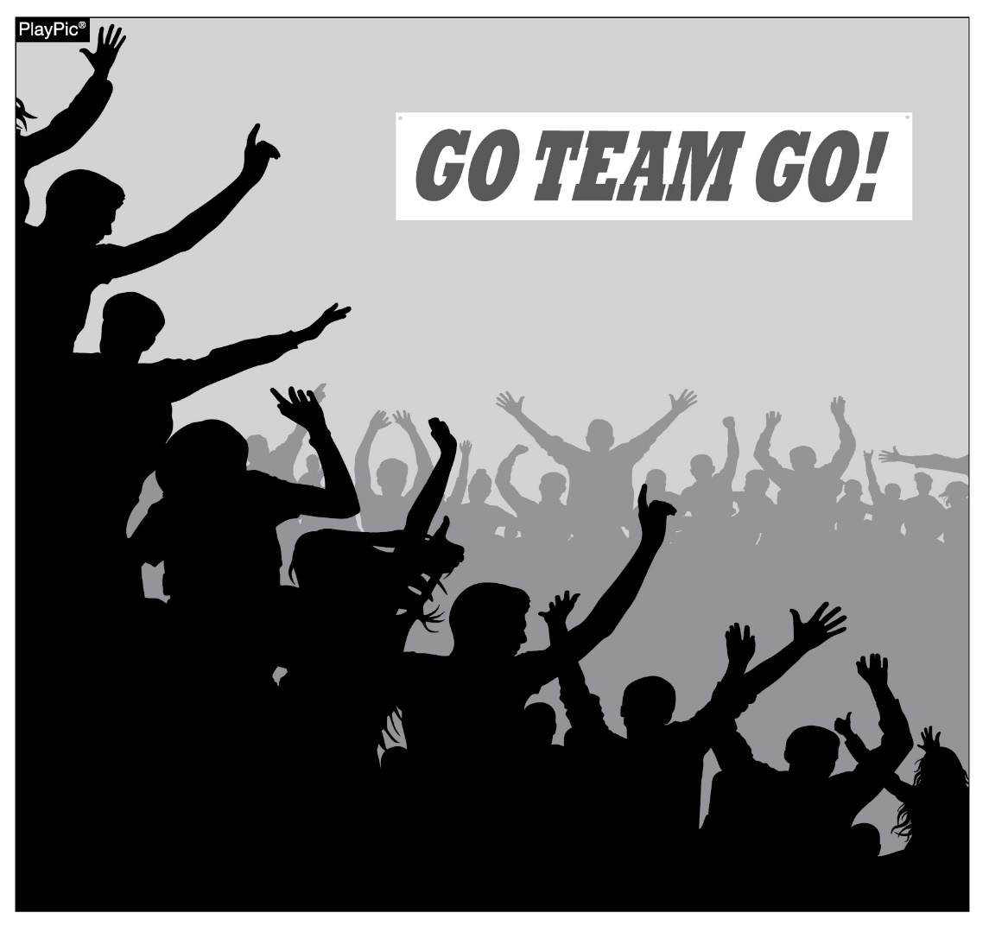
sportsmanship
NFHS playing rules are written to encourage sportsmanship. Participation in these programs should promote respect, integrity and sportsmanship. However, for these ideals to occur, everyone involved in these programs must be doing their part.
Notes:
NFHS playing rules are written to encourage sportsmanship. Participation in these programs should promote respect, integrity and sportsmanship. However, for these ideals to occur, everyone involved in these programs must be doing their part.
Sportsmanship, or good sporting behavior, is about treating one another with respect and exhibiting appropriate behavior. It is about being fair, honest and caring. When these types of appropriate behavior occur, competitive play is more enjoyable for everyone.

Slide 33
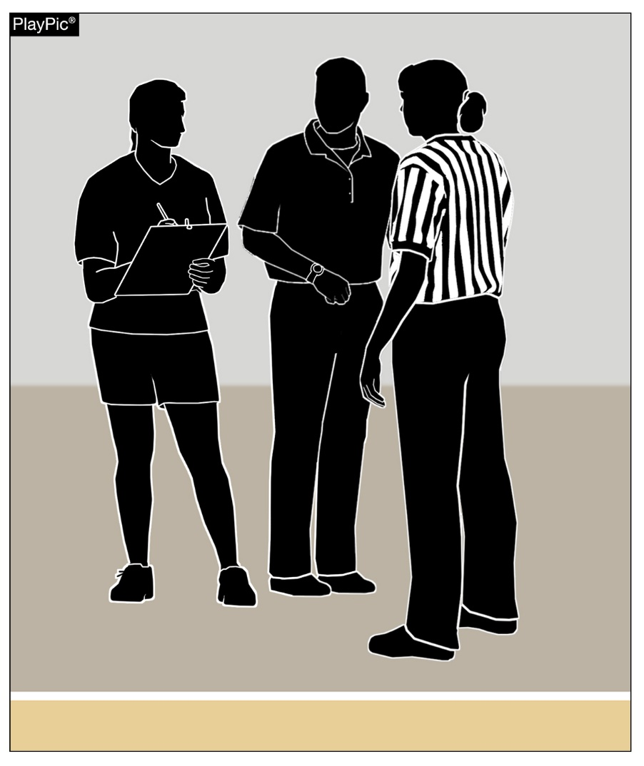
sportsmanship
There must be a collaborative, working relationship between contest officials and game administration to promote good sportsmanship and safely conduct the contest.
Everyone has their roles to play in creating a positive, sportsmanlike atmosphere at contests.
Notes:
There must be a collaborative, working relationship between contest officials and game administration to promote good sportsmanship and safely conduct the contest.
Everyone has their roles to play in creating a positive, sportsmanlike atmosphere at contests.

Slide 34
sportsmanship
Contest officials should never engage with spectators who are exhibiting unsporting behavior.
School administration is responsible for dealing with unruly spectators prior to, during and after the contest.
If spectators are using demeaning or profane language at officials, coaches or players – or at others in the stands – those individuals should be removed from the contest by school administration.
Notes:
Contest officials should never engage with spectators who are exhibiting unsporting behavior.
School administration is responsible for dealing with unruly spectators prior to, during and after the contest.
If spectators are using demeaning or profane language at officials, coaches or players – or at others in the stands – those individuals should be removed from the contest by school administration.

Slide 35
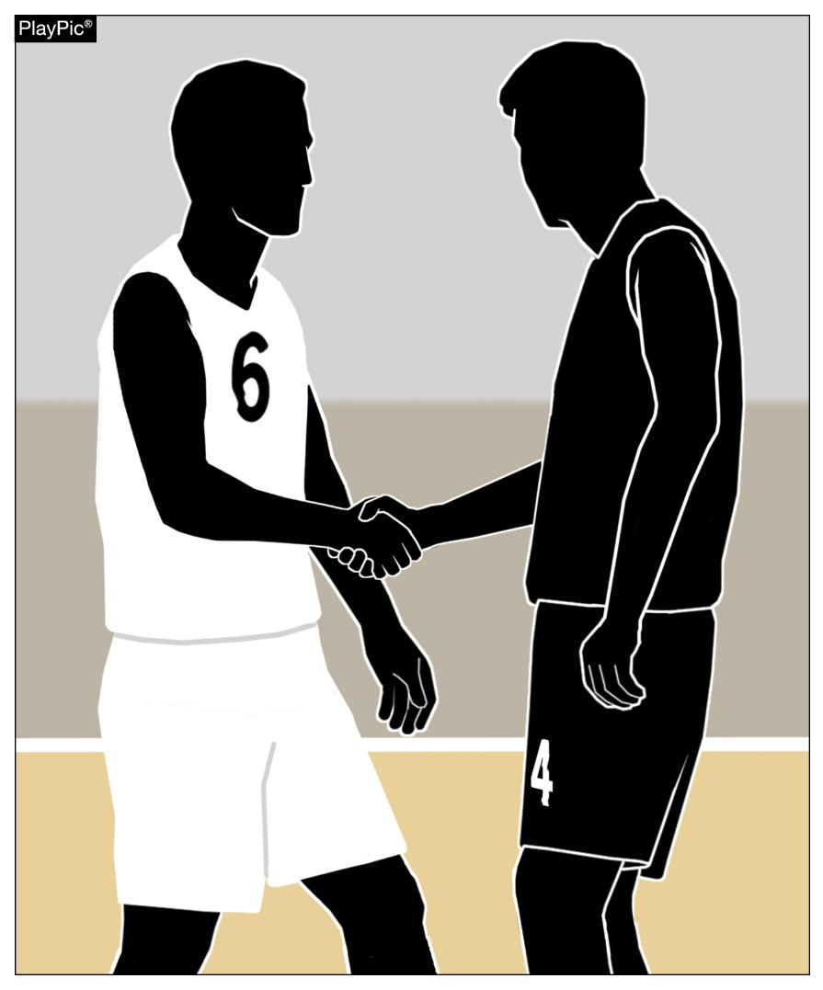
sportsmanship
Good sports win with humility, lose with grace and do both with dignity.
It takes the efforts of everyone every day to ensure that sportsmanship remains one of the top priorities in education-based activity programs.
Notes:
Good sports win with humility, lose with grace and do both with dignity.
It takes the efforts of everyone every day to ensure that sportsmanship remains one of the top priorities in education-based activity programs.

Slide 36
NFHS OFFICIALS Education

Slide 37
OFFICIALS EDUCATION
Content remains free of charge
TEACHING
AIDS
RULES
CHANGES
DIAGRAMS
VIDEO
LIBRARY
OFFICIALS
COURSES
Notes:
Sport-Specific Officiating courses are offered in several sports. They are ideal for new officials and those in the first few years of officiating. These courses introduce officials to the mechanics and techniques used in the sport and provide specific information on an area within that sport. Individuals can complete a course within 30-45 minutes. These courses are free to all officials and prospective officials.
“Interscholastic Officiating” is a general course on sports officiating, and it is free to all officials and prospective officials. This course provides an introduction to skills and concepts used as an official. Several topics are covered such as: basics of becoming and staying an official, science of officiating, art of officiating, how to combine these skills for successful officiating.
Video clips are made available to NFHS Officials Association members. The video is clipped on specific topics and provides the rules references as well as dialogue on the topic.
The courses and videos are offered at www.NFHSLearn.com .
Courses Available:
Officiating Football
Officiating Volleyball – Ball Handling
Officiating Volleyball – Alignment
Officiating Volleyball – E-Whistle
Officiating Basketball
Officiating Basketball – Three-Person Mechanics
Officiating Basketball - Pre-Game Conference
Soccer – Fouls and Misconduct
Soccer – Offside
Soccer - Pre-Game Conference
Swimming and Diving
Officiating Wrestling
Umpiring Softball
Officiating Field Hockey
Officiating Track and Field
Future Courses to be Considered:
Umpiring Baseball
Umpiring Softball – 2 Person Mechanics
Communication Among Officials and Coaches

Slide 38
Future Developments
Improved Schedule View
Year Two Accomplishments
Auto-Assign
Years of Service
14
121,508
$9.2M
Enhanced Payment Capabilities
States Registering Officials
Contests
Assigned
Payments
Sent to
Officials
100% FREE to your state as a NFHS-Member Benefit.
Notes:
NFHS CENTER FOR OFFICIALS SERVICES (COS)
Your Complete Solution for Officials Management and More:
Registration
Assignment
Payment
Testing
Background Checks
For More Information on the NFHS – Center for Officials Services (COS) Contact:
Dana Pappas, Director of Officiating Services, dpappas@nfhs.org
Also If You’re Interested in Eligibility and Monitoring Requirements Contact the Folks at Dragonfly:
Kirk Miller, Dragonfly, kirk@dragonflyathletics.com
Brandon Wallace, Dragonfly, brandon@dragonflyathletics.com

Slide 39
NFHS Learning Center

Slide 40
Notes:
The NFHS Learning Center is the home to more than 90 online professional development courses for everyone within the interscholastic community - coaches, students, officials, parents, administrators, and individuals within performing arts programs. More than 60 courses are available for free.
The NFHS is an Accredited Institution and has delivered more than 15 million courses on its NFHS Learning Center platform since its inception in 2007. In receiving national accreditation by Cognia, the NFHS has upheld itself to rigorous standards that focus on productive learning environments, equitable resource allocation that meet the needs of learners, and effective leadership.
The NFHS Learning Center features its flagship coaching course, “Fundamentals of Coaching,” as well as several health and safety courses that have been completed by millions of individuals, such as “Concussion in Sports,” “Heat Illness Prevention,” “Sudden Cardiac Arrest” and “Protecting Students from Abuse.” The NFHS Learning Center offers several national credentials that can be earned by individuals who complete specific NFHS courses. Through the School Honor Roll Program, schools can earn a physical banner to hang in their school.
To learn more and start your professional development journey, please visit the NFHS Learning Center at NFHSLearn.com.

Slide 41
NFHS Network

Slide 42
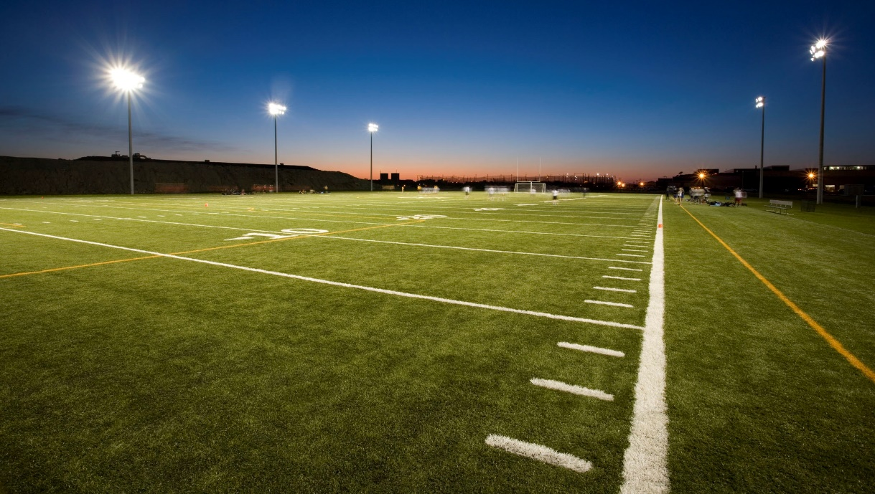
NFHS Network
By 2025, every high school sporting event in America will be streamed live.
The NFHS Network will be THE DESTINATION for fans to view these broadcasts.
27 Different Sports and Activities
www.NFHSnetwork.com
Notes:
The NFHS Network is the leader in streaming Live and On Demand high school sports.
Partnered with the National Federation of State High School Associations, 45 high school state athletic/activities associations, and PlayOn! Sports, the NFHS Network is a joint venture created to provide fans with the ability to stream high school sports on any device, from wherever they are.
All NFHS Network events are available to watch online at www.NFHSnetwork.com and through the NFHS Network Live App for iOS and Android. Follow us on Facebook, Twitter, Instagram, and YouTube.
Watching high school sports and events has never been easier.
The NFHS Network’s goal to broadcast live all 2 million high school sporting events by 2025.
The NFHS Network covers 27 different regular season and postseason sports, as well as other high school activities, celebrating the accomplishments of students-athletes, student broadcasters, and high schools across the country.

Slide 43
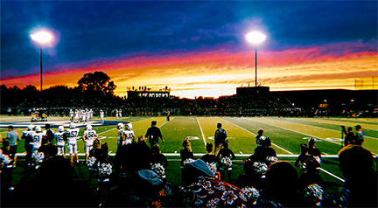
Over 1 million events this year…
Notes:
The NFHS Network will broadcast over 150,000 live events this year. If your school is not a member of the NFHS Network School Broadcast Program, please contact us at Mark.Koski@NFHSnetwork.com

Slide 44
Thank You
National Federation of State High School Associations PO Box 690 | Indianapolis, IN 46206 Phone: 317-972-6900 | Fax: 317.822.5700 www.nfhs.org | www.nfhslearn.com | www.nfhsnetwork.com

