Slide 1
2024 NFHS Baseball Rule changes Powerpoint

Slide 2
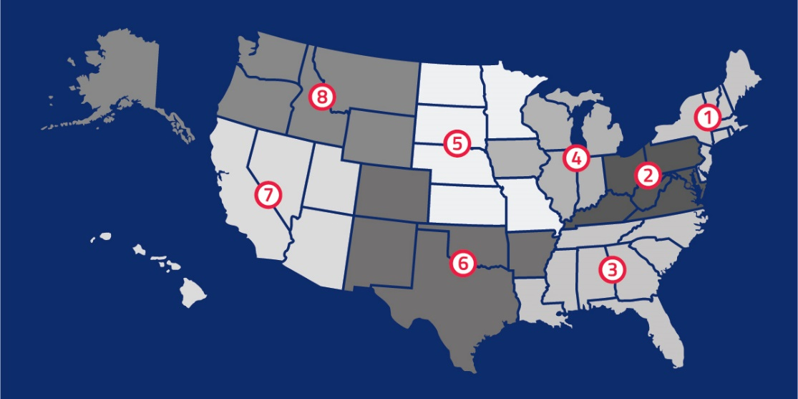
National Federation of State High School Associations
NFHS (located in Indianapolis, IN – Est. 1920):
National leader and advocate for high school athletics and performing arts programs.
Serves 51 state associations, 19,500 high schools and 12 million student participants.
Writes playing rules for 17 high school sports for boys and girls.
Offers online education courses for high school coaches, officials, parents, students and others.
Ensures that students have opportunity to enjoy healthy participation, achievement and good sportsmanship in education-based athletics.

Slide 3
NFHS Rules Review Committee
The NFHS Rules Review Committee is chaired by the chief operating officer and composed of all rules editors. After each committee concludes its deliberations and has adopted its recommended changes for the subsequent year, such revisions will be evaluated by the Rules Review Committee.
Davis Whitfield
Chief Operating Officer
Lindsey Atkinson
Basketball, Girls Lacrosse and Volleyball
Bob Colgate
Football and Sports
Medicine
Sandy Searcy
Softball, Swimming & Diving and Water Polo
Elliot Hopkins
Baseball and Wrestling
Julie Cochran
Cross Country, Gymnastics, Field Hockey, Soccer and
Track & Field
James Weaver
Boys Lacrosse
and Spirit
Dan Schuster
Ice Hockey

Slide 4
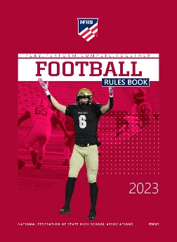
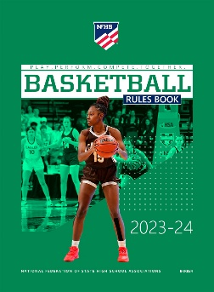
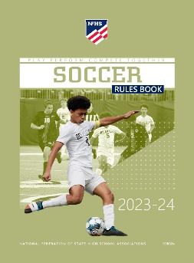
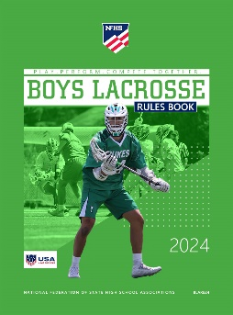
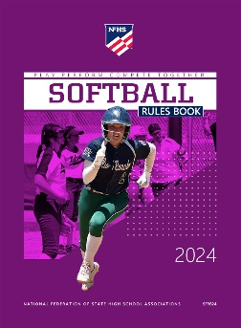
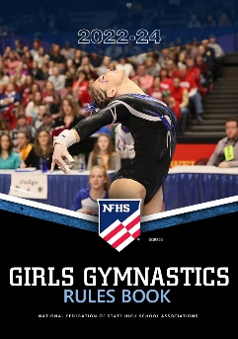
National Federation of State High School Associations
The NFHS writes playing rules for 17 sports for boys and girls at the high school level.
Publishes 4 million pieces of materials annually.

Slide 5
NEW NFHS AllAccess – Website
AllAccess is the New NFHS Digital Publications Platform that includes:
Rules Publications
High School Today Magazine
Policy Debate Quarterlies
Other NFHS Digital Publications
Website organized for associations and individuals to assign books and manage purchases
Visit www.allaccess.nfhs.org

Slide 6
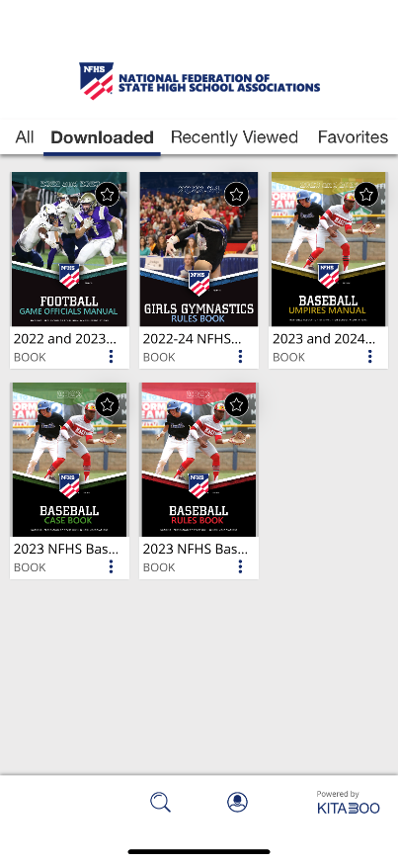
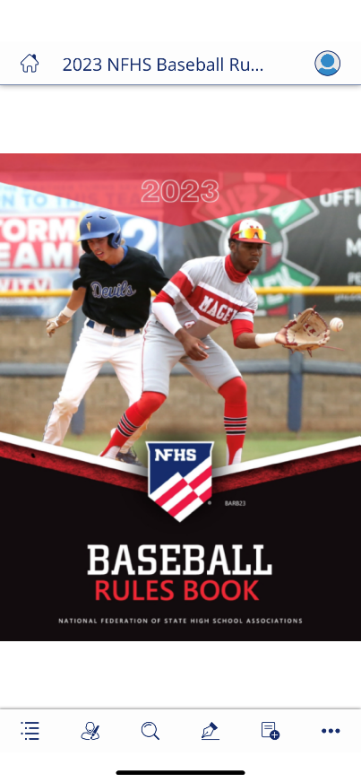
NEW NFHS AllAccess – Mobile App
Access Via Website or Mobile App:
View available publications for sale
View publications assigned to you
Download books for offline viewing
Read publications as an e-book
Book features include:
Table of contents
Highlighting text
Creating ‘sticky notes’ on pages
Searching for terms
Mark-up pen feature
Viewing highlights and notes on data page
Available on App Store and Google Play

Slide 7
2024 NFHS BASEBALL
Rules Changes

Slide 8
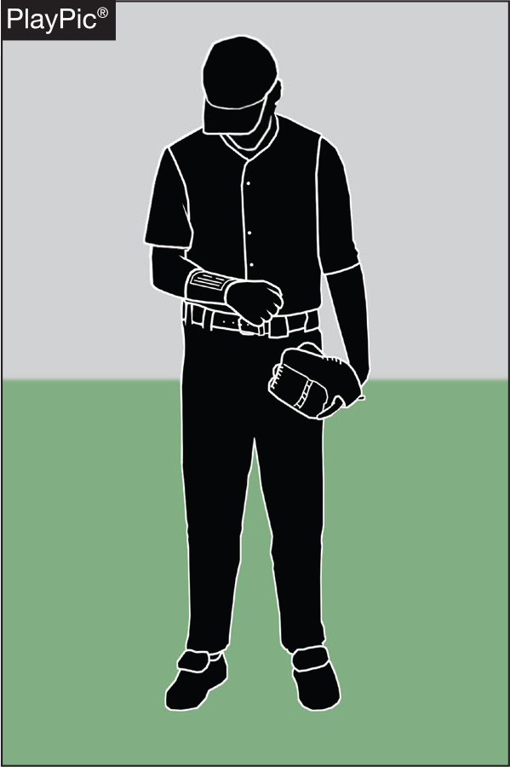
1-6-1 PLAYER COMMUNICATION EQUIPMENT
• Any wristband with defensive shifts/offensive plays/pitching choices or game directions attached shall be considered non-electronic equipment and is permitted as long as it a single, solid color.

Slide 9
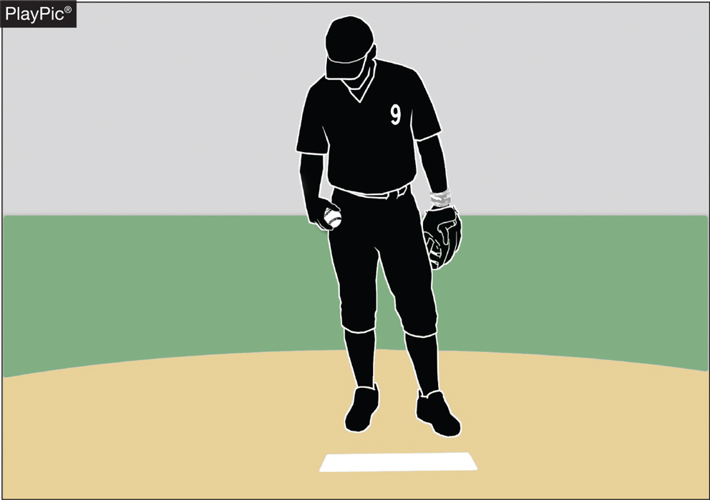
1-6-1 PLAYER COMMUNICATION EQUIPMENT
• For pitchers, it may not contain the colors white, gray or be distracting.
• It does not have to match the color of the uniform or the sleeves worn underneath the uniform.

Slide 10
1-6-1 PLAYER COMMUNICATION EQUIPMENT
• It shall only be worn on player(s) wrist or forearm and pitchers shall wear it on their non-pitching arm.

Slide 11
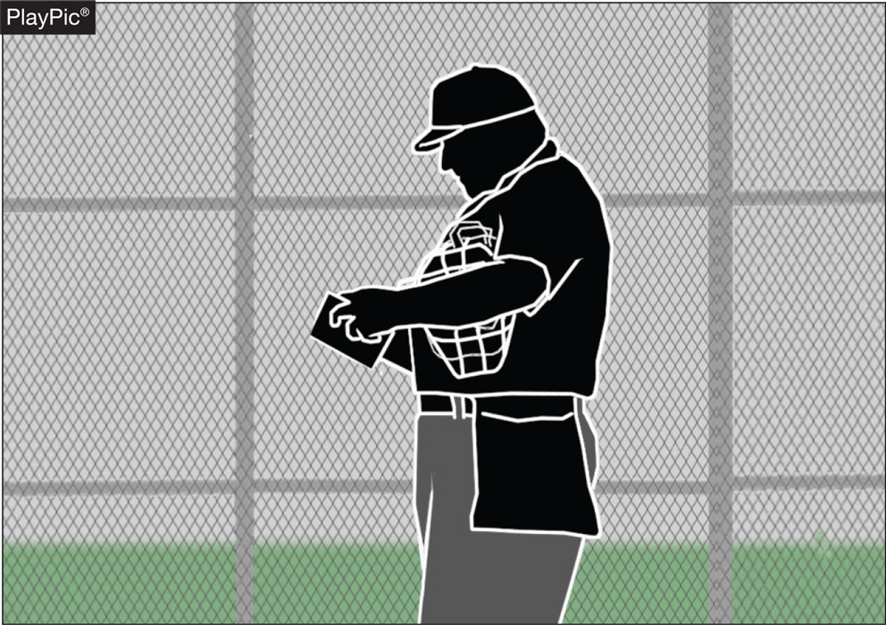
1-6-1 PLAYER COMMUNICATION EQUIPMENT
• The penalty for wearing this equipment improperly is a team warning to the coach on a first offense.
• The next offender of that team will be ejected along with the team’s head coach.

Slide 12
player communication equipment Rule 1-6-1 (New section)
ART. 1 . . . Any wristband with defensive shifts/offensive plays/pitching choices or game directions attached shall be considered non-electronic equipment and is permitted as long as it is a single, solid color. For pitchers, it may not contain the colors white, gray or be distracting. It does not have to match the color of the uniform or the sleeves worn underneath the uniform. It shall only be worn on a player(s) wrist or forearm and pitchers shall wear it on their non-pitching arm.
PENALTY: The umpire shall issue a team warning to coach of the team involved and the next offender(s) of that team will be ejected along with the head coach.
Rationale:
Clarification. With the increase in popularity of these style of communication systems, confusion has been realized when the players wear them other than on their arm. This change will prohibit these types of products from being worn other places.

Slide 13
PLAYER COMMUNICATION EQUIPMENT rule 3-2-5
• One-way electronic communication devices are permissible from the dugout to the catcher while the team is on defense for the purpose of calling pitches.

Slide 14
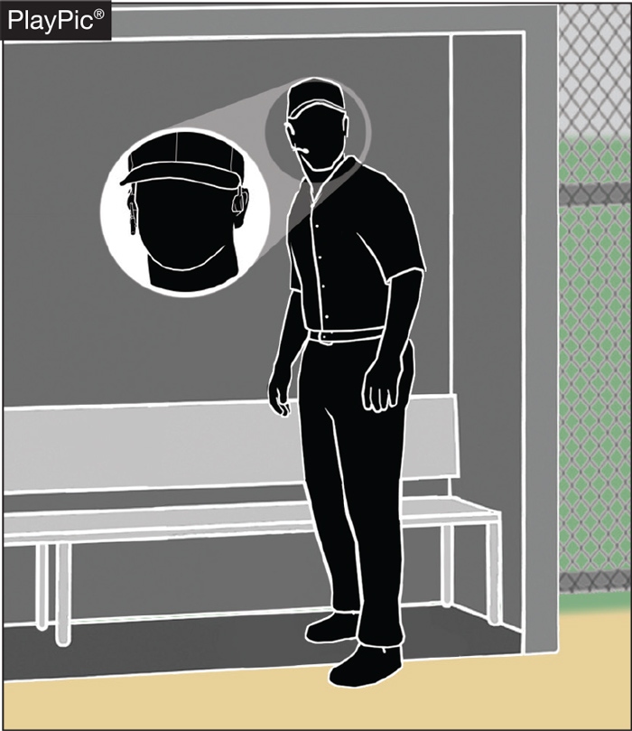
PLAYER COMMUNICATION EQUIPMENT rule 1-6-2
• When using the electronic communication device, the coach cannot be outside the dugout/bench area.

Slide 15
player communication equipment Rule 1-6-2 (New section)
ART. 2 . . . One-way electronic communication devices are permissible from the dugout to the catcher while the team is on defense for the purpose of calling pitches. When using the electronic communication device, the coach cannot be outside the dugout/bench area.
PENALTY: The umpire shall issue a team warning to coach of the team involved and the next offender(s) of that team will be ejected along with the head coach.
Rationale:
This rule allows for a team to utilize an electronic device for the purpose of calling pitches from the dugout. The device would only be able to be one-way, meaning the player cannot use an electronic device to respond or communicate back to the coach. Various technologies, earpiece, electronic band or a smart watch could be used giving teams several options at varying costs. No other player would be able to wear or use this device nor would the coach be able to communicate with any other player using electronic communication.

Slide 16
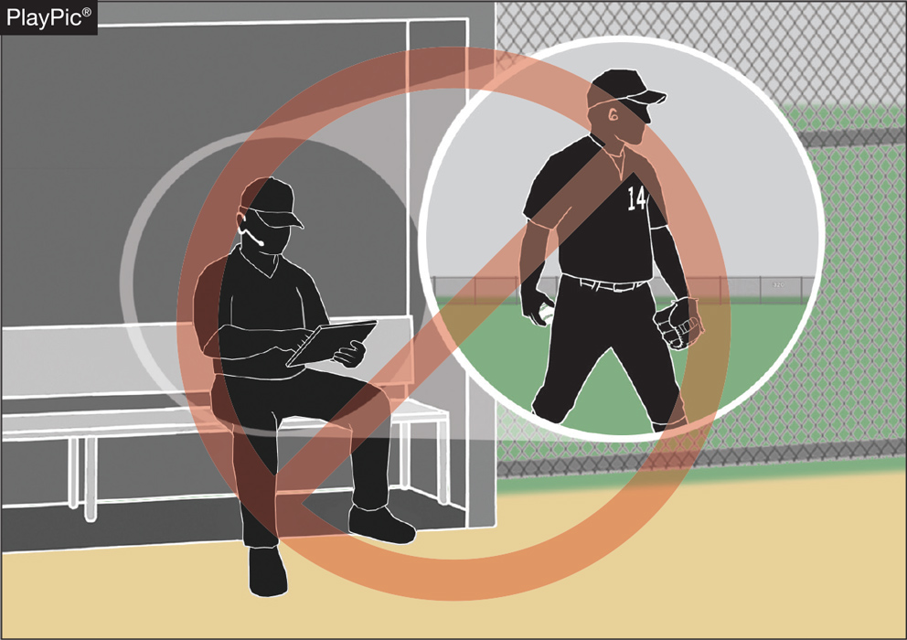
COACHING (PLAYER COMMUNICATION EQUIPMENT) rule 3-2-5
• Coaches may not use electronic communication device(s) to communicate with any other team member than the catcher while on defense, or any team member while on offense.

Slide 17
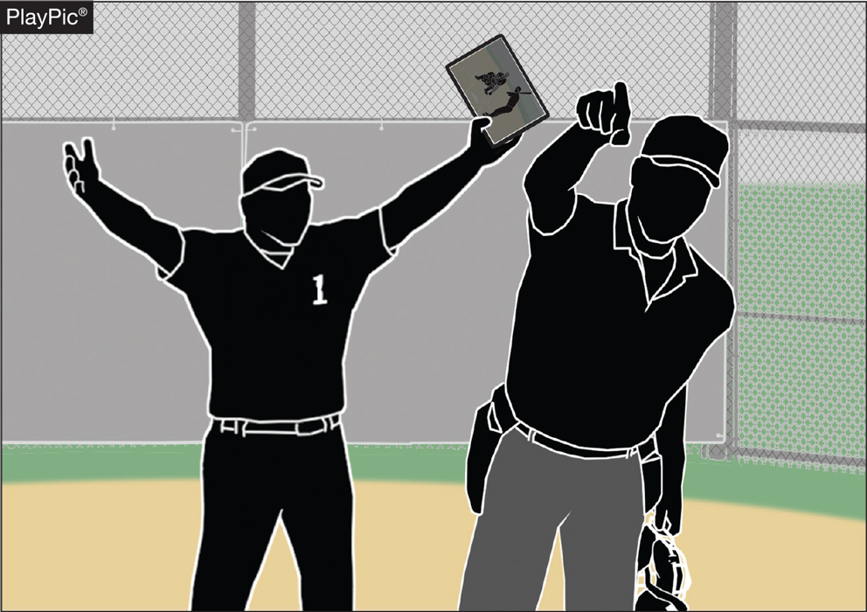
COACHING (PLAYER COMMUNICATION EQUIPMENT) rule 3-2-5
• The penalty for improper use is a team warning on the first offense.
• The next offender of that team will be ejected, along with the team’s head coach.

Slide 18
Coaching rule 3-2-5
ART. 5 . . . A coach may use a one-way electronic communication device to communicate to the catcher for the purpose of calling pitches. Coaches may not use electronic communication device(s) to communicate with any other team member while on defense or any team member while on offense. When using the electronic communication device, the coach cannot be outside the dugout/bench area.
PENALTY: The umpire shall issue a team warning to coach of the team involved and the next offender(s) of that team will be ejected along with the head coach.
Rationale:
Allows for the coach to communicate with the catcher using an electronic communication device for the purpose of calling pitches.

Slide 19
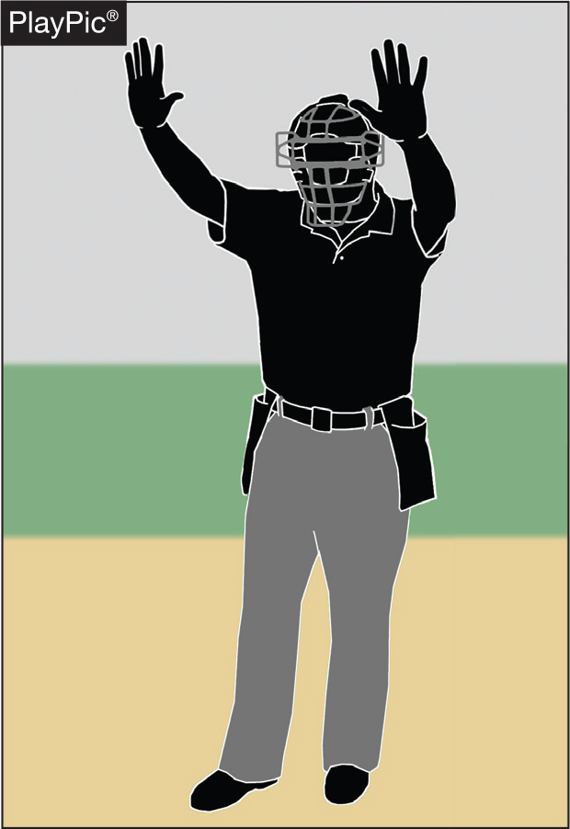
UMPIRE-IN-CHIEF Rule 10-2-3h
• The umpire-in-chief may forfeit the game for prescribed infractions by coaches, players or team/bench personnel.

Slide 20
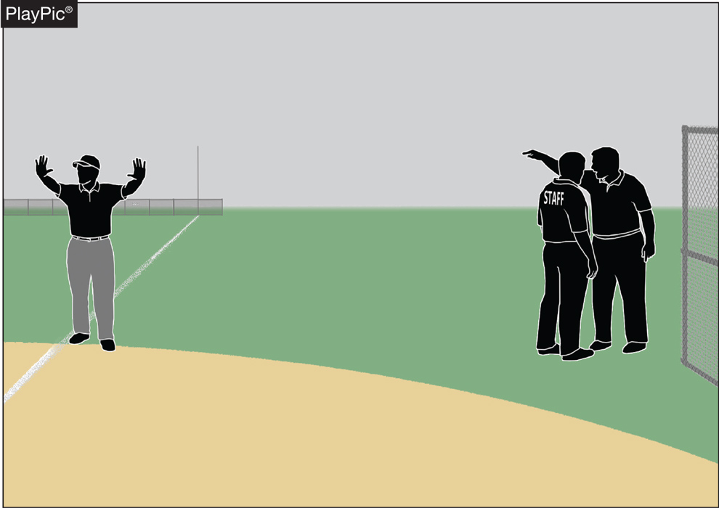
UMPIRE-IN-CHIEF Rule 10-2-3h
• Umpires have jurisdiction over the confines of the players, coaches and team/bench personnel.
• If there are issues with spectators, it is the responsibility of game management to deal with spectators and to ensure the facility is safe for all involved.

Slide 21
UMPIRE-IN-CHIEF rule 10-2-3h
h. Forfeit the game for prescribed infractions by spectators, coaches, players or team/bench personnel.
Rationale:
Umpires have jurisdiction over the confines of the field, players, coaches and team/bench personnel. If there are issues with spectators, it is the responsibility of game management to deal with spectators and to ensure that the facility is safe for all involved.

Slide 22
2024 NFHS BASEBALL
Points of Emphasis

Slide 23
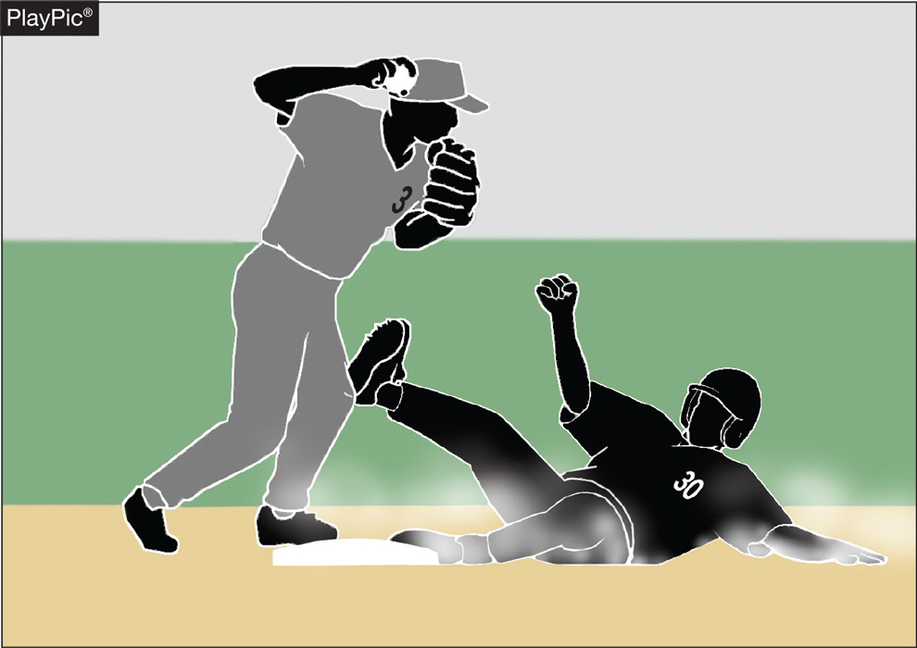
Malicious contact
Malicious contact can be initiated by either an offensive or defensive player(s).
It should not be confused with incidental contact or “train wreck” plays that sometimes occur in baseball.
Notes:
NFHS playing rules are written to encourage sportsmanship. Participation in these programs should promote respect, integrity and sportsmanship. However, for these ideals to occur, everyone involved in these programs must be doing their part.
Sportsmanship, or good sporting behavior, is about treating one another with respect and exhibiting appropriate behavior. It is about being fair, honest and caring. When these types of appropriate behavior occur, competitive play is more enjoyable for everyone.

Slide 24
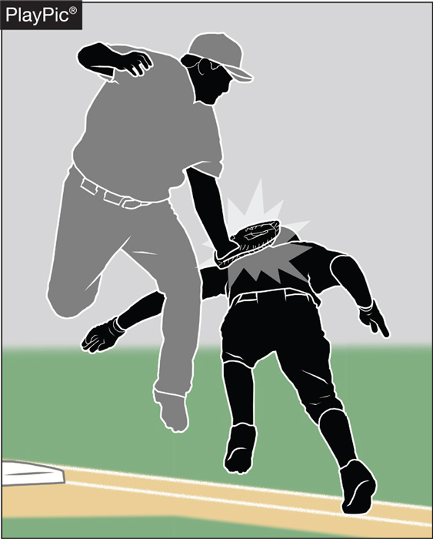
Malicious contact
Contact or a collision is considered to be malicious if it the result of excessive force and/or there is an intent to injure.
The absence of these two conditions does not preclude the presence of malicious contact but would provide a reasonable starting point for proper interpretation.
Notes:
NFHS playing rules are written to encourage sportsmanship. Participation in these programs should promote respect, integrity and sportsmanship. However, for these ideals to occur, everyone involved in these programs must be doing their part.
Sportsmanship, or good sporting behavior, is about treating one another with respect and exhibiting appropriate behavior. It is about being fair, honest and caring. When these types of appropriate behavior occur, competitive play is more enjoyable for everyone.

Slide 25
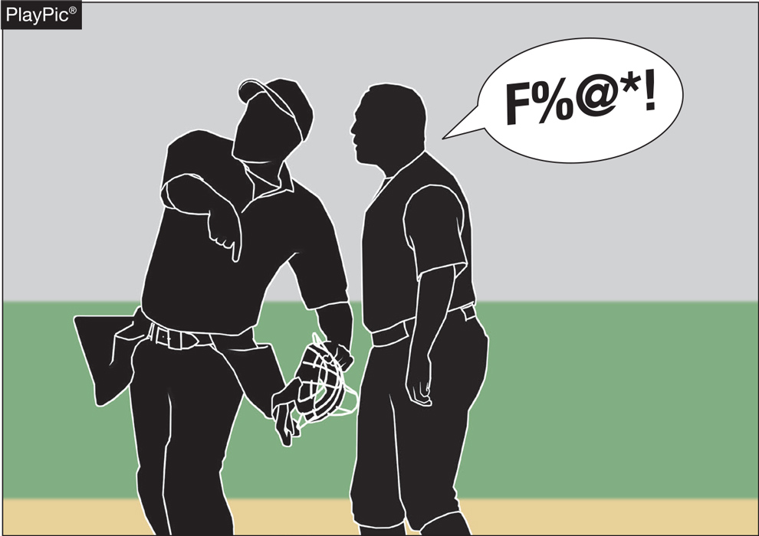
Profanity (DIRECT OR INDIRECT)
Education-based athletics is a direct extension of the classroom.
There is no excuse for foul language in school or on the baseball field.
Notes:
NFHS playing rules are written to encourage sportsmanship. Participation in these programs should promote respect, integrity and sportsmanship. However, for these ideals to occur, everyone involved in these programs must be doing their part.
Sportsmanship, or good sporting behavior, is about treating one another with respect and exhibiting appropriate behavior. It is about being fair, honest and caring. When these types of appropriate behavior occur, competitive play is more enjoyable for everyone.

Slide 26
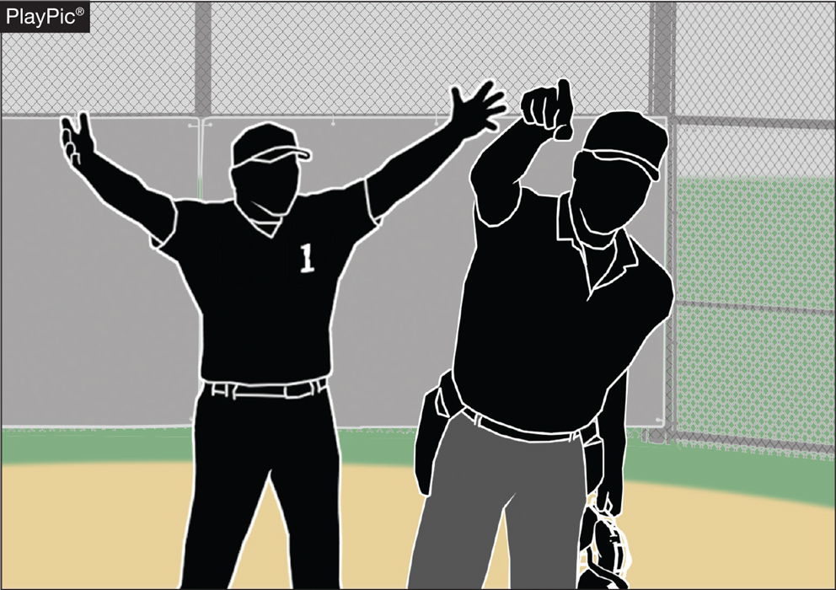
Profanity (DIRECT OR INDIRECT)
The penalties are a verbal warning to the offender on the first offense; a written warning to the offender that warrants restriction to the dugout/bench for the remainder of the game for a second offense; or ejection for a major offense.
Notes:
NFHS playing rules are written to encourage sportsmanship. Participation in these programs should promote respect, integrity and sportsmanship. However, for these ideals to occur, everyone involved in these programs must be doing their part.
Sportsmanship, or good sporting behavior, is about treating one another with respect and exhibiting appropriate behavior. It is about being fair, honest and caring. When these types of appropriate behavior occur, competitive play is more enjoyable for everyone.

Slide 27
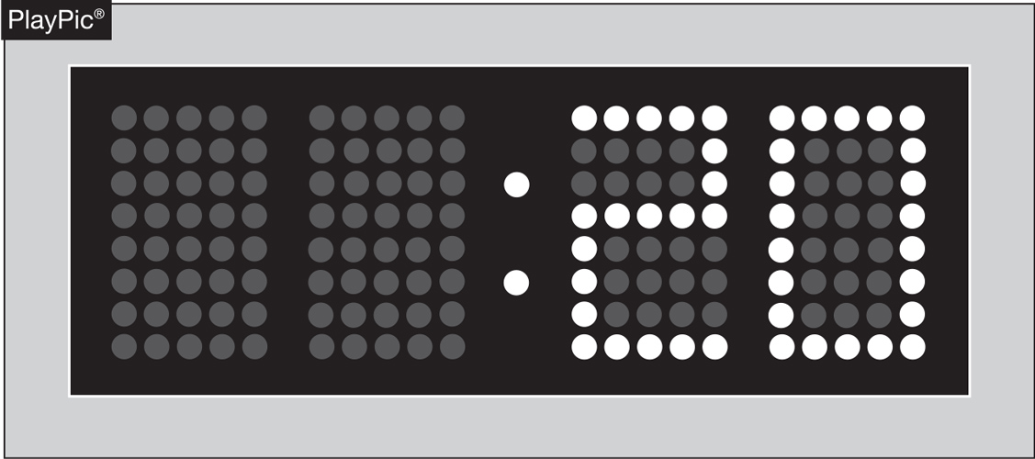
PACE OF PLAY
A 20-second time limit rule has been in the NFHS rules book since the 1970s.
The rule is meant to only be utilized when other preventive umpiring measures fail to achieve a reasonable pace or rhythm.
Notes:
NFHS playing rules are written to encourage sportsmanship. Participation in these programs should promote respect, integrity and sportsmanship. However, for these ideals to occur, everyone involved in these programs must be doing their part.
Sportsmanship, or good sporting behavior, is about treating one another with respect and exhibiting appropriate behavior. It is about being fair, honest and caring. When these types of appropriate behavior occur, competitive play is more enjoyable for everyone.

Slide 28
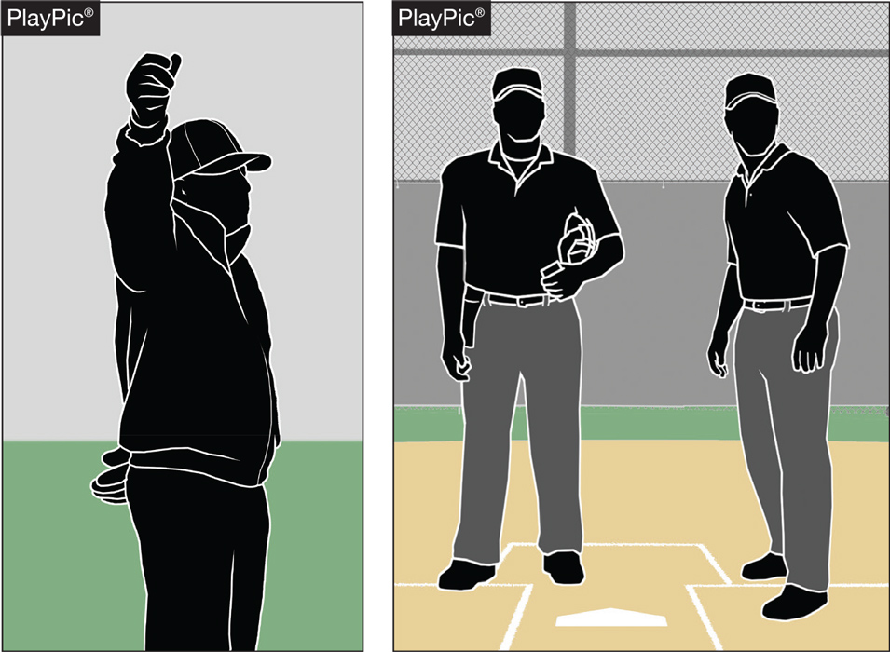
PACE OF PLAY
By rule, the time between the last out of one half-inning and the first pitch of the next half-inning is 1 minute, 20 seconds.
Umpires should facilitate this and refrain from visiting with fans or having prolonged discussions with other crew members.
Notes:
NFHS playing rules are written to encourage sportsmanship. Participation in these programs should promote respect, integrity and sportsmanship. However, for these ideals to occur, everyone involved in these programs must be doing their part.
Sportsmanship, or good sporting behavior, is about treating one another with respect and exhibiting appropriate behavior. It is about being fair, honest and caring. When these types of appropriate behavior occur, competitive play is more enjoyable for everyone.

Slide 29
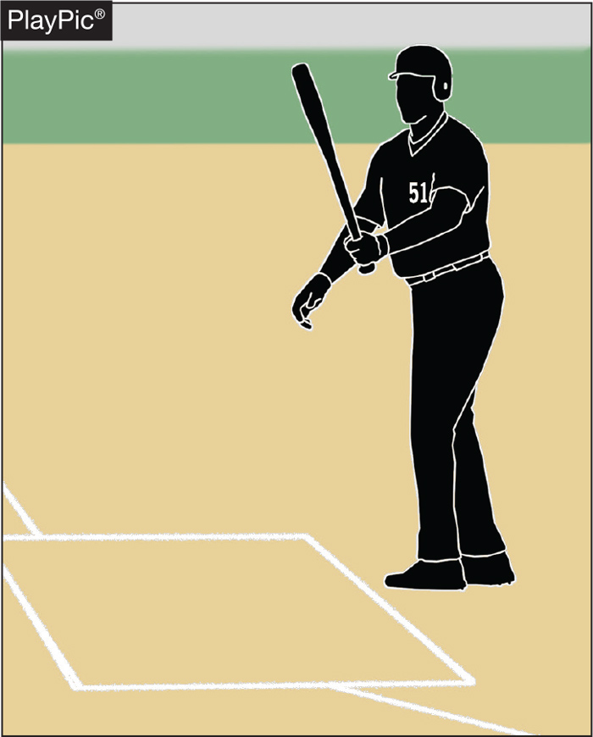
PACE OF PLAY
Rule 7-3-1 spells out the situations when a batter is allowed to leave the batter’s box.
Repeatedly stepping out to alter the rhythm of the pitcher or delay the game is not acceptable, and umpire needs to apply the proper penalty.
Notes:
NFHS playing rules are written to encourage sportsmanship. Participation in these programs should promote respect, integrity and sportsmanship. However, for these ideals to occur, everyone involved in these programs must be doing their part.
Sportsmanship, or good sporting behavior, is about treating one another with respect and exhibiting appropriate behavior. It is about being fair, honest and caring. When these types of appropriate behavior occur, competitive play is more enjoyable for everyone.

Slide 30
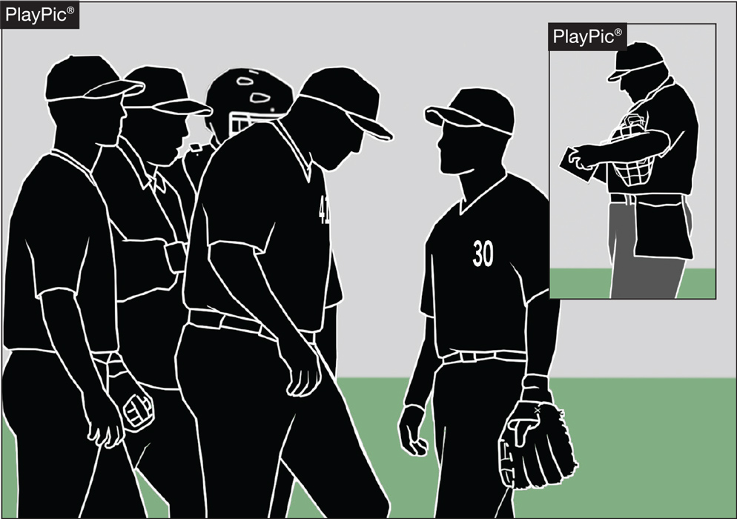
PACE OF PLAY
Umpires need to be consistent in monitoring how teams get on/off the field, conferences, enforcing the batter’s box rule and in other areas to create a sense of urgency during the contest.
Notes:
NFHS playing rules are written to encourage sportsmanship. Participation in these programs should promote respect, integrity and sportsmanship. However, for these ideals to occur, everyone involved in these programs must be doing their part.
Sportsmanship, or good sporting behavior, is about treating one another with respect and exhibiting appropriate behavior. It is about being fair, honest and caring. When these types of appropriate behavior occur, competitive play is more enjoyable for everyone.

Slide 31
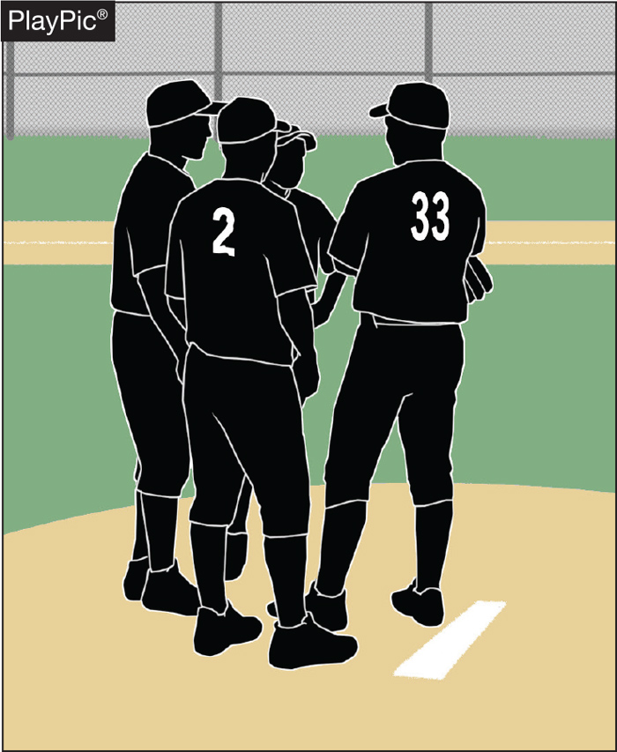
PACE OF PLAY
Umpires need to recognize when excessive player conferences begin to delay the game, step in and expedite the conclusion of the meeting.
Notes:
NFHS playing rules are written to encourage sportsmanship. Participation in these programs should promote respect, integrity and sportsmanship. However, for these ideals to occur, everyone involved in these programs must be doing their part.
Sportsmanship, or good sporting behavior, is about treating one another with respect and exhibiting appropriate behavior. It is about being fair, honest and caring. When these types of appropriate behavior occur, competitive play is more enjoyable for everyone.

Slide 32
NFHS OFFICIALS Education

Slide 33
OFFICIALS EDUCATION
Content remains free of charge
TEACHING
AIDS
RULES
CHANGES
DIAGRAMS
VIDEO
LIBRARY
OFFICIALS
COURSES
Notes:
Sport-Specific Officiating courses are offered in several sports. They are ideal for new officials and those in the first few years of officiating. These courses introduce officials to the mechanics and techniques used in the sport and provide specific information on an area within that sport. Individuals can complete a course within 30-45 minutes. These courses are free to all officials and prospective officials.
“Interscholastic Officiating” is a general course on sports officiating, and it is free to all officials and prospective officials. This course provides an introduction to skills and concepts used as an official. Several topics are covered such as: basics of becoming and staying an official, science of officiating, art of officiating, how to combine these skills for successful officiating.
Video clips are made available to NFHS Officials Association members. The video is clipped on specific topics and provides the rules references as well as dialogue on the topic.
The courses and videos are offered at www.NFHSLearn.com .
Courses Available:
Officiating Football
Officiating Volleyball – Ball Handling
Officiating Volleyball – Alignment
Officiating Volleyball – E-Whistle
Officiating Basketball
Officiating Basketball – Three-Person Mechanics
Officiating Basketball - Pre-Game Conference
Soccer – Fouls and Misconduct
Soccer – Offside
Soccer - Pre-Game Conference
Swimming and Diving
Officiating Wrestling
Umpiring Softball
Officiating Field Hockey
Officiating Track and Field
Future Courses to be Considered:
Umpiring Baseball
Umpiring Softball – 2 Person Mechanics
Communication Among Officials and Coaches

Slide 34
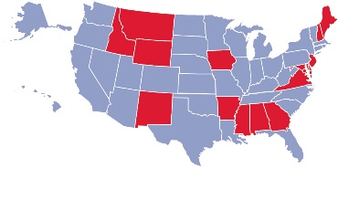
Future Developments:
Auto Assign
Mobil Assign
Customized Game and Travel Fees
Mass Update Capabilities
Integrated Playoff Financial Reporting
Improvements:
Invoicing
Updated Financial Reporting
Playoff and Tournament Bracketing
Eligibility Tracking Notifications
NFHS Learn Integration
Coming Fall 2023:
NFHS Exam Center
New Team App
New Form Builder
Year Two Accomplishments
16
194,810
$29M
States Registering Officials
Contests
Assigned
Payments
Sent to
Officials
100% FREE to your state as a NFHS-Member Benefit.
Notes:
NFHS CENTER FOR OFFICIALS SERVICES (COS)
Your Complete Solution for Officials Management and More:
Registration
Assignment
Payment
Testing
Background Checks
For More Information on the NFHS – Center for Officials Services (COS) Contact:
Dana Pappas, Director of Officiating Services, dpappas@nfhs.org
Also If You’re Interested in Eligibility and Monitoring Requirements Contact the Folks at Dragonfly:
Kirk Miller, Dragonfly, kirk@dragonflyathletics.com
Brandon Wallace, Dragonfly, brandon@dragonflyathletics.com

Slide 35
NFHS Learning Center

Slide 36
Notes:
The NFHS Learning Center is the home to more than 90 online professional development courses for everyone within the interscholastic community - coaches, students, officials, parents, administrators, and individuals within performing arts programs. More than 60 courses are available for free.
The NFHS is an Accredited Institution and has delivered more than 15 million courses on its NFHS Learning Center platform since its inception in 2007. In receiving national accreditation by Cognia, the NFHS has upheld itself to rigorous standards that focus on productive learning environments, equitable resource allocation that meet the needs of learners, and effective leadership.
The NFHS Learning Center features its flagship coaching course, “Fundamentals of Coaching,” as well as several health and safety courses that have been completed by millions of individuals, such as “Concussion in Sports,” “Heat Illness Prevention,” “Sudden Cardiac Arrest” and “Protecting Students from Abuse.” The NFHS Learning Center offers several national credentials that can be earned by individuals who complete specific NFHS courses. Through the School Honor Roll Program, schools can earn a physical banner to hang in their school.
To learn more and start your professional development journey, please visit the NFHS Learning Center at NFHSLearn.com.

Slide 37
NFHS Network

Slide 38
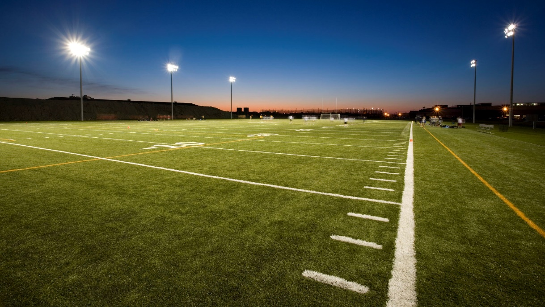
NFHS Network
By 2025, every high school sporting event in America will be streamed live.
The NFHS Network will be THE DESTINATION for fans to view these broadcasts.
27 Different Sports and Activities
www.NFHSnetwork.com
Notes:
The NFHS Network is the leader in streaming Live and On Demand high school sports.
Partnered with the National Federation of State High School Associations, 45 high school state athletic/activities associations, and PlayOn! Sports, the NFHS Network is a joint venture created to provide fans with the ability to stream high school sports on any device, from wherever they are.
All NFHS Network events are available to watch online at www.NFHSnetwork.com and through the NFHS Network Live App for iOS and Android. Follow us on Facebook, Twitter, Instagram, and YouTube.
Watching high school sports and events has never been easier.
The NFHS Network’s goal to broadcast live all 2 million high school sporting events by 2025.
The NFHS Network covers 27 different regular season and postseason sports, as well as other high school activities, celebrating the accomplishments of students-athletes, student broadcasters, and high schools across the country.

Slide 39
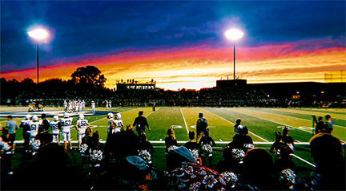
Over 1 million events this year…
Notes:
The NFHS Network will broadcast over 150,000 live events this year. If your school is not a member of the NFHS Network School Broadcast Program, please contact us at Mark.Koski@NFHSnetwork.com

Slide 40
Thank You
National Federation of State High School Associations PO Box 690 | Indianapolis, IN 46206 Phone: 317-972-6900 | Fax: 317.822.5700 www.nfhs.org | www.nfhslearn.com | www.nfhsnetwork.com

