Slide 1
National federation of state high school associations
2023 Baseball Rules Changes and Points of Emphasis

Slide 2
NFHS Corporate partner
Notes:
The NFHS welcomes and thanks Game Changer as our exclusive corporate partner. As their status with the NFHS has been contractually established, they are the only company that can use our logo/wordmark.

Slide 3
Important facts and dates
2021-22 Participation Results
Baseball (4th largest) 481,004 (boys)[down from 2018-19 {482,740}]
Girls’: 1,156 (down from 2018-19 1,284)
Online Interpretation Meeting Date
January 19, 2023
Mid-Season Webinar Date
April 21, 2023
Rule Change Proposal Submission Dates
Open Date: September 1, 2022
Close Date: May 1, 2023
Rules Committee Date
June 4-6, 2023

Slide 4
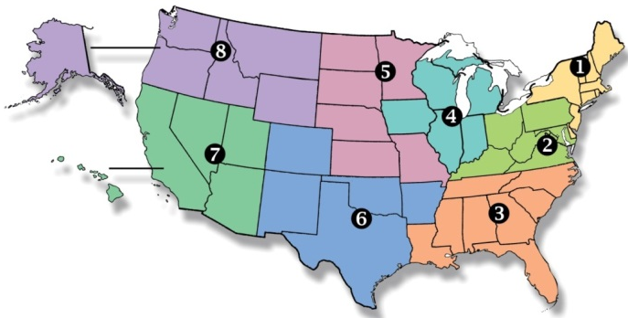
National Federation of State High School Associations
NFHS (located in Indianapolis, IN – Est. 1920):
National leader and advocate for high school athletics and performing arts programs.
Serves 51 state associations, 19,500 high schools and 12 million student participants.
Writes playing rules for 17 high school sports for boys and girls.
Offers online education courses for high school coaches, officials, parents, students and others.
Ensures that students have opportunity to enjoy healthy participation, achievement and good sportsmanship in education-based athletics.
Notes:
The NFHS is the national leader and advocate for high school athletics and performing arts programs. Services of the NFHS reach more than 19,000 high schools and 12 million participants throughout the 8 NFHS sections across the U.S.
A significant responsibility of the NFHS is the commitment to writing quality playing rules for 17 high school sports for boys and girls, in addition to providing educational resources for high school coaches, officials, parents and students.

Slide 5
NFHS Rules Review Committee
The NFHS Rules Review Committee is chaired by the chief operating officer and composed of all rules editors. After each committee concludes its deliberations and has adopted its recommended changes for the subsequent year, such revisions will be evaluated by the Rules Review Committee.
Davis Whitfield
Chief Operating Officer
Lindsey Atkinson
Basketball, Girls Lacrosse and Volleyball
Bob Colgate
Football and Sports
Medicine
Sandy Searcy
Softball, Swimming & Diving and Water Polo
Elliot Hopkins
Baseball and Wrestling
Julie Cochran
Cross Country, Gymnastics, Field Hockey, Soccer and
Track & Field
James Weaver
Boys Lacrosse
and Spirit
Dan Schuster
Ice Hockey

Slide 6
Rule changes

Slide 7
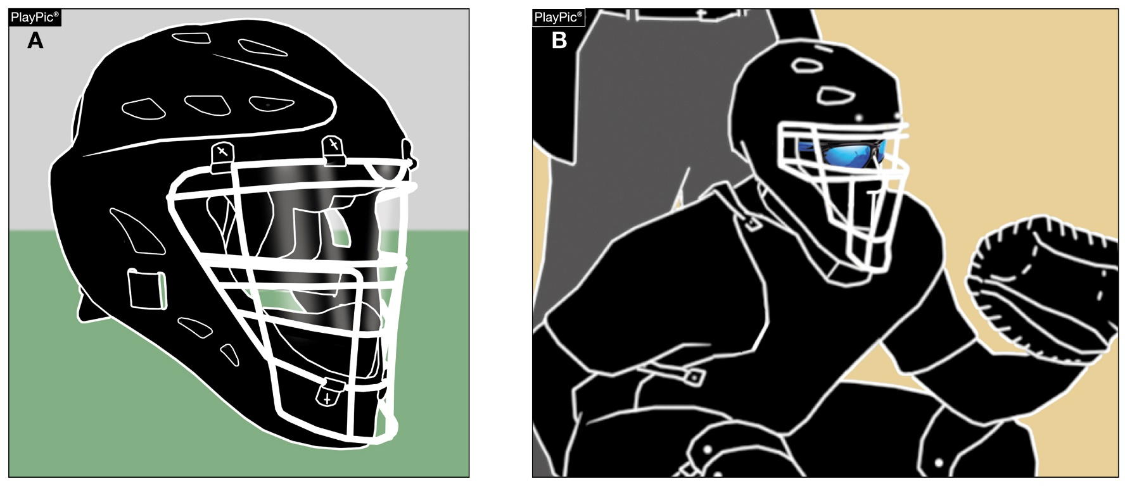
1-5-4 player equipment- Catcher’s Helmet and Mask
Ilegal Legal

Slide 8
1-5-4 player equipment- Catcher’s Helmet and Mask
ART. 4 . . . The catcher's helmet and mask combination shall meet the NOCSAE standard at the time of manufacture. Eye shields shall not be attached to the catcher's mask after manufacture. Eye shields that are attached to the catcher's mask at the time of manufacture will be constructed of a molded rigid material and be clear without the presence of any tint. Tinted eyewear worn on the face and under the face mask is permitted. Any helmet or helmet and mask combination...and a protective cup (male only). (1-5-9)

Slide 9
1-5-4 player equipment- Catcher’s Helmet and Mask
RATIONALE:
There has been an increase of catchers attaching aftermarket eye shields to their face masks that are tinted and not approved by the face mask manufacturer.
Attaching a product that was not manufactured for the specific face mask is a risk to the wearer. The tinted eye shield is problematic because it would prevent a medical professional from accessing the eyes of the catcher to determine their condition.

Slide 10
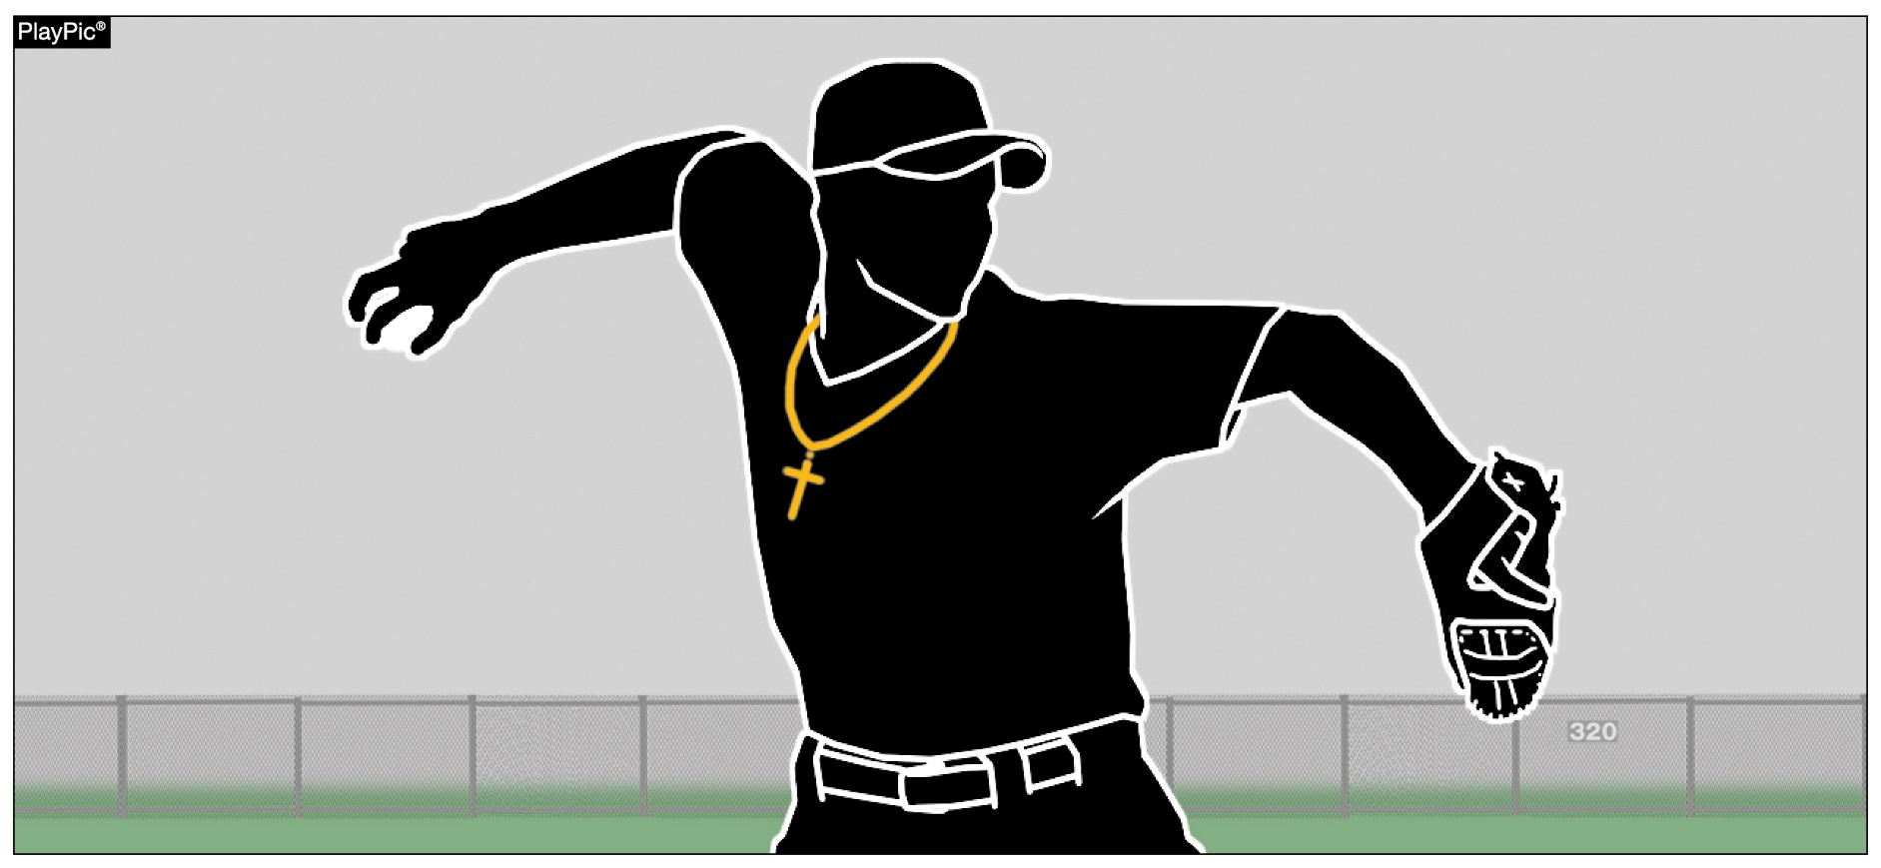
1-5-12, 3-3-1d PLAYER EQUIPMENT – Wearing of Jewelry
Legal

Slide 11
1-5-12, 3-3-1d player equipment – Wearing of Jewelry
ART. 12 . . . Jewelry shall not be worn be permitted (3-3-1d) except for including religious and medical medals. Any jewelry that poses harm or injury to the wearer or the opponent shall be immediately removed. (1-5-9) A religious medal must be taped and worn under the uniform. A medical alert must be taped and may be visible.
ART. 1 . . . A coach, player, substitute, attendant or other bench personnel shall not:
Sub-articles a-e remain the same.
d. wear jewelry (players participating in the game) or wear bandannas;

Slide 12
1-5-12, 3-3-1d PLAYER EQUIPMENT – Wearing of Jewelry

Slide 13
1-5-12, 3-3-1d player equipment – Wearing of Jewelry
RATIONALE:
Any jewelry worn that poses harm or injury to the player or their opponent is covered in existing rules.
Rule 3 is a companion rule change with the deletion of Rule 1-5-12.
If jewelry is worn that poses harm to the player, teammate or their opponent, there are existing rules support to handle the situation.
Bandannas are still prohibited.

Slide 14
2-4-4 lodged ball definition

Slide 15
2-4-4 lodged ball definition
ART. 4 . . . A baseball that remains on the playing field but has become wedged, stuck, lost, or unreachable, is defined to be a lodged ball. If the ball impacts any object in the course of play, stops abruptly, and does not fall or roll immediately, it is considered lodged. It is a dead ball (5-1-1f-3,4; 5-1-1g-4).
Exception: if a ball becomes stuck in the webbing of the fielder’s glove, it remains in play. The glove/ball combination is treated as a live ball.

Slide 16
2-4-4 lodged ball definition
RATIONALE:
A definition of a lodged ball was necessary and appropriate to differentiate when it is stuck on the field or in an apparatus, compared to when it is stuck in a glove.

Slide 17
6-1-1, 6-1-2, 6-1-3 PITCHING – Determination of pitching position
ART. 1 . . . The pitcher shall pitch while facing the batter from either a windup (Art.2) or a set position (Art. 3). The position of the pitcher’s feet determine whether the pitcher will pitch from the windup or the set position. The pitcher shall take or simulate taking the sign from the catcher with the pivot foot in contact with the pitcher’s plate. The pitcher will be considered to be in the set position when the pivot foot is in contact with or directly in front of and parallel to the pitcher’s plate. The pitcher will be considered to be in the windup position when the pivot foot is in contact with the pitcher’s plate and is not parallel to it. The pitching regulations…but not both.

Slide 18
6-1-1, 6-1-2, 6-1-3 PITCHING – Determination of pitching position
ART. 2 . . . For the wind-up position, the pitcher is not restricted as to how they shall hold the ball. A pitcher assumes the windup position when the hands are: (a) together in front of the body; (b) both hands are at the side; (c) either hand is in front of the body and the other hand is at the side. The pitcher's non-pivot foot shall be in any position on or behind a line extending through the front edge of the pitcher's plate. The pitcher is limited…lift either foot.

Slide 19
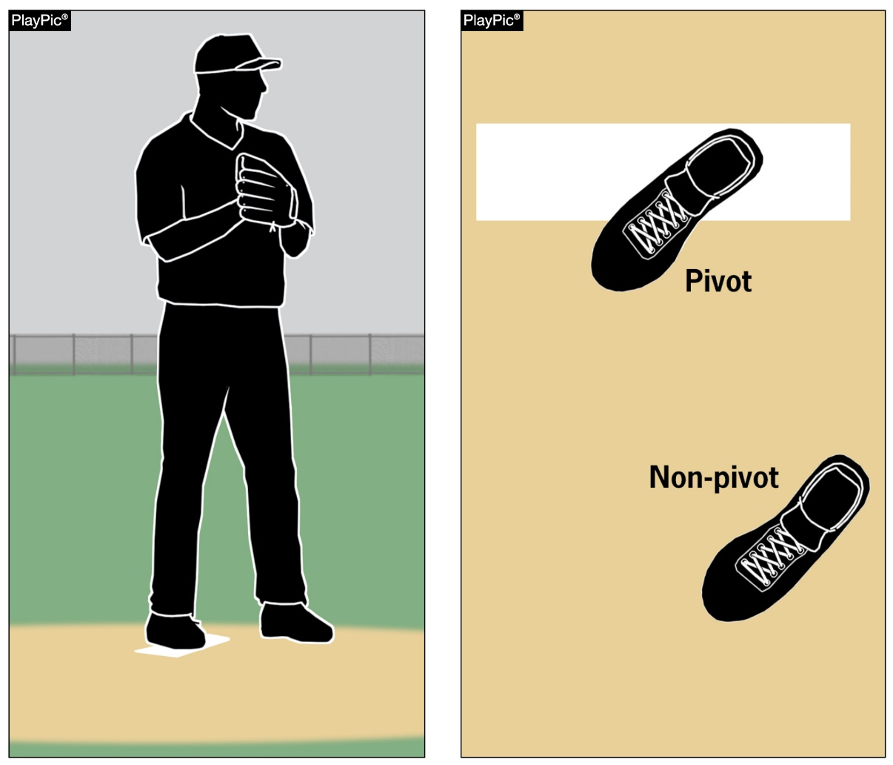
6-1-1, 6-1-2, 6-1-3 PITCHING – Determination of pitching position

Slide 20
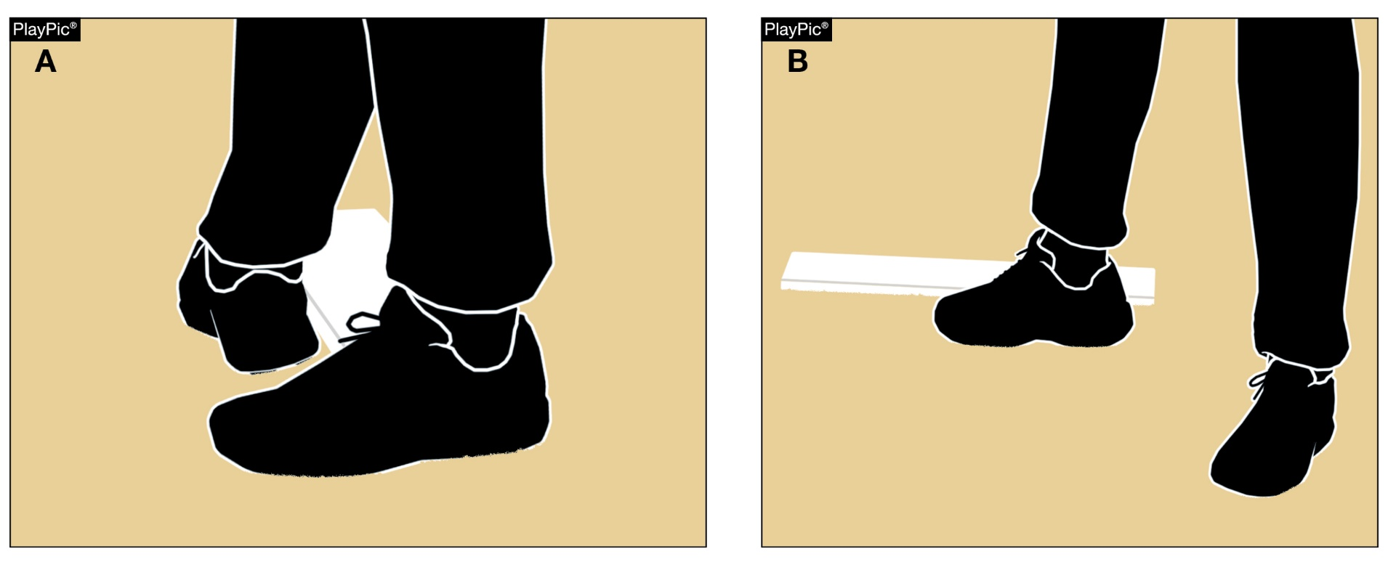
6-1-1, 6-1-2, 6-1-3 PITCHING – Determination of pitching position

Slide 21
6-1-1, 6-1-2, 6-1-3 PITCHING – Determination of pitching position
ART. 3 . . . For the set position, the pitcher shall have the ball in either the gloved hand or the pitching hand. The pitcher’s hand shall be down at the side or behind the back. Before starting the delivery, the pitcher shall stand with the pivot foot in contact with or directly in front of and parallel to the pitcher's plate. The pitcher shall go…any other fielder.

Slide 22
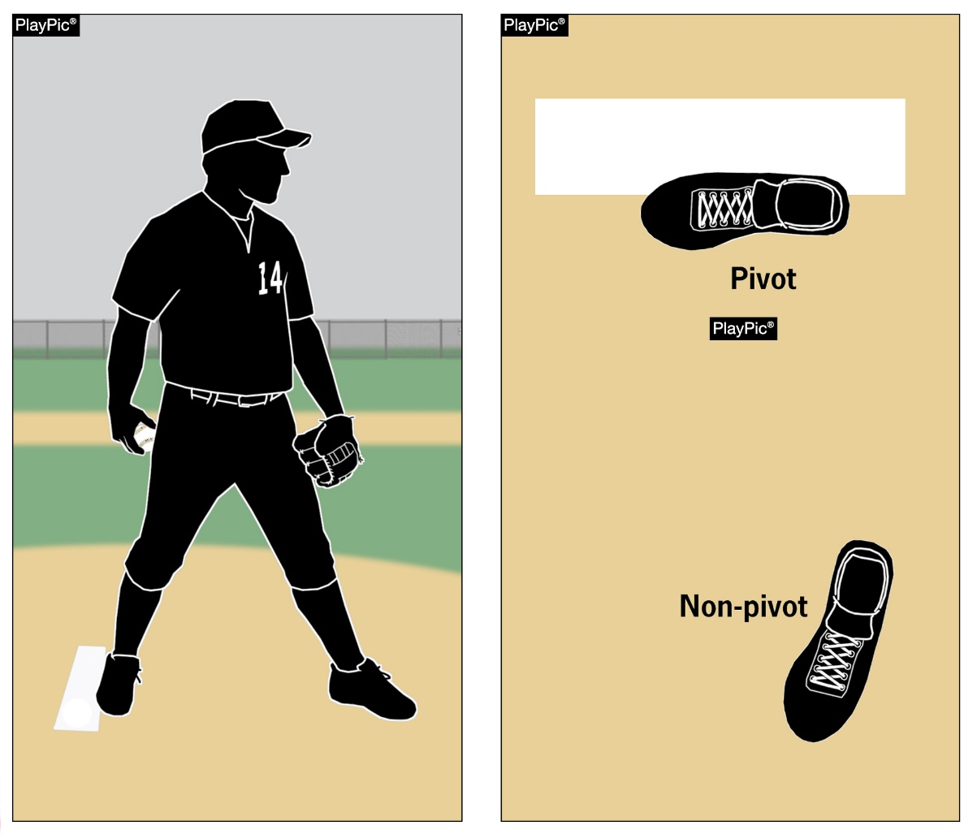
6-1-1, 6-1-2, 6-1-3 PITCHING – Determination of pitching position

Slide 23
6-1-1, 6-1-2, 6-1-3 PITCHING – Determination of pitching position
RATIONALE:
In reference to the high school pitching rule, the position of both the pivot and non-pivot foot was the determining factor to deem if a pitcher was pitching from the windup position or the set position.
The game has evolved throughout high school baseball for the pitcher to pitch with the pivot foot in a windup description with the non-pivot foot in a set description.
This "hybrid" position was previously illegal by NFHS rule.

Slide 24
6-1-1, 6-1-2, 6-1-3 PITCHING – Determination of pitching position
What is important is that umpires, coaches, and players know what position the pitcher is using so they know which part of Rule 6 is in play.
Deleting the use of the non-pivot foot does no damage to the existing pitching position rule and having only the pivot foot determine makes it clean and easily discernible for all involved.

Slide 25
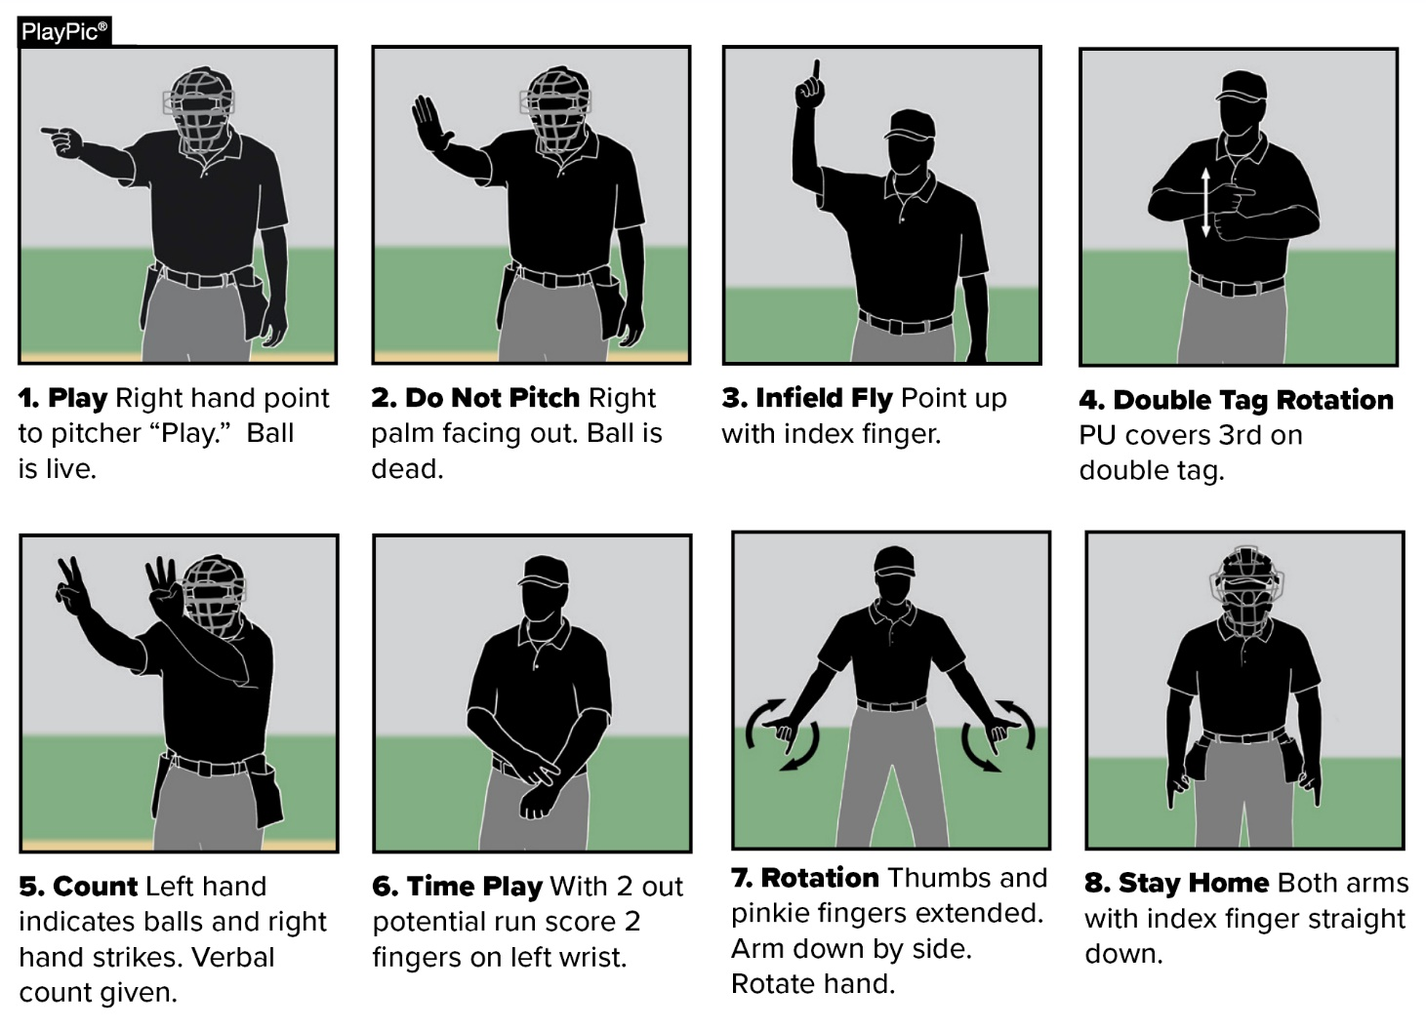
NFHS OFFICIALS SIGNALS Pre-pitch situational signals
• Eight signals have been approved to be used pre-pitch between umpires to demonstrate situations, situational changes and their explanations.

Slide 26
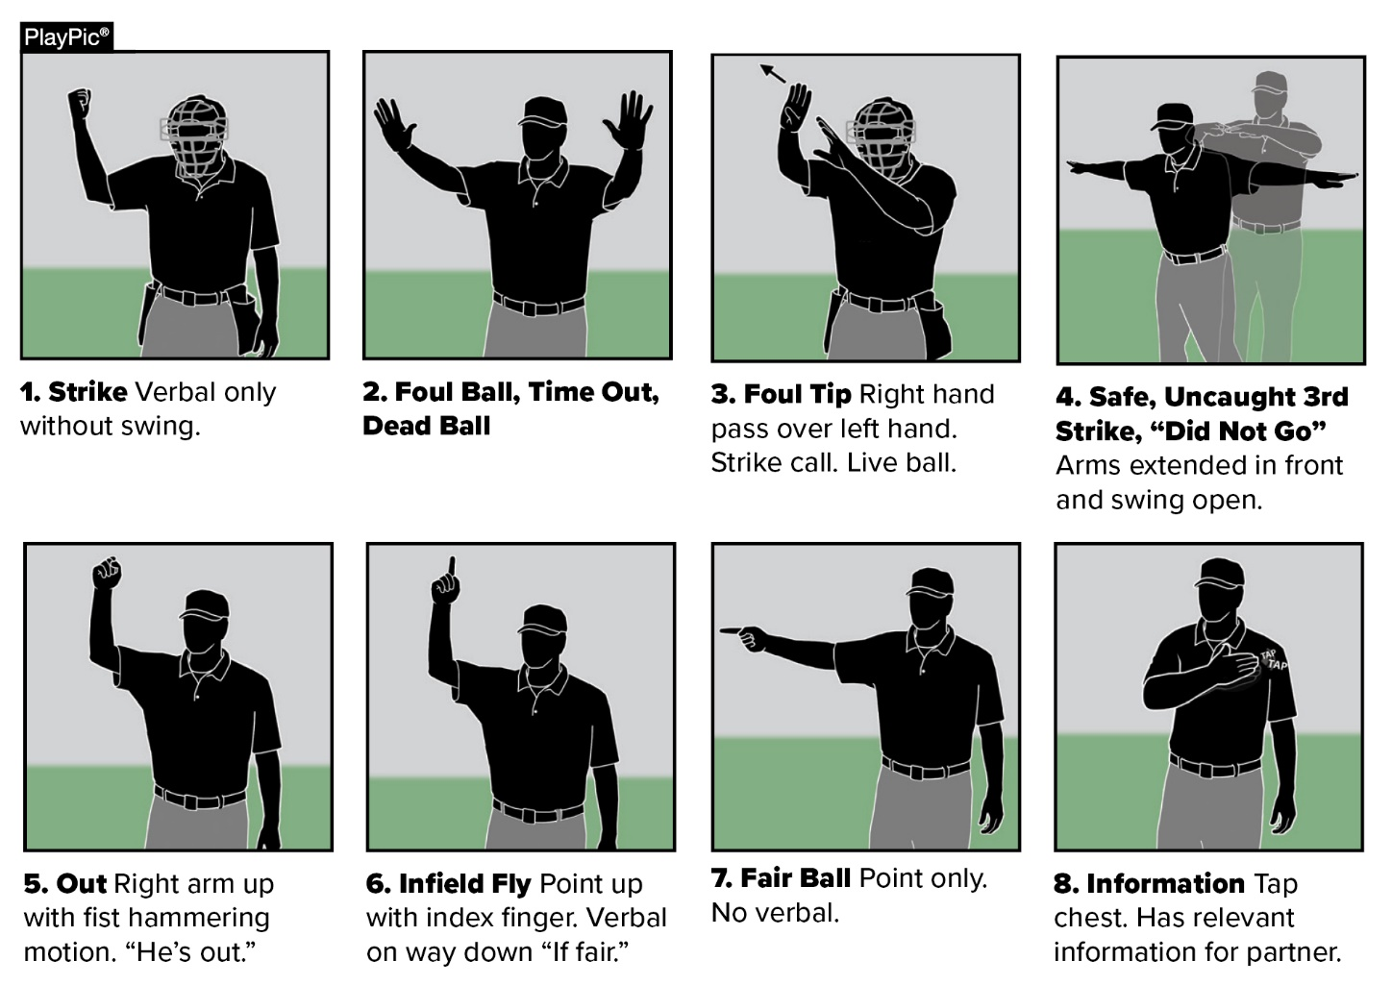
NFHS OFFICIALS SIGNALS during play and results
• Eight signals have been approved to be used to demonstrate calls during play and their results.

Slide 27
Points of emphasis

Slide 28
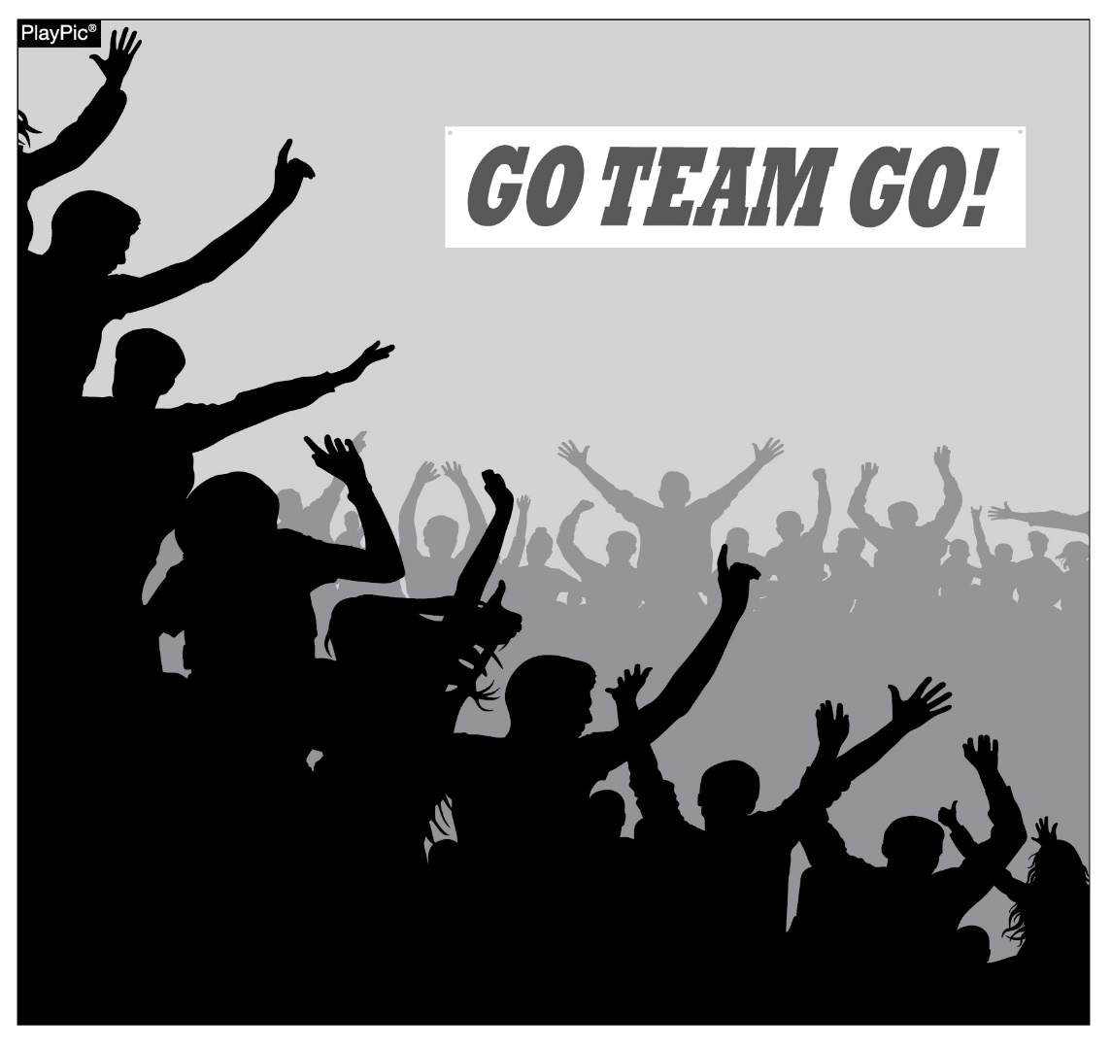
sportsmanship

Slide 29
sportsmanship
Good sporting behavior is one of the fundamental ingredients to the continued success and enjoyment of education-based high school sports and activities.
In fact, in the 103-year history of organized high school sports in the United States, good sportsmanship has been one of the most important outcomes of high school activity programs.

Slide 30
sportsmanship
NFHS playing rules are written to encourage sportsmanship. Participation in these programs should promote respect, integrity and sportsmanship. However, for these ideals to occur, everyone involved in these programs must be doing their part.
The NFHS is concerned that unsporting behavior in education-based athletics has increased across all sports. As a result, the NFHS has made sportsmanship the No. 1 Point of Emphasis for the 2022-23 school year.

Slide 31
sportsmanship
Sportsmanship, or good sporting behavior, is about treating one another with respect and exhibiting appropriate behavior. It is about being fair, honest and caring. When these types of appropriate behavior occur, competitive play is more enjoyable for everyone.
Coaches set the tone at athletic contests with their display of sportsmanship. If these individuals act in a sportsmanlike manner, their behavior sets the tone for players, spectators and others. If coaches, however, are complaining constantly about the decision of contest officials, spectators are more likely to do the same.

Slide 32
sportsmanship
There must be a collaborative, working relationship between contest officials and game administration to promote good sportsmanship and safely conduct the contest. Everyone has their roles to play in creating a positive, sportsmanlike atmosphere at contests.
Officials should focus on the actions of players, coaches and other bench/sideline personnel. A positive, open line of communication between officials and coaches ultimately results in a better contest for everyone involved.

Slide 33
sportsmanship
Contest officials, however, should never engage with spectators who are exhibiting unsporting behavior. Once the contest begins, school administration is responsible for dealing with unruly spectators.
A proactive approach by school administration includes monitoring the behavior of spectators and intervening as needed.
If spectators are using demeaning or profane language at officials – or at others in the stands – those individuals should be removed from the contest by school administration.

Slide 34
sportsmanship
In recent years, a heightened level of unsportsmanlike behavior has been occurring by spectators at high school sporting events, and it must be stopped.
The use of demeaning language, or hate speech, by students, parents and other fans must cease.
High school sports and other activities exist to lift people up, not demean or tear people down. The goal is to treat everyone fairly and treat each other with respect. Any speech or harassment that is insulting, demeaning or hurtful will not be tolerated.

Slide 35
sportsmanship
High schools must establish a culture that values the worth of every single person – both players on the school’s team and players on the opposing team. There must be a no-tolerance policy regarding behavior that shows disrespect for another individual.
Good sports win with humility, lose with grace and do both with dignity. It takes the efforts of everyone every day to ensure that sportsmanship remains one of the top priorities in education-based activity programs.

Slide 36
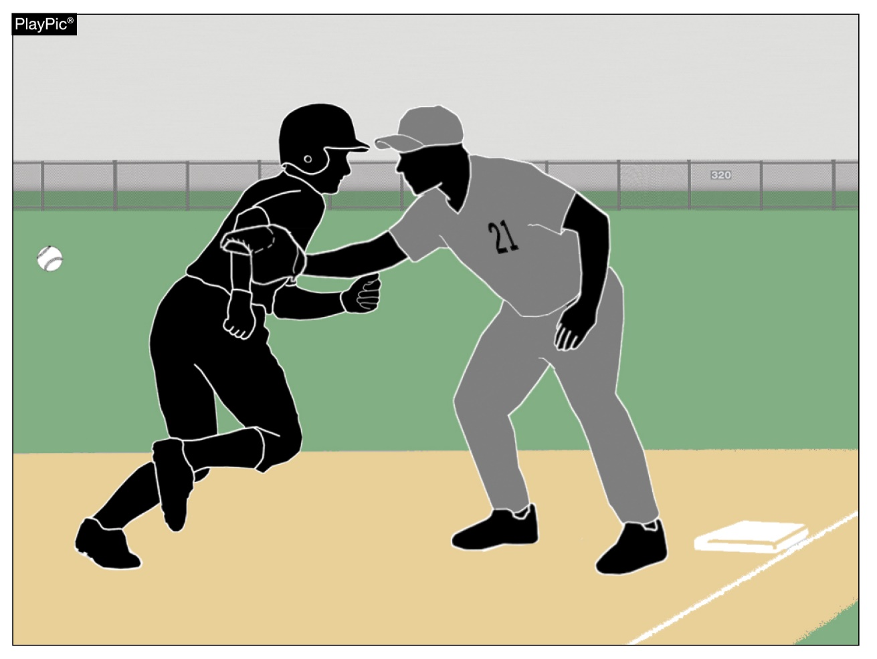
OBSTRUCTION AND INTERFERENCE

Slide 37
OBSTRUCTION AND INTERFERENCE
Obstruction and interference are two familiar terms that have been in the game of baseball since the early beginnings of the sport.
Simply stated, obstruction is any act accidental, intentional, verbal, or physical that a fielder or any member of the defensive team (or team personnel) that hinders a runner or affects the pattern of play.
Besides affecting scoring plays, obstruction can occur anywhere on the field resulting in some unsportsmanlike behaviors.
That is why the penalty for obstruction is some of the sternest penalties in our rules code.

Slide 38
OBSTRUCTION AND INTERFERENCE
Interference is very similar to obstruction; it addresses the behavior of the offensive team.
It is any act, verbal or physical by the team at bat that impedes, hinders or confuses any defensive fielder attempting to make a play.
There are several other types of interference: umpire, spectator, follow-through, and backswing.
Umpire interference is when the umpire-in-chief accidently moves in the way of the catcher’s attempt to throw or when a live ball or thrown ball touches them.

Slide 39
OBSTRUCTION AND INTERFERENCE
Spectator interference is when a spectator for either team impedes the progress of the game in any way.
Follow-through interference is when the bat of the batter in the batter’s box hinders action at home plate or when the catcher is attempting to make a play on a runner.
Backswing interference is when the batter contacts the catcher or their equipment prior to the pitch.

Slide 40
OBSTRUCTION AND INTERFERENCE
As one might realize, there are many nuances to both obstruction and the multi-layers of interference.
Coaches, umpires and players have a roll in understanding the rules of two extremely powerful rules.
Because both violations are sportsmanship-centered at their core, the penalties are commensurate to the overarching concern regarding fair and equitable play in interscholastic baseball.

Slide 41
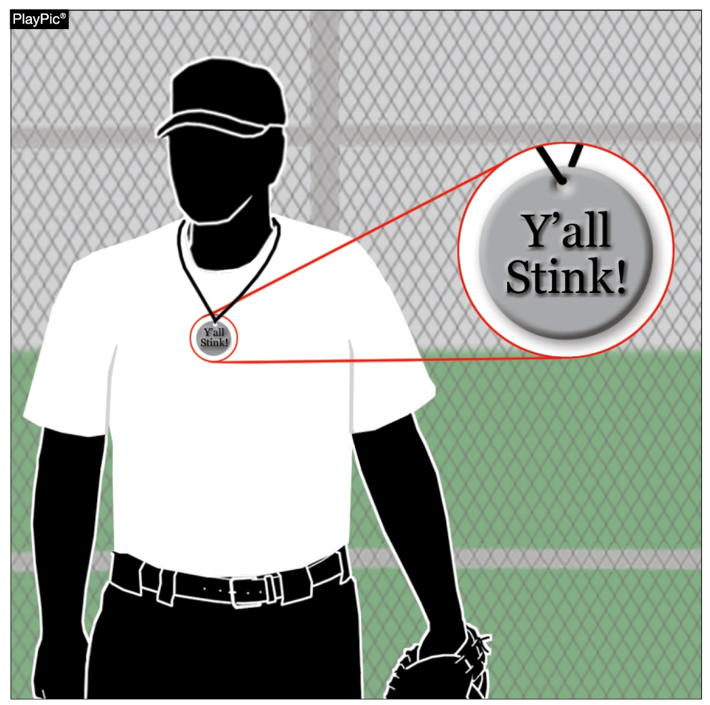
Elimination of JEWELRY

Slide 42
Elimination of JEWELRY
Jewelry in baseball was originally defined as any item on the body of the player that was not a natural part of their person.
That also included medical alert bracelets and some religious, cultural or tribal adornments.
The elimination of the jewelry rule will permit players to wear these items freely.
Additionally, with that freedom to wear jewelry, please note that any jewelry that contains profanity, taunting, language to intimidate or baiting an opponent would not be allowed under our sportsmanship rule, bench and field conduct policies.

Slide 43
Elimination of JEWELRY
Besides those examples, there is existing rule coverage that gives guidance on any player equipment that presents a danger to the player, their teammates or opponent.

Slide 44
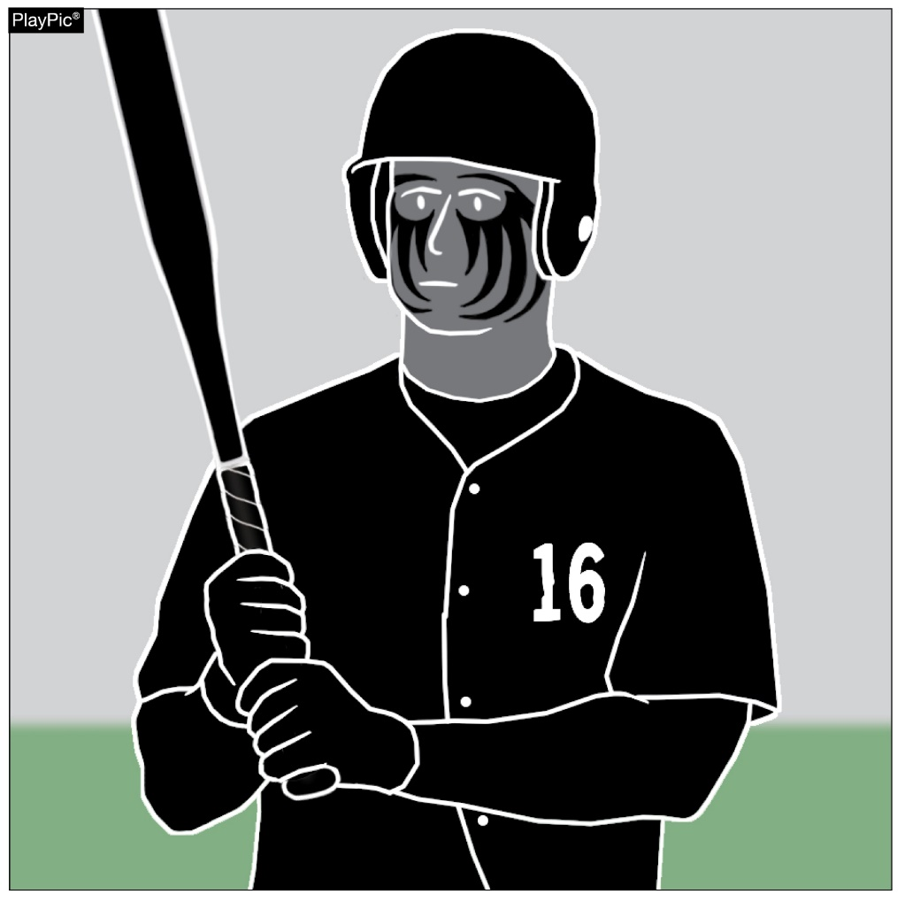
USAGE OF EYE BLACK
The high school game is now experiencing eye black that is being used as face decoration, with images and/or sayings being drawn on the faces of players to try to intimidate and/or taunt an opponent.
Existing sportsmanship rules are available to prohibit any use of eye black in an inappropriate or unfavorable way.

Slide 45
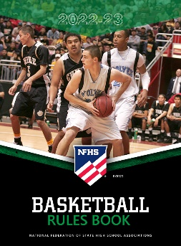
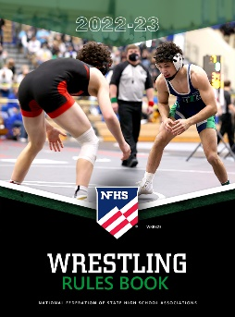
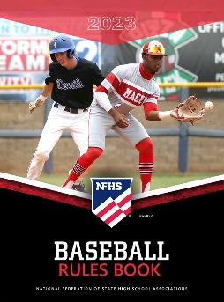
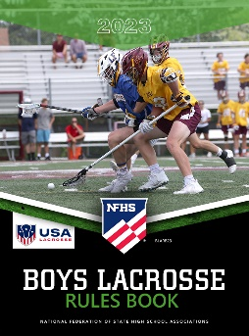
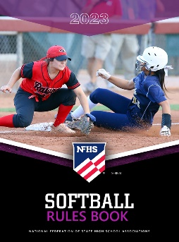
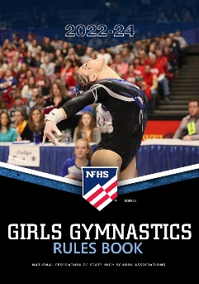
National Federation of State High School Associations
The NFHS writes playing rules for 17 sports for boys and girls at the high school level.
Publishes 4 million pieces of materials annually.
Notes:
The NFHS writes playing rules for 17 sports, publishes High School Today (HST) along with several other key publications totaling over 4 million pieces annually.

Slide 46
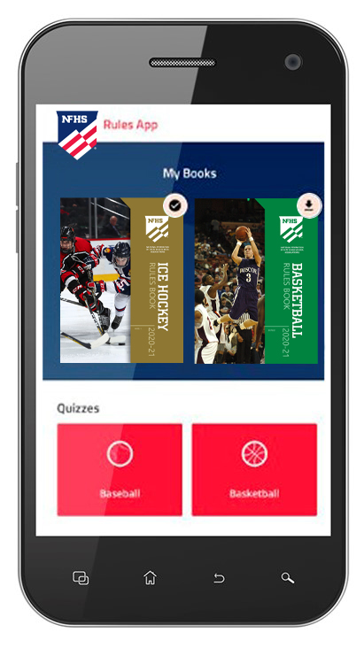
NEW NFHS Rules App
Rules App features:
Searchable
Highlight notes
Bookmarks
Quizzes for all sports
Easy navigation
Immediate availability
Free to paid members of the NFHS Coaches and Officials Associations
www.nfhs.org/erules for more information

Slide 47
Guidelines for Schools and state associations for consideration of accommodations
Notes:
To assist state associations in working with schools for the inclusion of students with disabilities, the following guide prepared by the NFHS Task Force on the Inclusion of Students with Disabilities is being provided for your review.
Following these guidelines will assist in the individual student assessment by the student and the school.
When requesting a possible accommodation, coaches should work with their school and the state association as early as possible in the sport season.
Contest officials shall defer decisions on rule accommodations to the respective state association.
This information serves as a guide. Each state association may develop its own process.

Slide 48
NFHS OFFICIALS Education

Slide 49
OFFICIALS EDUCATION
Content remains free of charge
TEACHING
AIDS
RULES
CHANGES
DIAGRAMS
VIDEO
LIBRARY
OFFICIALS
COURSES
Notes:
Sport-Specific Officiating courses are offered in several sports. They are ideal for new officials and those in the first few years of officiating. These courses introduce officials to the mechanics and techniques used in the sport and provide specific information on an area within that sport. Individuals can complete a course within 30-45 minutes. These courses are free to all officials and prospective officials.
“Interscholastic Officiating” is a general course on sports officiating, and it is free to all officials and prospective officials. This course provides an introduction to skills and concepts used as an official. Several topics are covered such as: basics of becoming and staying an official, science of officiating, art of officiating, how to combine these skills for successful officiating.
Video clips are made available to NFHS Officials Association members. The video is clipped on specific topics and provides the rules references as well as dialogue on the topic.
The courses and videos are offered at www.NFHSLearn.com .
Courses Available:
Officiating Football
Officiating Volleyball – Ball Handling
Officiating Volleyball – Alignment
Officiating Volleyball – E-Whistle
Officiating Basketball
Officiating Basketball – Three-Person Mechanics
Officiating Basketball - Pre-Game Conference
Soccer – Fouls and Misconduct
Soccer – Offside
Soccer - Pre-Game Conference
Swimming and Diving
Officiating Wrestling
Umpiring Softball
Officiating Field Hockey
Officiating Track and Field
Future Courses to be Considered:
Umpiring Baseball
Umpiring Softball – 2 Person Mechanics
Communication Among Officials and Coaches

Slide 50
Future Developments
Improved Schedule View
Year Two Accomplishments
Auto-Assign
Years of Service
14
121,508
$9.2M
Enhanced Payment Capabilities
States Registering Officials
Contests
Assigned
Payments
Sent to
Officials
100% FREE to your state as a NFHS-Member Benefit.
Notes:
NFHS CENTER FOR OFFICIALS SERVICES (COS)
Your Complete Solution for Officials Management and More:
Registration
Assignment
Payment
Testing
Background Checks
For More Information on the NFHS – Center for Officials Services (COS) Contact:
Dana Pappas, Director of Officiating Services, dpappas@nfhs.org
Also If You’re Interested in Eligibility and Monitoring Requirements Contact the Folks at Dragonfly:
Kirk Miller, Dragonfly, kirk@dragonflyathletics.com
Brandon Wallace, Dragonfly, brandon@dragonflyathletics.com

Slide 51
NFHS Learning Center

Slide 52
Notes:
The NFHS Learning Center is the home to more than 90 online professional development courses for everyone within the interscholastic community - coaches, students, officials, parents, administrators, and individuals within performing arts programs. More than 60 courses are available for free.
The NFHS is an Accredited Institution and has delivered more than 15 million courses on its NFHS Learning Center platform since its inception in 2007. In receiving national accreditation by Cognia, the NFHS has upheld itself to rigorous standards that focus on productive learning environments, equitable resource allocation that meet the needs of learners, and effective leadership.
The NFHS Learning Center features its flagship coaching course, “Fundamentals of Coaching,” as well as several health and safety courses that have been completed by millions of individuals, such as “Concussion in Sports,” “Heat Illness Prevention,” “Sudden Cardiac Arrest” and “Protecting Students from Abuse.” The NFHS Learning Center offers several national credentials that can be earned by individuals who complete specific NFHS courses. Through the School Honor Roll Program, schools can earn a physical banner to hang in their school.
To learn more and start your professional development journey, please visit the NFHS Learning Center at NFHSLearn.com.

Slide 53
NFHS Network

Slide 54
NFHS Network
By 2025, every high school sporting event in America will be streamed live.
The NFHS Network will be THE DESTINATION for fans to view these broadcasts.
27 Different Sports and Activities
www.NFHSnetwork.com
Notes:
The NFHS Network is the leader in streaming Live and On Demand high school sports.
Partnered with the National Federation of State High School Associations, 45 high school state athletic/activities associations, and PlayOn! Sports, the NFHS Network is a joint venture created to provide fans with the ability to stream high school sports on any device, from wherever they are.
All NFHS Network events are available to watch online at www.NFHSnetwork.com and through the NFHS Network Live App for iOS and Android. Follow us on Facebook, Twitter, Instagram, and YouTube.
Watching high school sports and events has never been easier.
The NFHS Network’s goal to broadcast live all 2 million high school sporting events by 2025.
The NFHS Network covers 27 different regular season and postseason sports, as well as other high school activities, celebrating the accomplishments of students-athletes, student broadcasters, and high schools across the country.

Slide 55
Over 1 million events this year…
Notes:
The NFHS Network will broadcast over 150,000 live events this year. If your school is not a member of the NFHS Network School Broadcast Program, please contact us at Mark.Koski@NFHSnetwork.com

Slide 56
Thank You
National Federation of State High School Associations PO Box 690 | Indianapolis, IN 46206 Phone: 317-972-6900 | Fax: 317.822.5700 www.nfhs.org | www.nfhslearn.com | www.nfhsnetwork.com

